Slide 1
January 2026
Current Affairs

Slide 2
Other News:

Slide 3
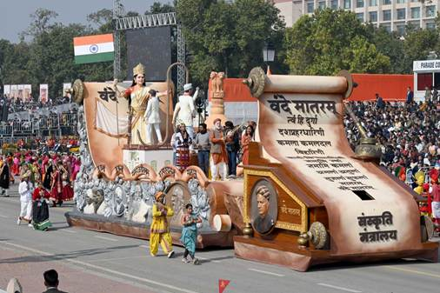
Vande Mataram:
Context: Ministry of Culture to Present Republic Day Tableau 2026 on ‘150 Years of Vande Mataram’

Slide 4
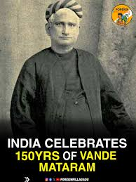
About Vande Mataram:
The 150-year celebrations of Vande Mataram were inaugurated by Narendra Modi on 7 November 2025.
The song was composed by Bankim Chandra Chatterjee on Akshaya Navami, 7 November 1875.
It was first published in Bangadarshan and later included in the novel Anandamath (1882).

Slide 5
The music for Vande Mataram was composed by Rabindranath Tagore.
The song symbolizes unity, sacrifice, and devotion to the motherland.
The first two verses were adopted as the National Song in 1937 by the Indian National Congress.

Slide 6
On 24 January 1950, Rajendra Prasad declared it would be honoured equally with the National Anthem Jana Gana Mana.
Though not mentioned in the Constitution, Article 51A(a) emphasizes respect for national symbols.
Vande Mataram became a powerful slogan of resistance against British colonial rule.

Slide 7
In 1896, Rabindranath Tagore first sang it at the Kolkata session of the Congress.
The English daily Bande Mataram was started in 1906 by Bipin Chandra Pal, later joined by Sri Aurobindo.
The song became a rallying cry during the Partition of Bengal and the Swadeshi Movement.
It was first used as a political slogan on 7 August 1905 in Calcutta protests.

Slide 8
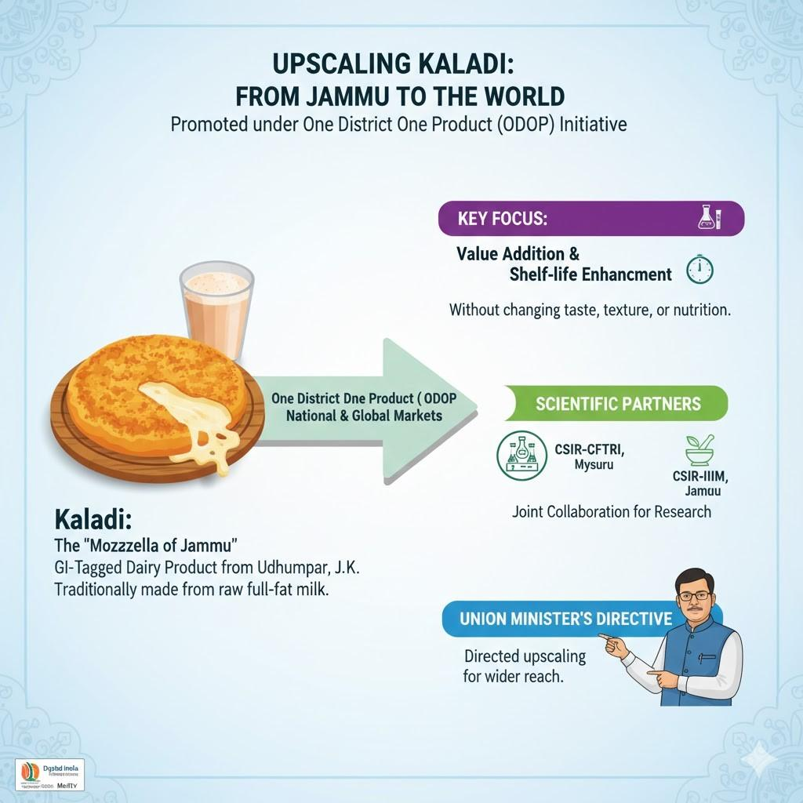
GI-tagged "Kaladi":
Context: Udhamapur’s GI-tagged "Kaladi" to be upscaled for diverse food recipes using advanced food technologies: Dr. Jitendra Singh.

Slide 9
What are GI tags?
A GI is a sign used on products that have a specific geographical origin and possess qualities or a reputation that are due to that origin.
The GI tag ensures that only the authorised users or those residing in the geographical territory are allowed to use the popular product name.
GI registration is overseen by the Department for Promotion of Industry and Internal Trade under the Ministry of Commerce and Industry.

Slide 10
India, as a member of the World Trade Organization (WTO), enacted the Geographical Indications of Goods (Registration and Protection) Act, 1999 w.e.f. September 2003.
GIs have been defined under Article 22 (1) of the WTO Agreement on Trade-Related Aspects of Intellectual Property Rights (TRIPS) Agreement.

Slide 11
The tag stands valid for 10 years.
Uttar Pradesh is the leading state in India with the highest number of GI-tagged products, having surpassed 75 registrations.
The Geographical Indications Registry is located at Chennai.

Slide 12
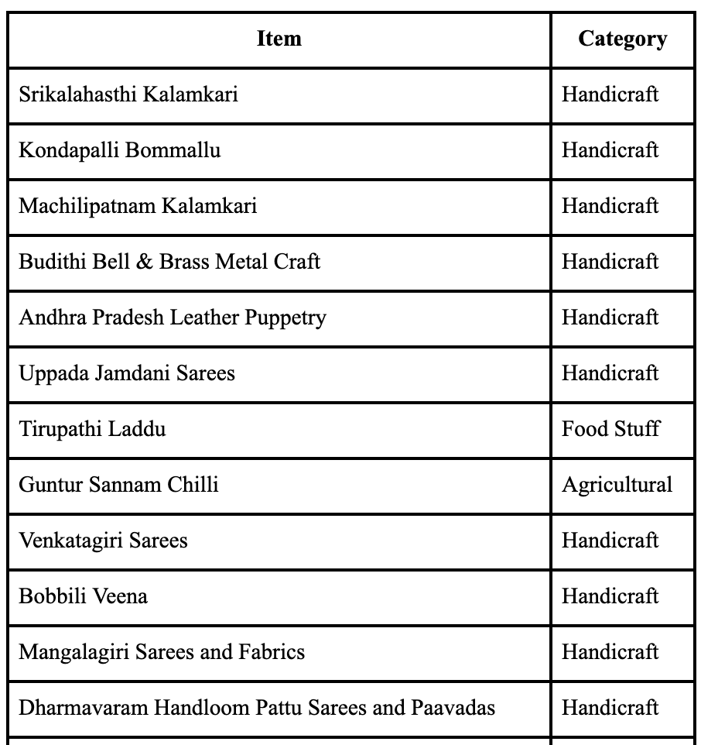
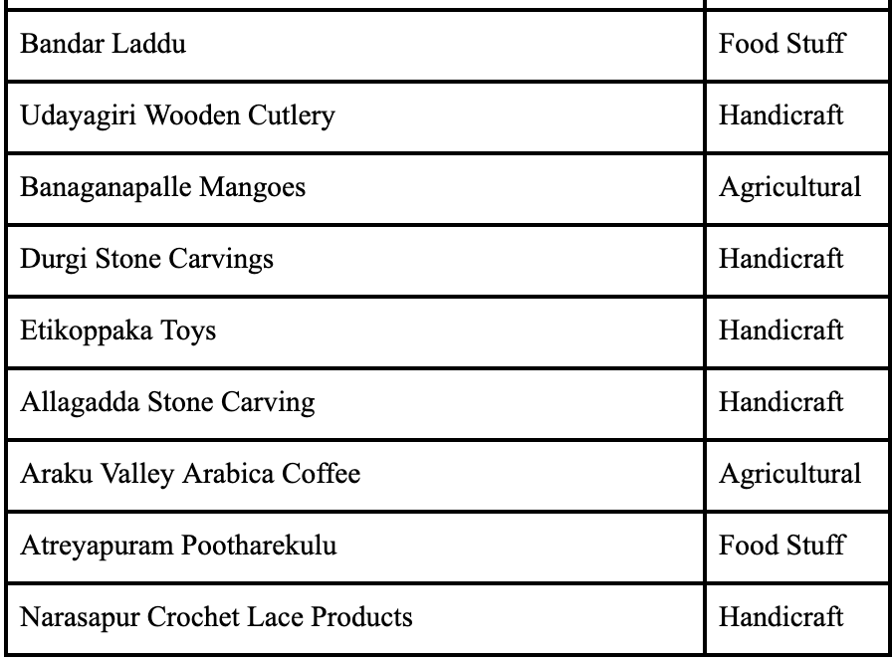
GI Tags in A.P:

Slide 13
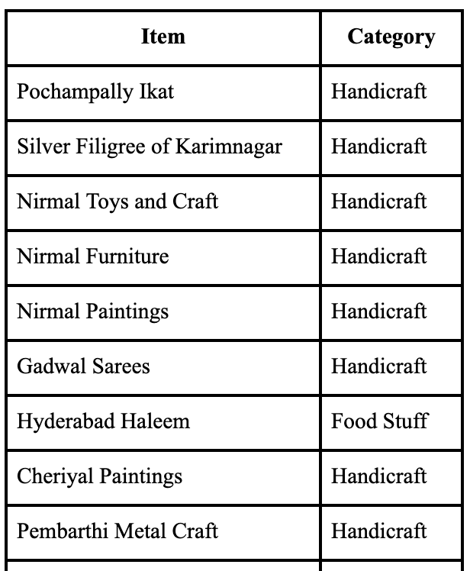
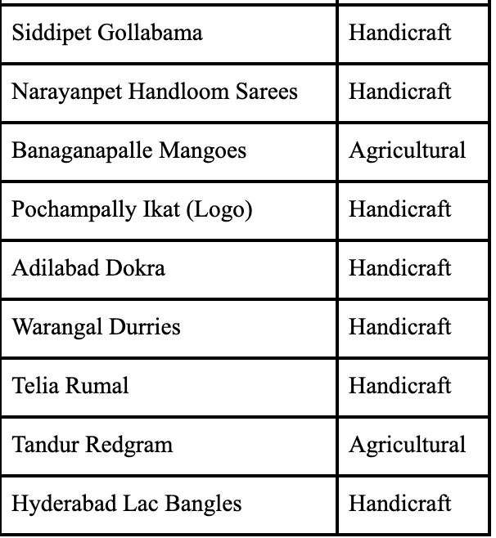
GI Tags in Telangana:

Slide 14
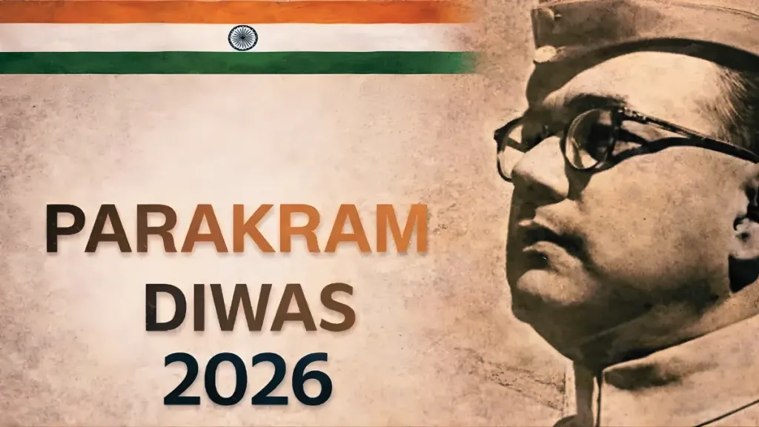
‘Parakram Diwas–2026’:
Context: Ministry of Culture to Organize ‘Parakram Diwas–2026’ to Commemorate 129th Birth Anniversary of Netaji Subhas Chandra Bose.

Slide 15
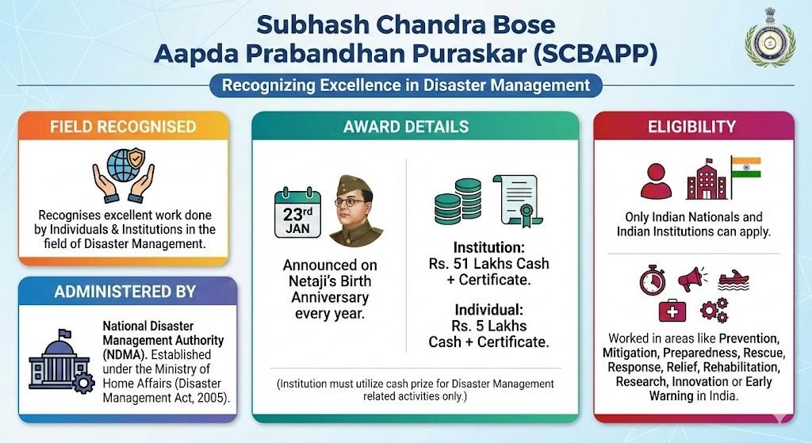
About Parakram Diwas:

Slide 16
Parakram Diwas is observed annually from 2021 to commemorate the birth anniversary of Netaji Subhas Chandra Bose.
The word “Parakram” means courage or valour, symbolising Netaji’s fearless leadership and sacrifice.
The day honours Netaji’s role in India’s freedom struggle and the legacy of the Azad Hind Fauj (INA).
Parakram Diwas 2026, the theme "Netaji: Courage, Determination and Patriotism".
It is organised by the Ministry of Culture in coordination with its allied institutions.

Slide 17
Granth Kutir:
Context: President of India inaugurates Granth Kutir at Rashtrapati Bhavan.

Slide 18
About Granth Kutir:
Granth Kutir is a cultural repository showcasing India’s literary, philosophical, and civilisational heritage.
It houses around 2,300 books in 11 classical Indian languages, reflecting rich linguistic diversity.
On 3 October 2024, the Government of India granted Classical Language status to Marathi, Pali, Prakrit, Assamese, and Bengali.
The collection covers subjects like epics, philosophy, history, science, governance, linguistics, and devotional literature.

Slide 19
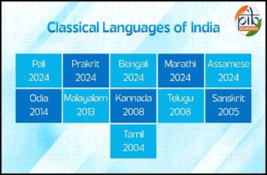
The Ministry of Education and Ministry of Culture support the initiative.
The Indira Gandhi National Centre for the Arts provides expertise in conservation and documentation.

Slide 20
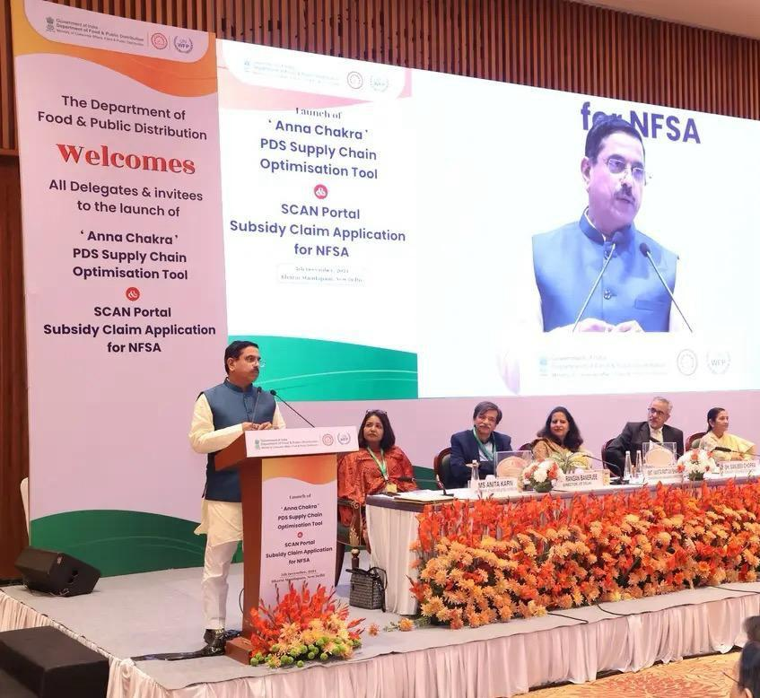
Franz Edelman Award 2026:
Context: INFORMS Announces Six Finalists for the 2026 Franz Edelman Award; Department of Food and Public Distribution among the Honorees.

Slide 21
More about:
The Department of Food and Public Distribution (DFPD) is among the six finalists for the 2026 Franz Edelman Award for its operations research–based initiative “Anna Chakra.”
“Anna Chakra” strengthens India’s Public Distribution System by optimising State-specific foodgrain logistics and supply chains.
The initiative was developed in collaboration with the United Nations World Food Programme (WFP) India and IIT Delhi.
The Franz Edelman Award recognises excellence in applying operations research to real-world problems.

Slide 22
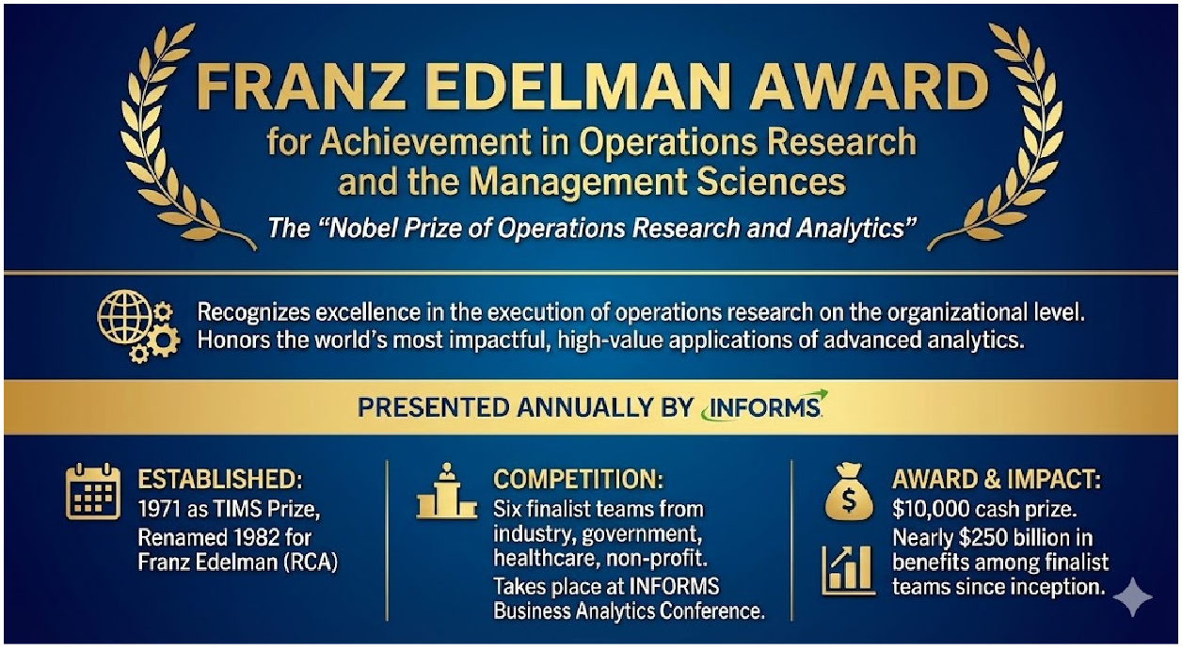

Slide 23

National Girl Child Day:
Context: National Girl Child Day, observed annually on January 24 since 2008, promotes awareness of girls’ rights, empowerment, and equal opportunities in India.

Slide 24

About National Girl Child Day:
National Girl Child Day is observed in India on January 24 to promote the rights, education, health, nutrition and overall welfare of girls.
It was initiated in 2008 by the Ministry of Women and Child Development (MWCD).
The day aims to raise awareness against gender discrimination and social biases faced by girls.

Slide 25
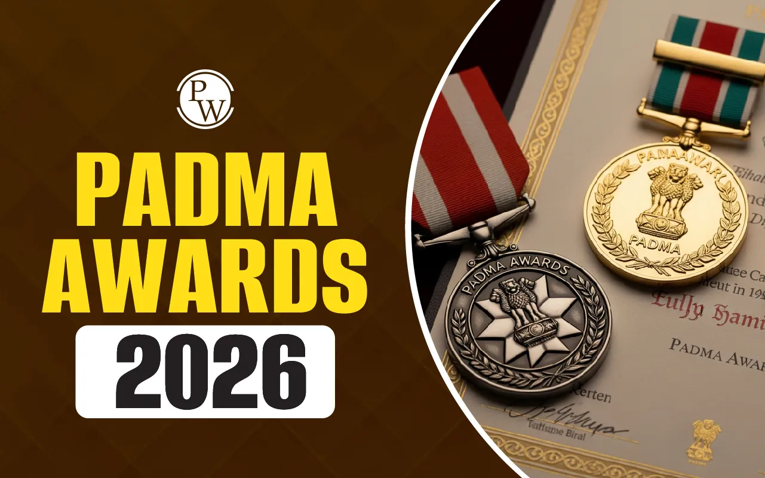
Padma awards:
Context: The Centre announced Padma honours for 2026, with five Padma Vibhushan, 13 Padma Bhushan, and 113 Padma Shri awards.

Slide 26
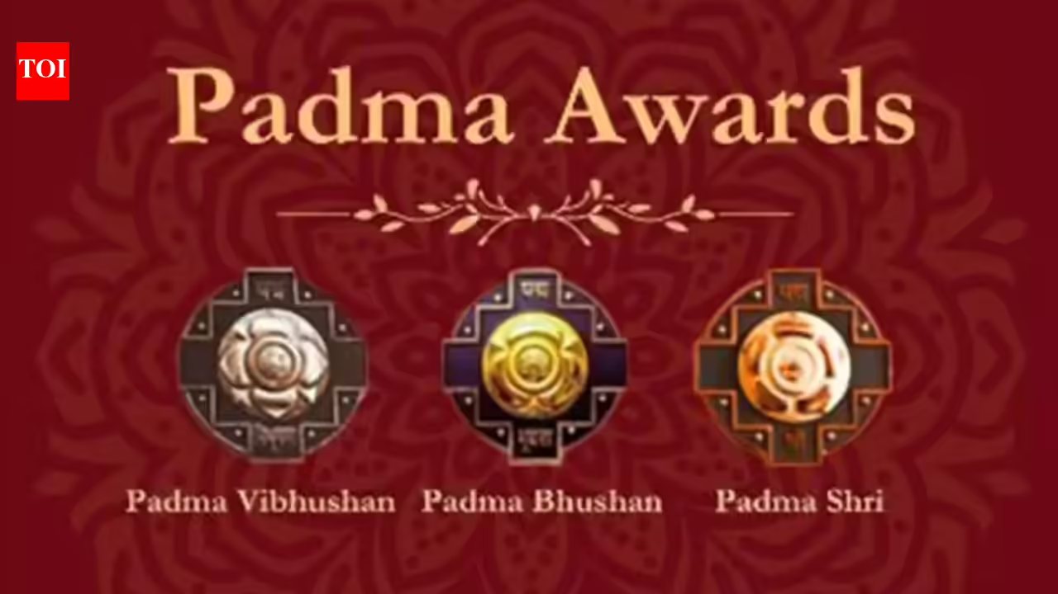
What are Padma awards?
The Padma Awards are one of the highest civilian honours of India announced annually on the eve of Republic Day.
The Awards are given in three categories:
Padma Vibhushan: for exceptional and distinguished service.
Padma Bhushan: distinguished service of higher order and
Padma Shri : distinguished service.

Slide 27
Objective of the awards:
The award seeks to recognize achievements in all fields of activities or disciplines where an element of public service is involved.

Slide 28
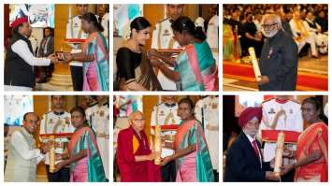
Nomination and selection:
The Padma Awards are conferred on the recommendations made by the Padma Awards Committee, which is constituted by the Prime Minister every year.
The nomination process is open to the public.
Even self-nomination can be made.

Slide 29
The Padma Awards Committee is headed by the Cabinet Secretary and includes Home Secretary, Secretary to the President and four to six eminent persons as members.
The recommendations of the committee are submitted to the Prime Minister and the President of India for approval.

Slide 30
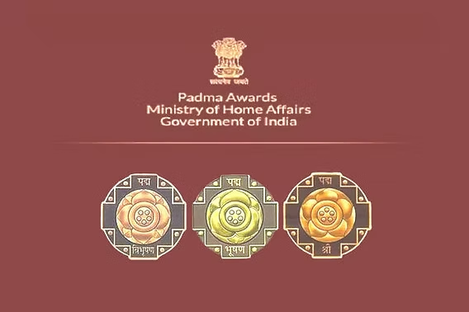
History of Padma awards:
Two awards, the Bharat Ratna and Padma Vibhushan were first instituted in 1954 as India’s highest civilian honours.
Padma Vibhushan had three classes: Pahela Varg (1st Class), Dusra Varg (Second Class) and Tisra Varg (Third Class).
In 1955, these were subsequently named as Padma Vibhushan, Padma Bhushan and Padma Shri respectively.

Slide 31
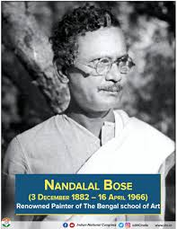
The first ever Padma Vibhushan awardees in 1954 were scientist Satyendra Nath Bose, artist Nandalal Bose and others.
The first ever non-Indian Padma Vibhushan awardee was Bhutanese king Jigme Dorji Wangchuk, who also received the award in 1954.
Padma Awards, which were instituted in the year 1954, is announced every year on the occasion of Republic Day except for brief interruption(s) during the years 1978 and 1979 and 1993 to 1997.

Slide 32
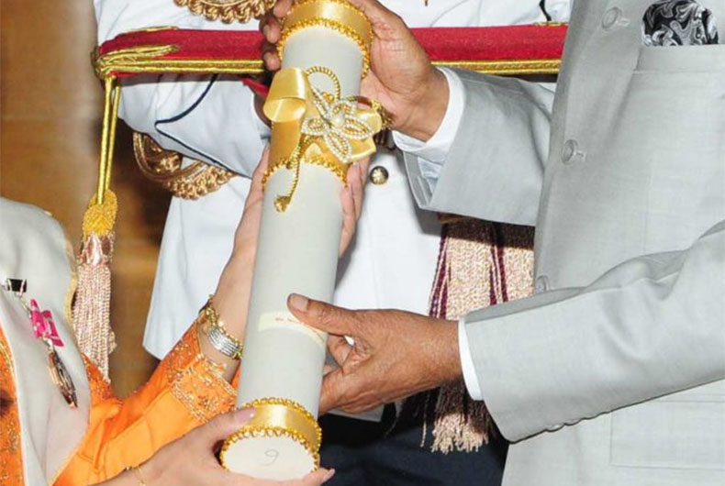
What the Padma Awards entail?
The awards are presented by the President of India, typically at the Rashtrapati Bhavan.
The awardees do not get any cash reward but a certificate signed by the President apart from a medallion which they can wear at public and government functions.

Slide 33
The awards are, however, not a conferment of title and the awardees are expected to not use them as prefix or suffix to their names.
The total number of awards to be given in a year (excluding posthumous awards and to NRI/foreigners/OCIs) should not be more than 120.
Government servants including those working with PSUs, except doctors and scientists, are not eligible for these awards.

Slide 34
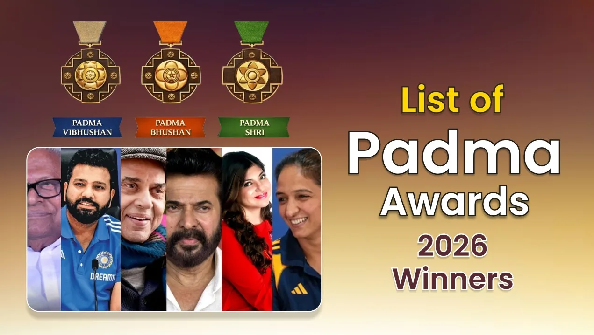
2026 winners:
For the year 2026, the President has approved conferment of 131 Padma Awards including 2 duo cases (in a duo case, the Award is counted as one).
The list comprises 5 Padma Vibhushan, 13 Padma Bhushan and 113 Padma Shri Awards.
19 of the awardees are women and the list also includes 6 persons from the category of Foreigners / NRI / PIO / OCI and 16 Posthumous awardees.

Slide 35
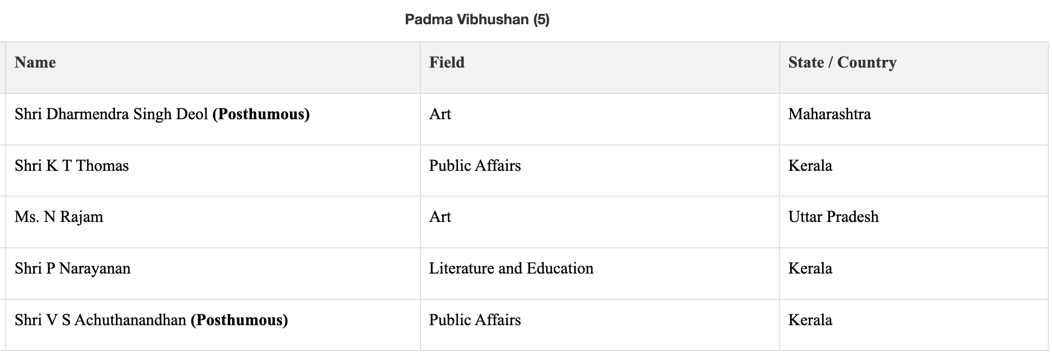

Slide 36
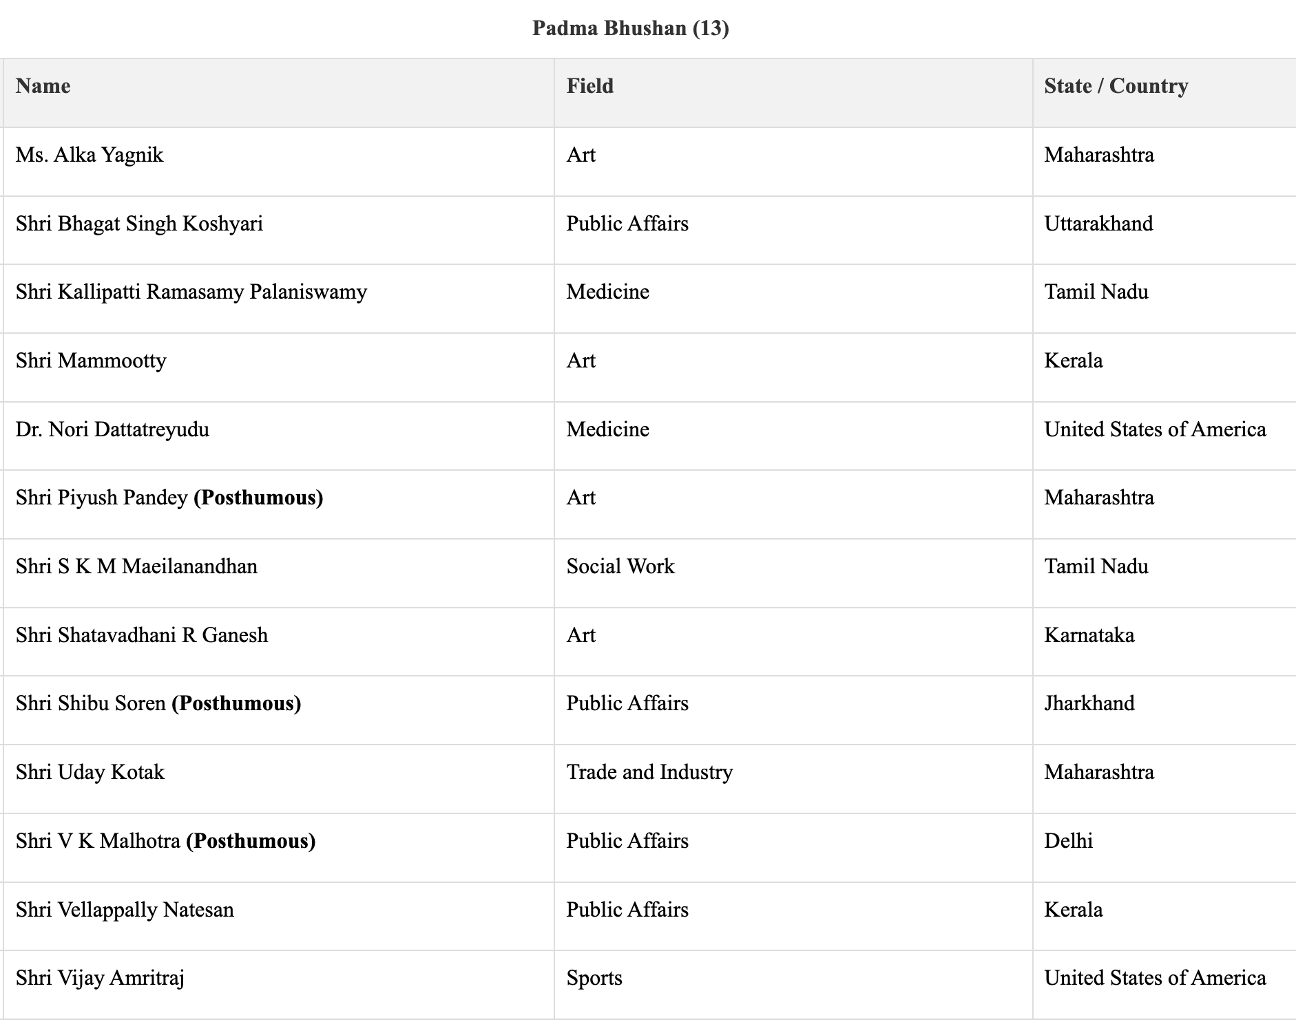

Slide 37
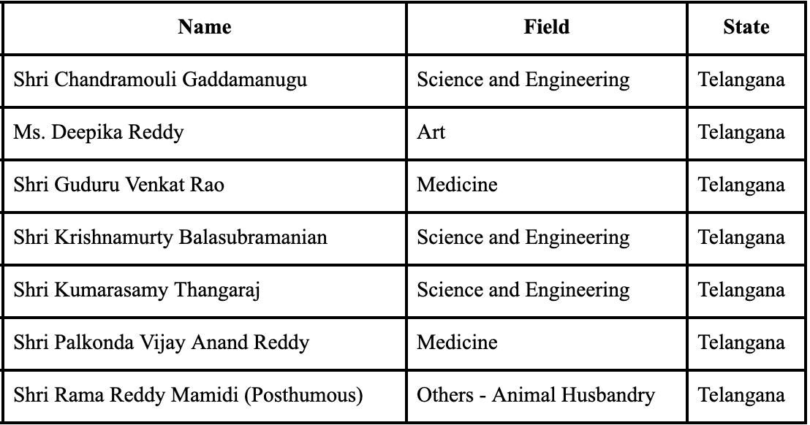
From TG:

Slide 38
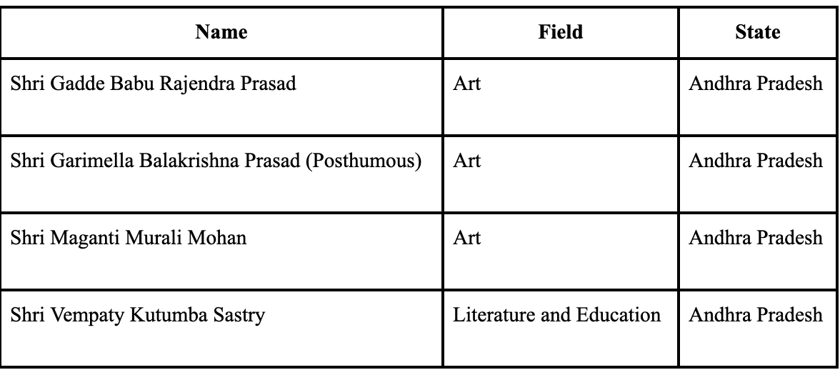
From A.P

Slide 39
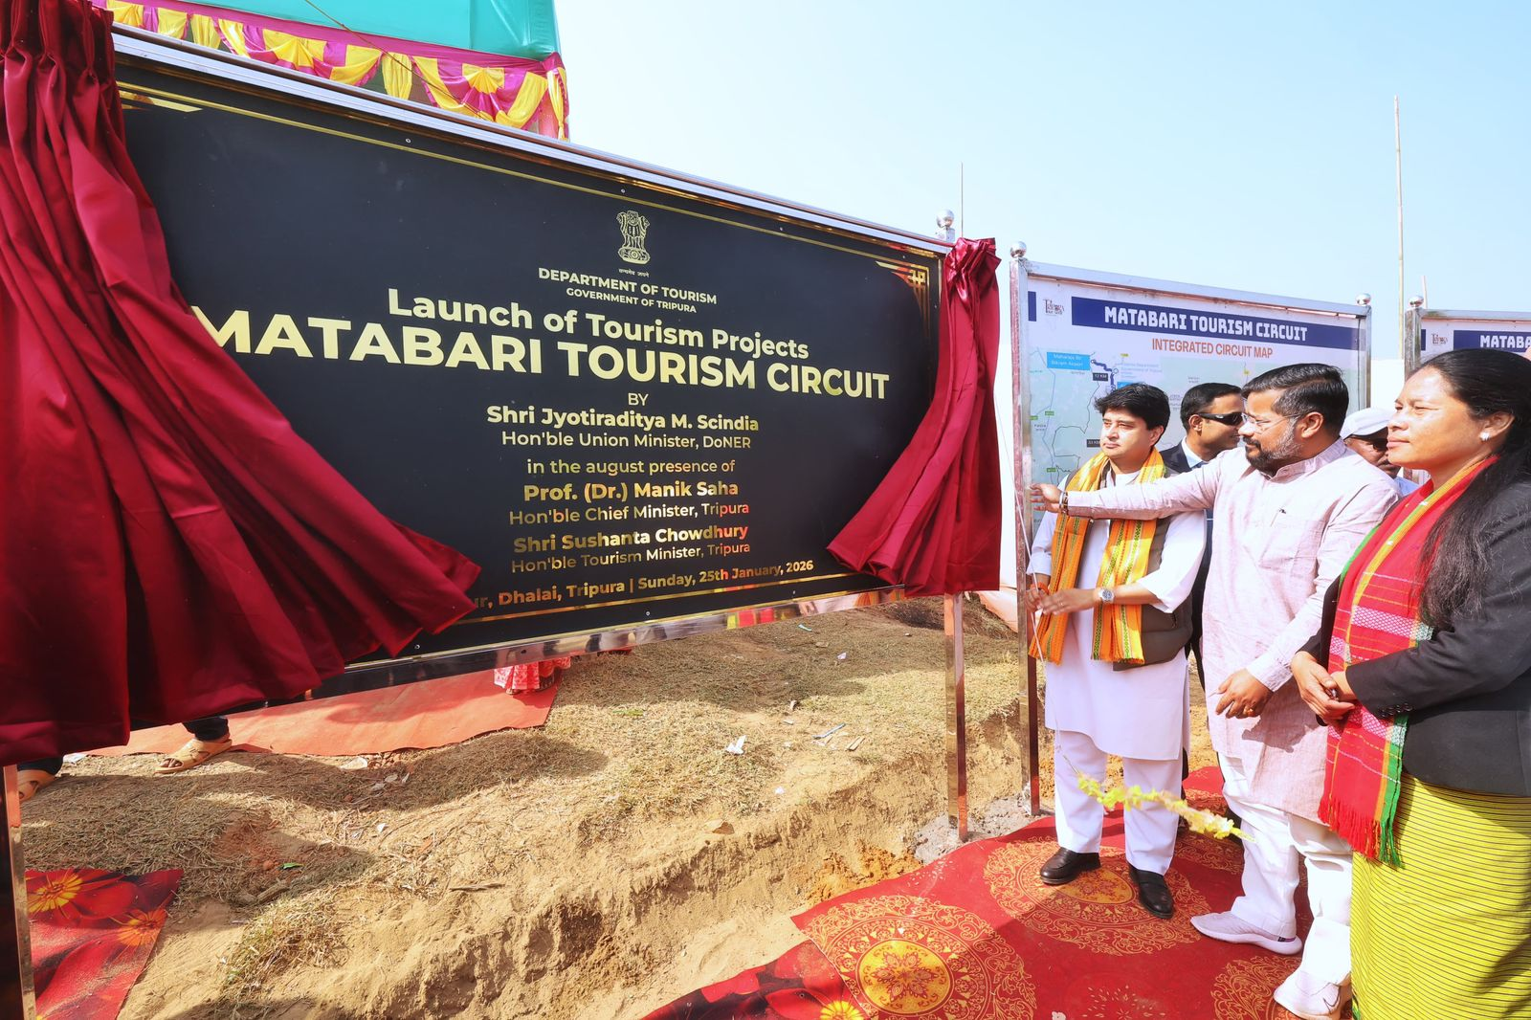
Matabari Tourism Circuit:
Context: Union Minister Jyotiraditya Scindia lays foundation stone of ₹450 crore ‘Matabari Tourism Circuit’ at Dumbur, Tripura.

Slide 40
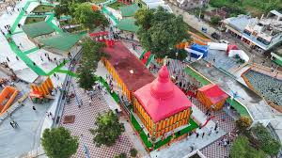
About Matabari Tourism Circuit:
The circuit will integrate the Tripura Sundari Temple, Chabimura and Dumbur Lake.
The project aims to place Tripura prominently on the global map of spiritual and eco-tourism.
The Ministry of Development of North Eastern Region is contributing ₹276 crore to the project.
The Dumbur region will be developed with floating jetties and eco-friendly resorts.

Slide 41
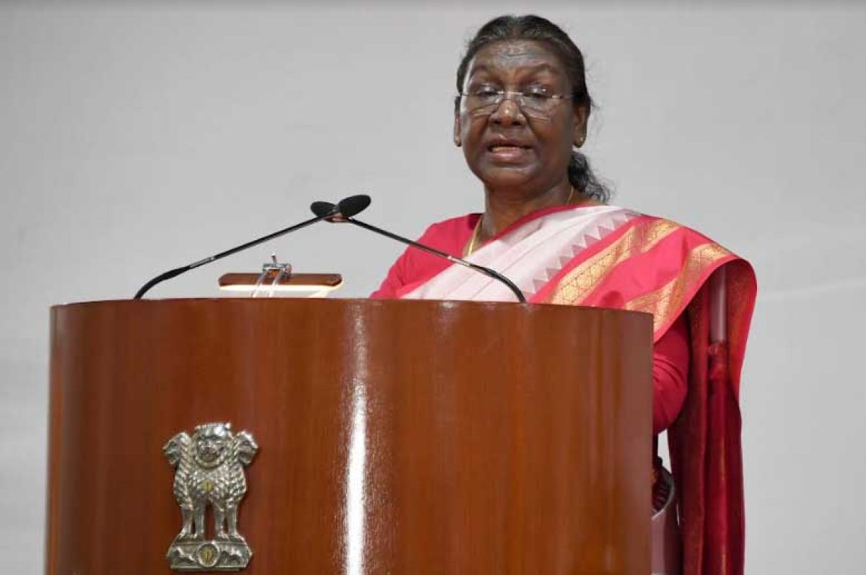
Jeevan Raksha Padak Series of Awards-2025:
Context: The President of India has approved the conferment of Jeevan Raksha Padak Series of Awards – 2025 on 30 persons which includes Sarvottam Jeevan Raksha Padak to 06, Uttam Jeevan Raksha Padak to 06 and Jeevan Raksha Padak to 18 persons. Six awardees are posthumous.

Slide 42
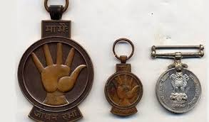
About Jeevan Raksha Padak Series of Awards-2025:
The Jeevan Raksha Padak Series of Awards recognise meritorious acts of bravery in saving human lives.
The awards are given in three categories: Sarvottam Jeevan Raksha Padak, Uttam Jeevan Raksha Padak and Jeevan Raksha Padak.
Persons from all walks of life are eligible for these awards.

Slide 43
The awards can also be conferred posthumously.
Each award includes a medal, a certificate signed by the Union Home Minister, and a lump-sum monetary allowance.
The awards are presented by the concerned Union Ministry, organisation or State Government to which the award belongs.

Slide 44
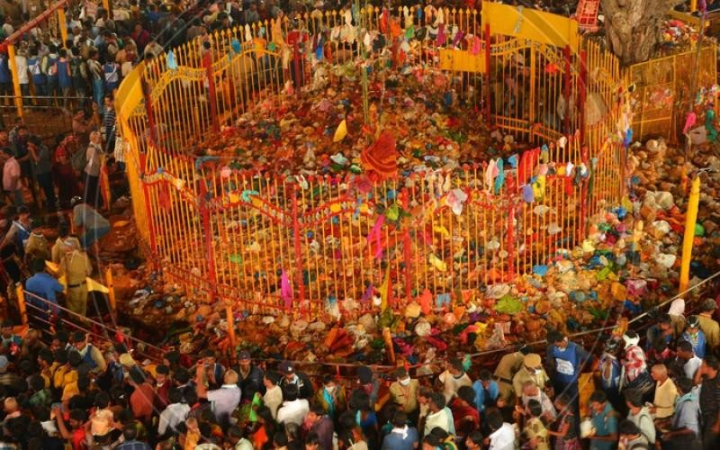
Sammakka-Saralamma Maha Jatara:
Context: The biennial Sammakka–Saralamma Maha Jatara held in Medaram, with traditional rituals marking its commencement.

Slide 45
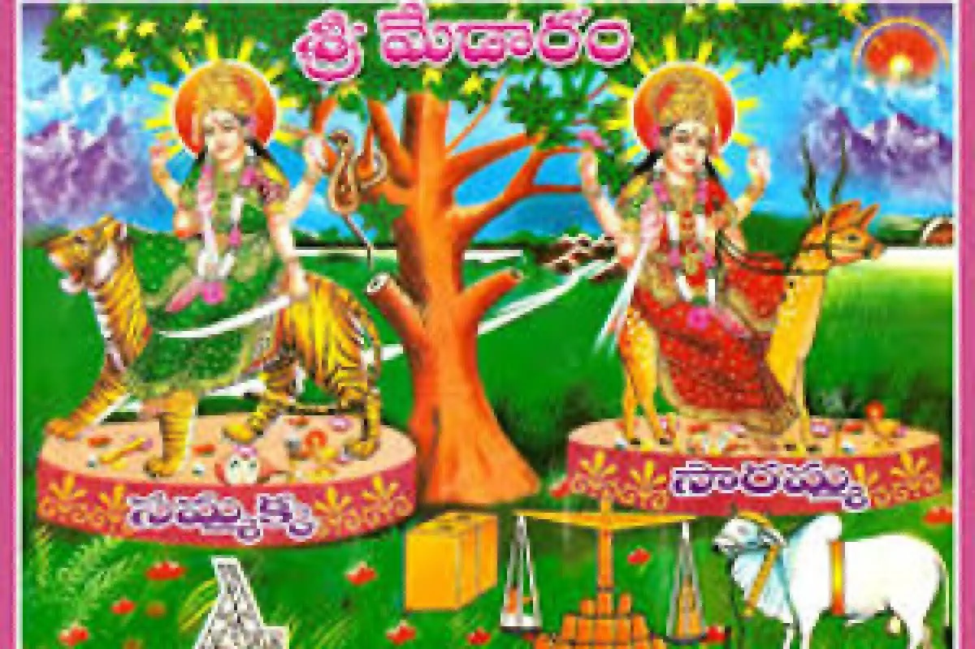
Understanding the History:
Sammakka is said to have been married to Pagididda Raju, a feudal chief of the Kakatiyas(a Deccan dynasty) who ruled the Warangal area.
She had two daughters and one son - Sarakka or Saralamma, Nagulamma and Jampanna, respectively.

Slide 46
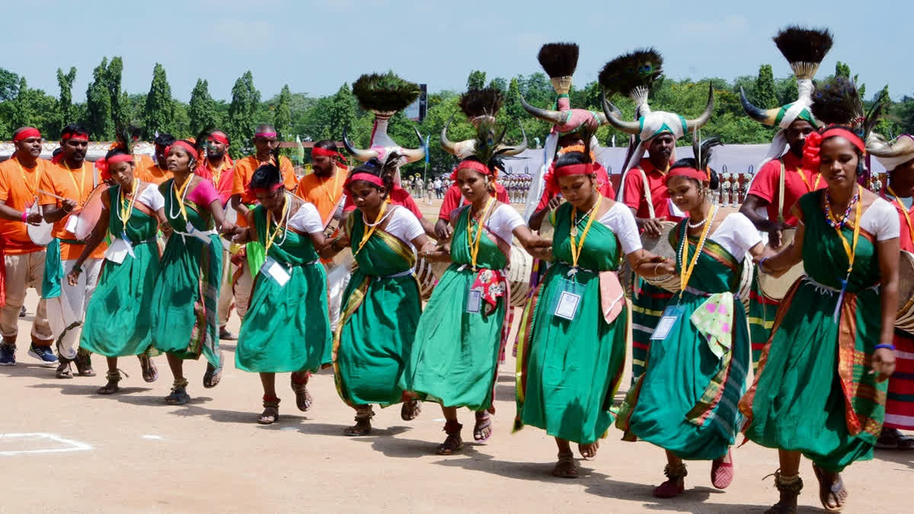
In the 13th-century, in a battle against the local rulers in protest against the imposition of taxes, Saralamma died while Sammakka disappeared into the hills.
The local (Koya) tribals believed that Sammakka metamorphosed into a vermillion casket.

Slide 47
Features of the festival:
It is a mega four-day jatara, happens in Medaram, Mulugu district of Telangana.
It takes place once in two years.
It is the only tribal fair devoted to pay tribute to tribal warriors who made supreme sacrifices defending the rights of aboriginal tribal people.

Slide 48
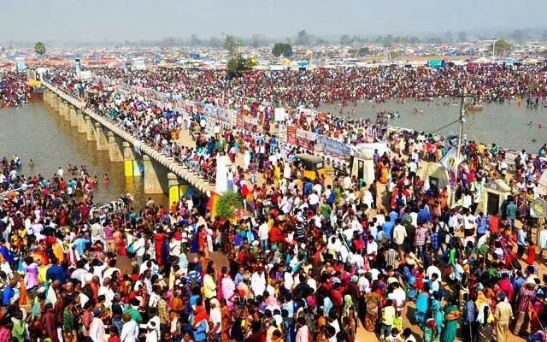
It symbolises the traditions and heritage of the Koya tribal people.
It is often referred to as the "Kumbh Mela of the tribals"
It is celebrated in Eturnagaram Wildlife Sanctuary.

Slide 49
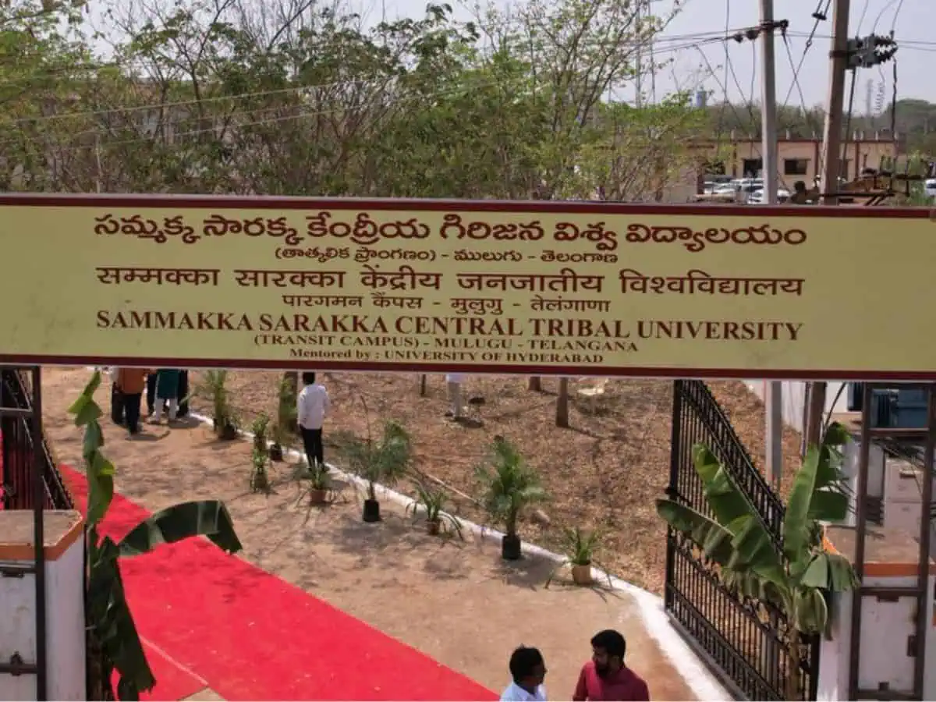
Sarakka Central Tribal University:
The Sarakka Central Tribal University, approved by the Union cabinet, is set to be established in Mulugu district, Telangana, with an estimated cost of Rs 889 crore.
This university fulfills a commitment made by the Central government under the Andhra Pradesh Reorganisation Act, 2014, to establish tribal universities in both Andhra Pradesh and Telangana.
The university aims to promote tribal education and culture.

Slide 50
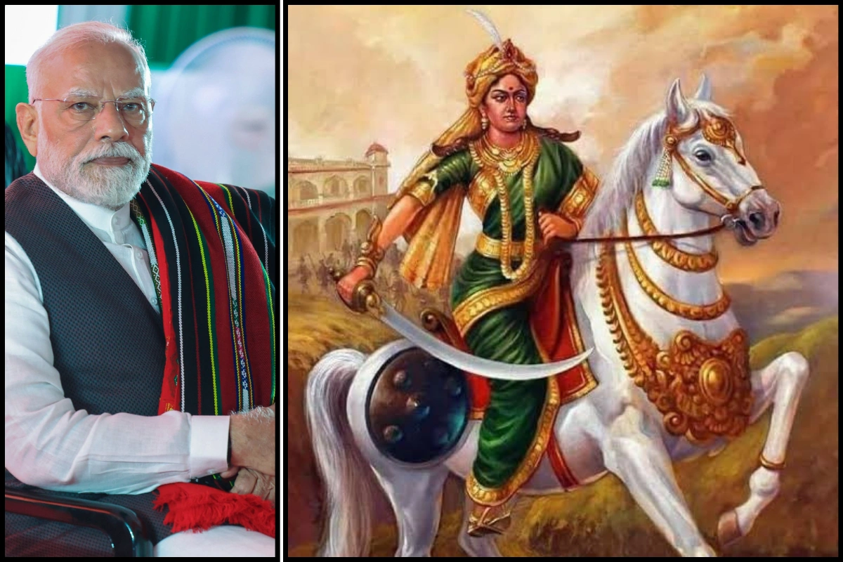
Rani Velu Nachiyar:
Context: Prime Minister Pays Tribute to Rani Velu Nachiyar on Her Birth Anniversary on January 3.

Slide 51
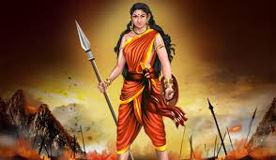
About Rani Velu Nachiyar:
Born: In 1730, she was born as the princess of Ramnad (Ramanathapuram), Tamil Nadu.
Skills: She was extensively trained in warfare, including horse riding, archery, and martial arts like Silambam and Valari.
Key Contributions: She forged an alliance with Hyder Ali of Mysore.

Slide 52
Women Battalion: She established the “Udaiyaal” battalion, one of the first all-women army units in world history.
Pioneer of Suicide Tactics: Her commander Kuyili carried out the first recorded suicide attack in Indian history by self-immolation to destroy a British ammunition depot in 1780.
Victory: In 1780, she successfully recaptured Sivaganga, defeating the British nearly 77 years before the 1857 Revolt.

Slide 53
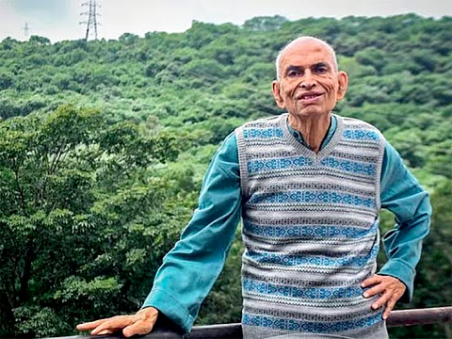
Madhav Gadgil:
Context: Renowned ecologist Madhav Gadgil passed away.

Slide 54
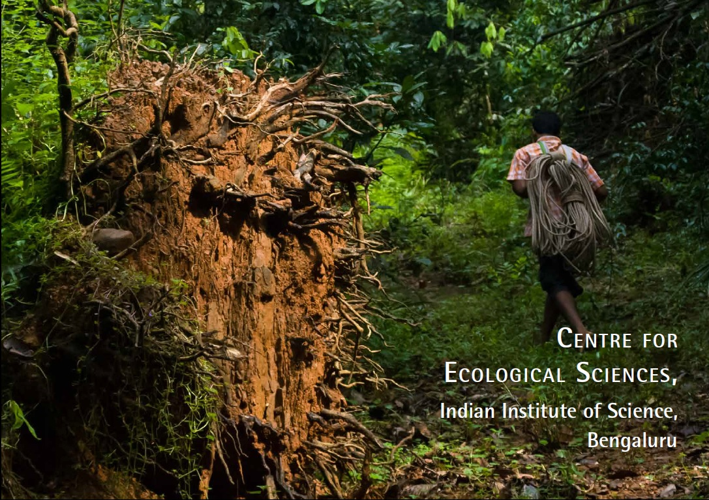
About Madhav Gadgil:
Madhav Gadgil was born in 1942 in Pune and is a leading voice in ecology and environmental protection in India
He founded the Centre for Ecological Sciences at the Indian Institute of Science in 1982
His efforts contributed to the establishment of the Nilgiri Biosphere Reserve in 1986

Slide 55
He chaired the Western Ghats Expert Ecology Panel and recommended graded ecological sensitivity for the entire Western Ghats
He played a key role in shaping India’s Biological Diversity Act and contributed to the implementation of the Forest Rights Act
He received major awards including Padma Shri, Padma Bhushan, Tyler Prize, Volvo Environment Prize, and UNEP’s Champions of the Earth award

Slide 56
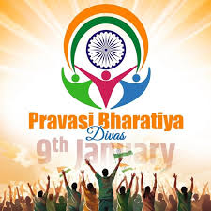
Pravasi Bharatiya Divas:
Context: On Pravasi Bharatiya Divas (PBD), the PM highlighted the role of the Indian diaspora as cultural ambassadors (Rashtradoots). PBD is a biennial flagship event celebrated on 9th January, the day in 1915 when Mahatma Gandhi returned to India from South Africa.

Slide 57
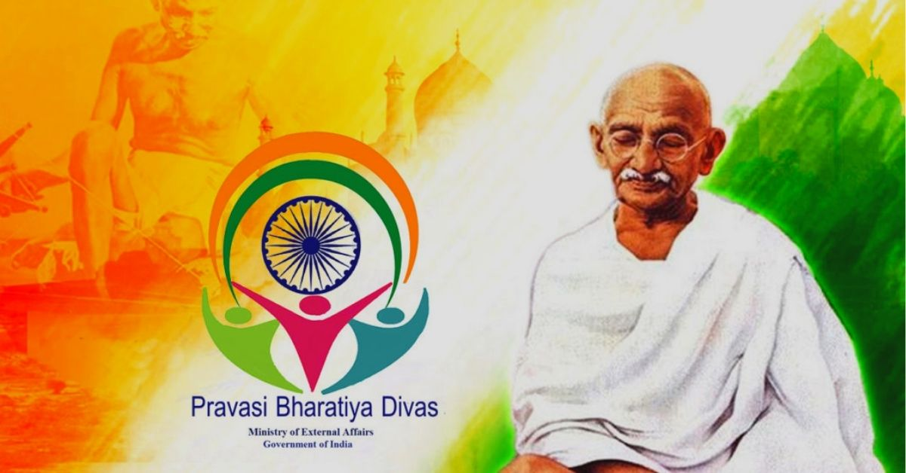
About Pravasi Bharatiya Divas:
Pravasi Bharatiya Diwas is celebrated on 9th January to honour the global Indian diaspora and its role as a bridge between India and the world
It is the flagship outreach programme of the Ministry of External Affairs to engage the Indian diaspora and showcase India’s diversity and development
Since 2015, it has been a biennial, theme-based convention for focused dialogue, engagement and networking

Slide 58
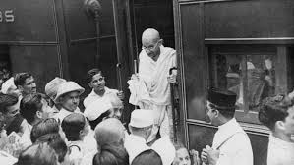
It commemorates Mahatma Gandhi’s return to India in 1915 from South Africa, symbolising diaspora contributions to the freedom struggle
It was instituted in 2003 under Atal Bihari Vajpayee to ensure structured and sustained diaspora engagement
It aims to recognise diaspora contributions, enhance India’s global image, support national causes and overseas Indian welfare.
The Pravasi Bharatiya Samman Award (PBSA) is the highest honour for NRIs, OCIs and diaspora organisations for their contributions to India and global community

Slide 60
Factual pointers:

Slide 61
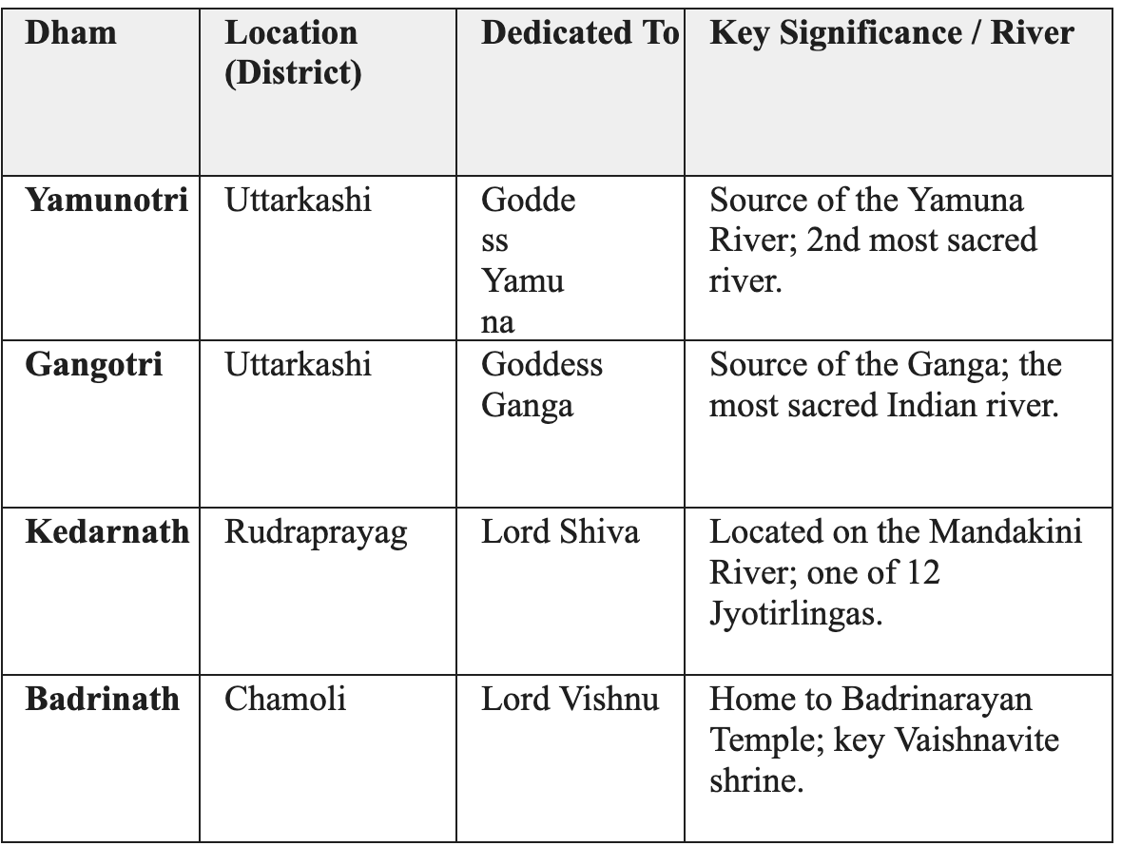
Char Dham temples:

Slide 62

International Data Privacy Day:
Context: Data Privacy Day is internationally observed annually on 28 January. It aims to raise awareness about the importance of protecting personal data and privacy in the digital age.
Also known as Data Protection Day, it was designated in 2006 by the Council of Europe to commemorate the signing of Convention 108- the world’s first legally binding international treaty on data protection.
The theme for International Data Privacy Day/Week 2026 is "Take Control of Your Data,"

Slide 63
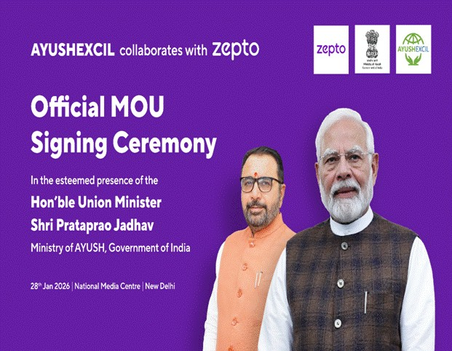
The Ministry of Ayush today signed a Memorandum of Understanding (MoU) between the Ayush Export Promotion Council (AYUSHEXCIL) and Zepto Limited to facilitate structured online access to Ayush medicines and wellness products across the country. The MoU aims to strengthen digital discovery while ensuring quality compliance and consumer trust in traditional healthcare products.

Slide 64
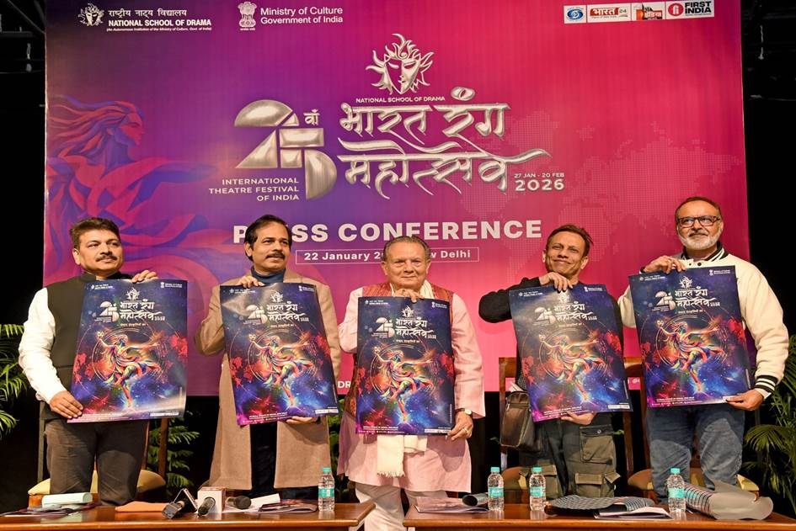
The Union Minister of Culture and Tourism, Shri Gajendra Singh Shekhawat, inaugurated the 25th Edition of Bharat Rang Mahotsav (BRM) 2026, the world’s largest international theatre festival, at the National School of Drama (NSD), Mandi House, New Delhi.

Slide 65
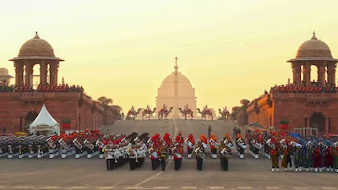
Beating Retreat is a ceremony that marks the end of Republic Day festivities in India. It is held on the evening of January 29, three days after Republic Day, at the Vijay Chowk, New Delhi.

Slide 66

The visit of Indian Navy’s First Training Squadron (1TS)—comprising INS Tir, INS Sujata, INS Shardul, and ICGS Sarathi—to Phuket Deep Sea Port, Thailand, concluded successfully with a Passage Exercise (PASSEX) in the company of HTMS Huahin on 28 Jan 26.

Slide 67
Present installed generation capacity of the country is 513.730 GW. Government of India has addressed the critical issue of power deficiency by adding 289.607 GW of fresh generation capacity since April, 2014 transforming the country from power deficit to power sufficient.

Slide 68
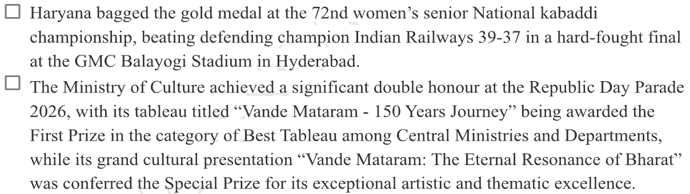

Slide 69
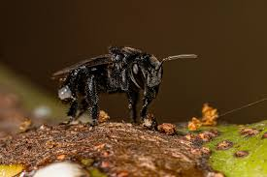
Amazon’s stingless bees (Meliponini) are the world’s oldest bee lineage, dating back nearly 80 million years, and although they possess stingers, these are highly reduced and ineffective for defense.
With nearly 500 species globally, including over 170 in Peru, they are highly diverse and ecologically vital. Their honey, often called “liquid gold,” is valued for strong antibacterial and anti-inflammatory properties.

Slide 70
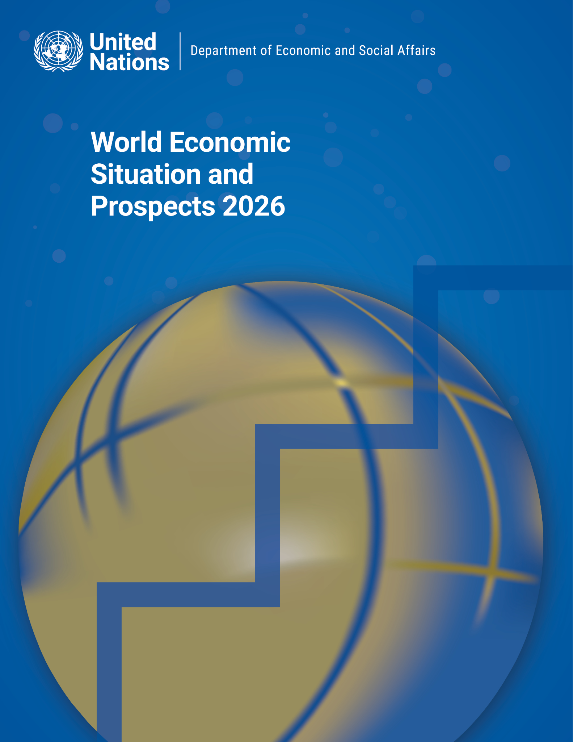
Recently, ‘World Economic Situation and Prospects 2026’ report, released by UNDESA, projected India’s GDP growth at 7.2% in 2025-26.

Slide 71
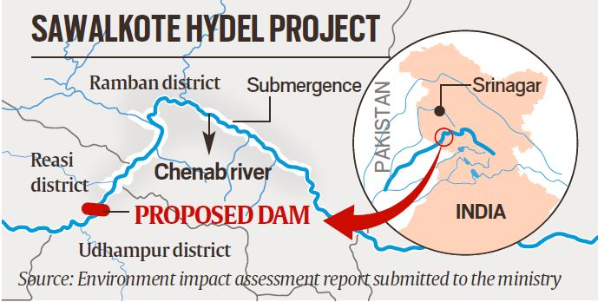
The Sawalkot Hydropower Project is a 1,856 MW run-of-the-river project proposed on the Chenab River in Jammu and Kashmir, with the government accelerating its development alongside projects like Ratle and Dulhasti amid concerns over the Indus Waters Treaty; other hydropower projects on the Chenab include Dulhasti-I, Baglihar and Salal, while projects such as Ratle, Dulhasti II, Kiru and Kwar are currently under construction.

Slide 72
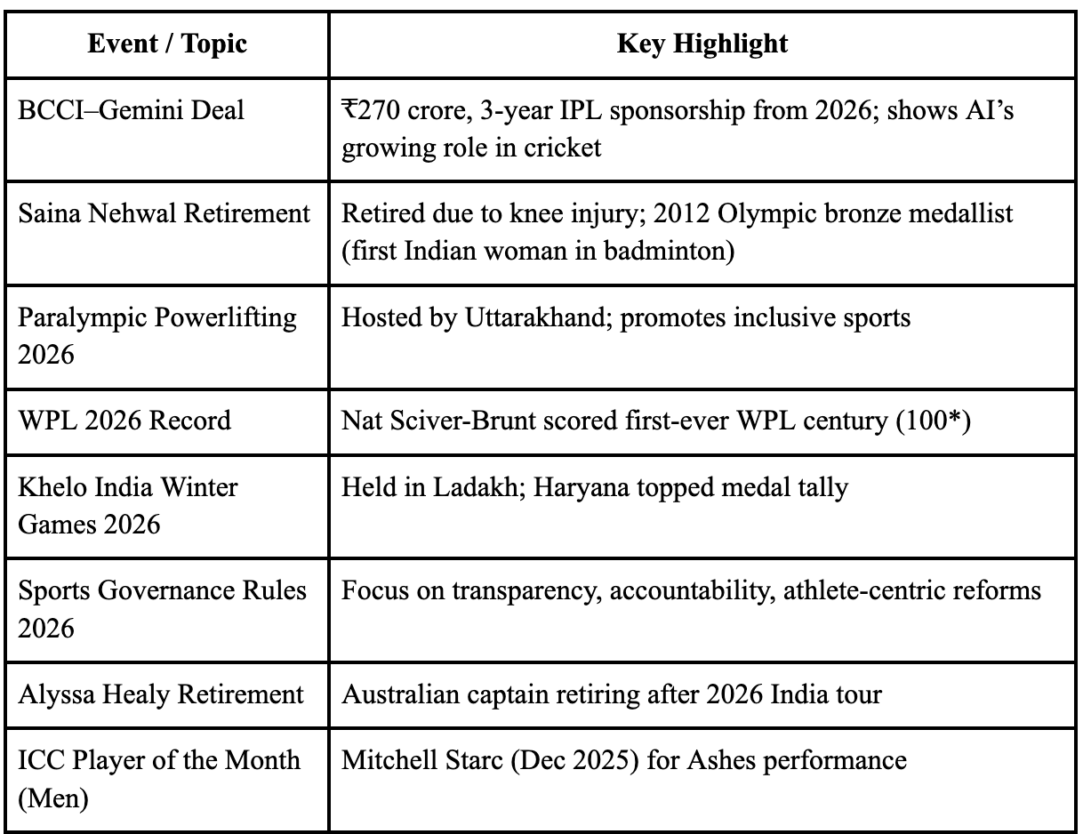

Slide 73
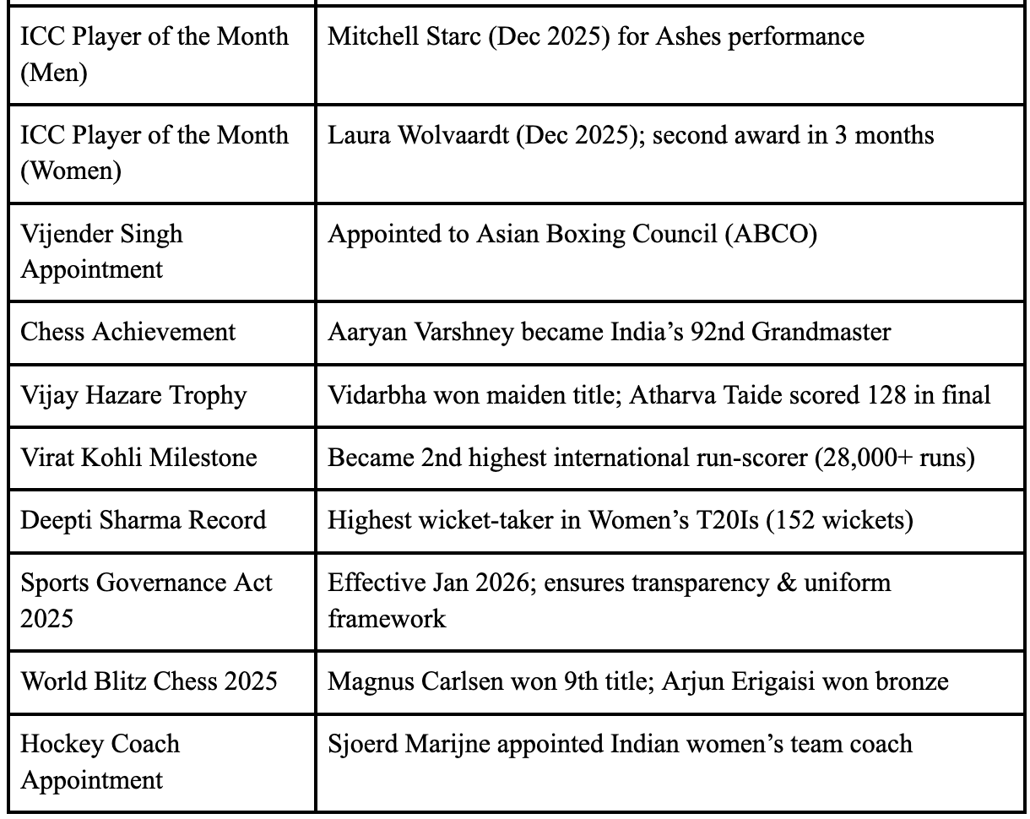

Slide 74
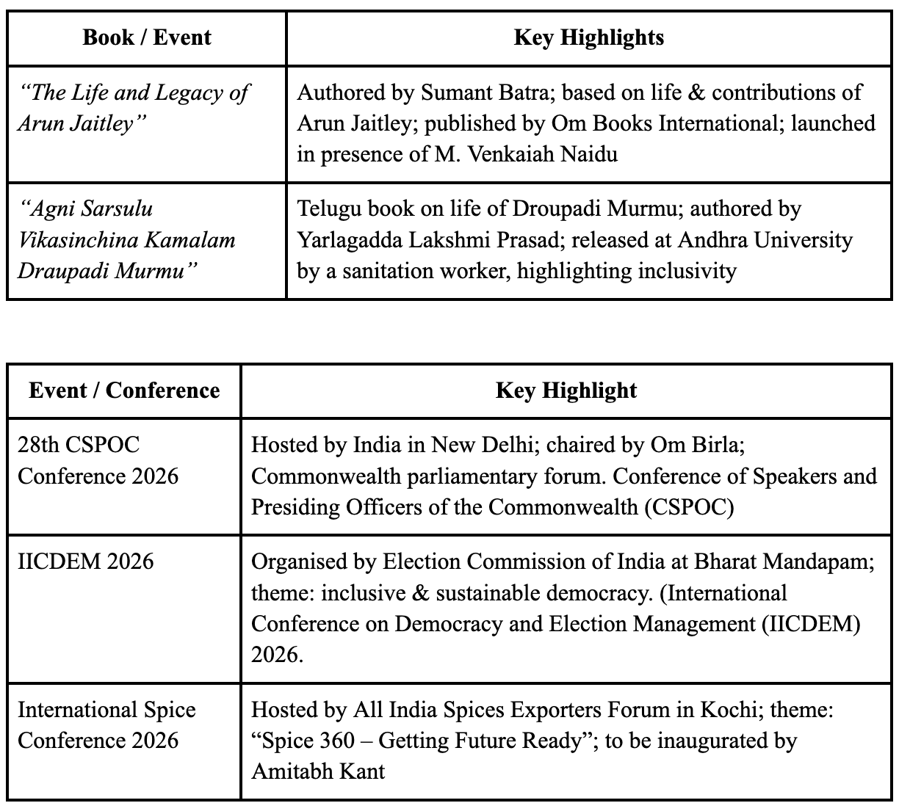

Slide 75


Slide 77


