Slide 1
January 2026
Current Affairs

Slide 2
Constitution and Governance:

Slide 3
Census 2027:
Context: The Registrar-General and Census Commissioner of India (RG&CCI) notified 33 questions that residents will have to answer in the first phase of Census 2027, which will be conducted between April 1 and September 30.

Slide 4
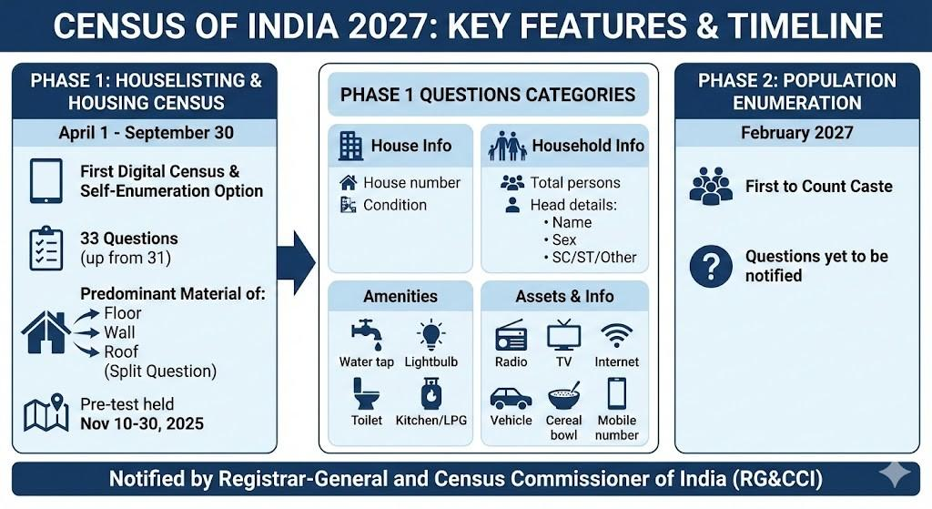

Slide 5
About Census 2027:
The Census of India 2027 will be India’s 16th census, conducted in two phases—housing census (2026) and population enumeration (2027).
The Houselisting and Housing Census will take place from April to September 2026, followed by population enumeration in February 2027.
Hilly and difficult regions like Jammu and Kashmir, Ladakh, Himachal Pradesh, and Uttarakhand will begin enumeration earlier from September 2026.

Slide 6
The census was originally scheduled for 2021 but was delayed due to COVID-19, boundary issues, and the 2024 general elections.
The 2027 Census will include caste enumeration for the first time since 1931, marking a major policy shift.
It will be conducted digitally using a mobile application in 16 languages to improve efficiency and accuracy.
The Union Budget 2021 allocated ₹37.68 billion for census operations, though utilisation was delayed.

Slide 7
Administrative boundary freezing, extended till 30 June 2024, is a prerequisite for census operations.
The census data will be used for delimitation of constituencies ahead of the 2029 general elections.
It will end the freeze on delimitation that has been in place since 1976.

Slide 8
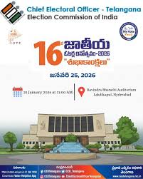
16th National Voters’ Day:
Context: 16th National Voters’ Day (NVD-2026) is being celebrated by the Election Commission of India on 25 January 2026.

Slide 9
About National Voters' Day:
National Voters' Day is celebrated annually in India on 25 January to mark the foundation day of Election Commission of India.
It established by the Government of India in order to encourage more young voters to take part in the political process, and first celebrated 25 January 2011.
Theme: “My India, My Vote”.

Slide 10
Tagline: “Citizen at the Heart of Indian Democracy”.
Venue: New Delhi.
Chief Guest: President of India Smt. Droupadi Murmu.
Two publications launched: “2025: A Year of Initiatives and Innovations” and “Chunav Ka Parv, Bihar Ka Garv”.

Slide 11
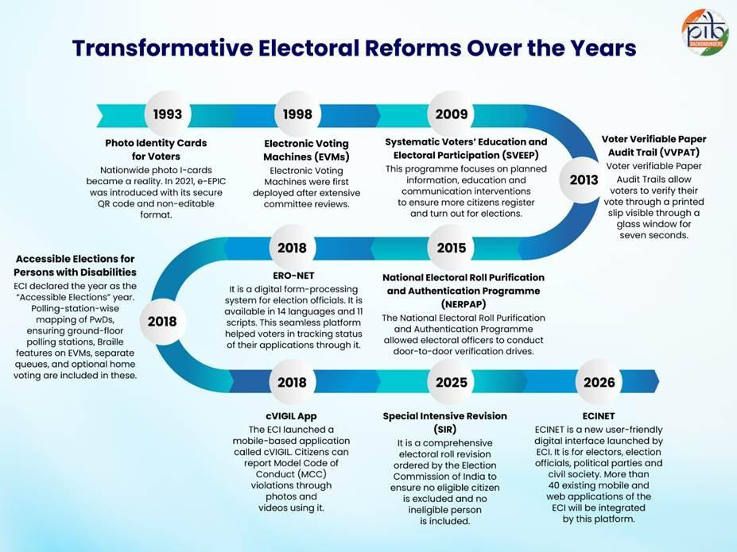

Slide 12
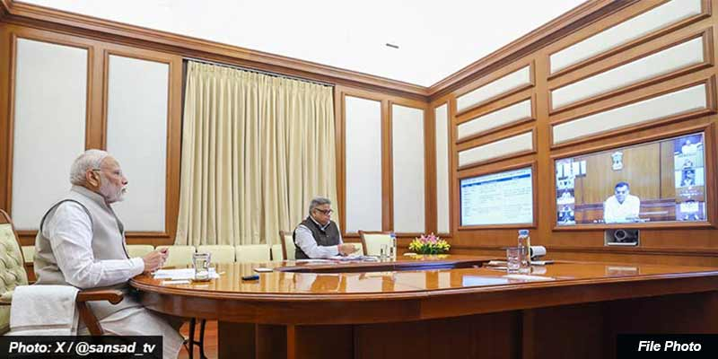
Pro-Active Governance and Timely Implementation (PRAGATI):
Context: Prime Minister chaired 50th meeting of Pro-Active Governance and Timely Implementation (PRAGATI). The system has accelerated the implementation of mega projects and key welfare schemes.

Slide 13
About PRAGATI:
Launched: PRAGATI (Pro-Active Governance and Timely Implementation) was launched in 2015.
Overview: It is a three-tier system involving the Prime Minister’s Office (PMO), Union Government Secretaries, and Chief Secretaries of States.
Objectives: It focuses on programme implementation (inter-agency coordination), project monitoring through a technology-based platform, and grievance redressal via CPGRAMS.

Slide 14

The Right of Children to Free and Compulsory Education Act, 2009:
Context: Supreme Court ruling aims to ensure that all schools make available 25% free seats for children from weaker and disadvantaged sections as per Section 12(1)(c) of the RTE Act..

Slide 15
Understanding the background:
The Right Of Children To Free And Compulsory Education Act, 2009 (RTE Act) place obligation on private schools to ensure that 25 percent of Class 1 students admitted must belong to “weaker section and disadvantaged group in the neighbourhood”.
Students admitted under this quota are given fee concessions, with the state government meant to reimburse private schools for the same.

Slide 16
About Right to Education (RTE) Act:
In the 1993 case of Unnikrishnan vs. State of Andhra Pradesh, the Supreme Court ruled that the citizens of this country have a fundamental right to education.
The said right flows from Article 21.
The Supreme Court also noted that every citizen of India should have the right to free education until 14 years of age.

Slide 17
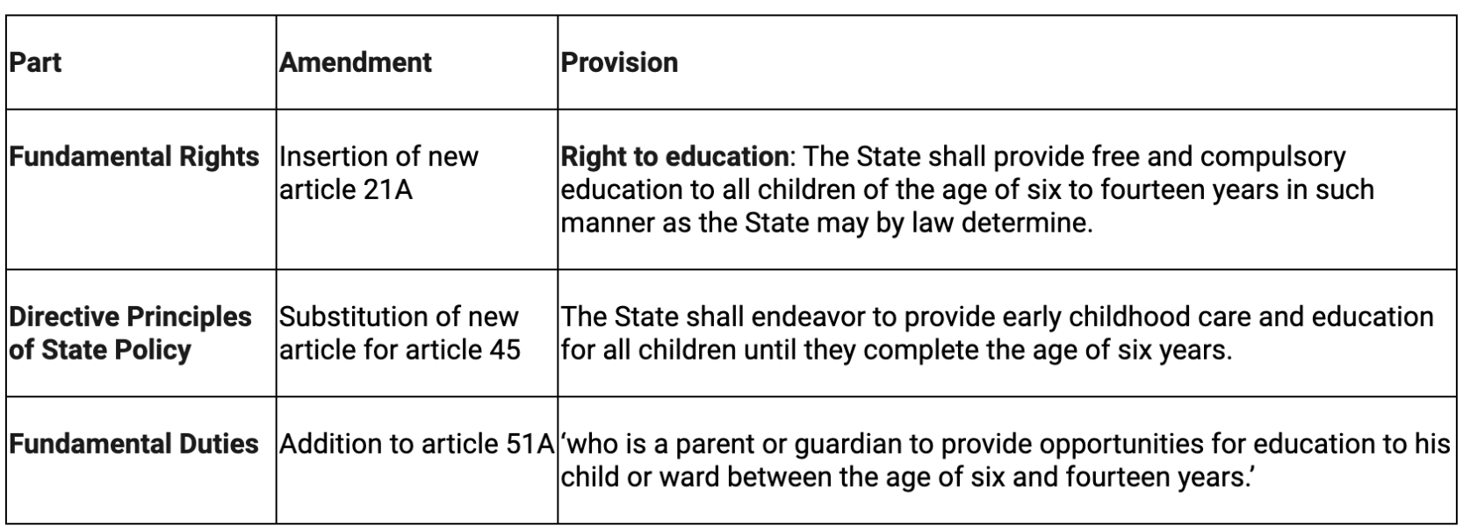
The Constitution (Eighty-sixth Amendment) Act, 2002 to give the constitutional status for Supreme Court observations.

Slide 18
To enforce Article 21A, The Right of Children to Free and Compulsory Education Act or Right to Education Act (RTE) was enacted in 2009. The important provisions include:
All children between the ages of 6 and 14 years have the right to free and compulsory education in a neighborhood school.
A child above 6 years of age who is not enrolled in school or was unable to complete his education shall be enrolled in an age-appropriate class.
Elementary education shall be free until completion, even if the child is older than 14 years.

Slide 19
No child shall be held back, expelled, or required to pass a board examination until the completion of elementary education.
The appropriate government (central or state government) shall specify an academic authority to develop the curriculum and evaluation procedure for elementary education.
All schools must comply with pupil-teacher ratio norms.

Slide 20
The teacher should pass the Teacher Eligibility Test (TET), which will be conducted by the appropriate Government.
Government schools shall provide free and compulsory education to all admitted children.
Similarly, aided schools shall provide free and compulsory education proportionate to the funding received, subject to a minimum of 25%.
Teachers are prohibited from giving private tuitions and undertaking non-teaching duties except for census, disaster relief, and election work.

Slide 22
Defence and internal security:

Slide 23
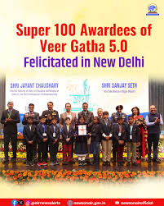
Veer Gatha 5.0:
Context: Raksha Rajya Mantri & Minister of State for Education felicitate Super-100 winners of Veer Gatha 5.0.

Slide 24
More about:
Veer Gatha 5.0 Super-100 winners were felicitated in New Delhi on 24 January 2026.
Felicitation done by Raksha Rajya Mantri Shri Sanjay Seth and MoS (Education & Skill Development & Entrepreneurship, I/C) Shri Jayant Chaudhary.
100 winners selected, including 64 girls from across India.

Slide 25
28,005 international students from CBSE schools abroad participated for the first time.
Each winner received ₹10,000 cash prize, a medal, and a certificate.
The Super-100 winners will attend the Republic Day Parade 2026 at Kartavya Path as special guests.

Slide 26
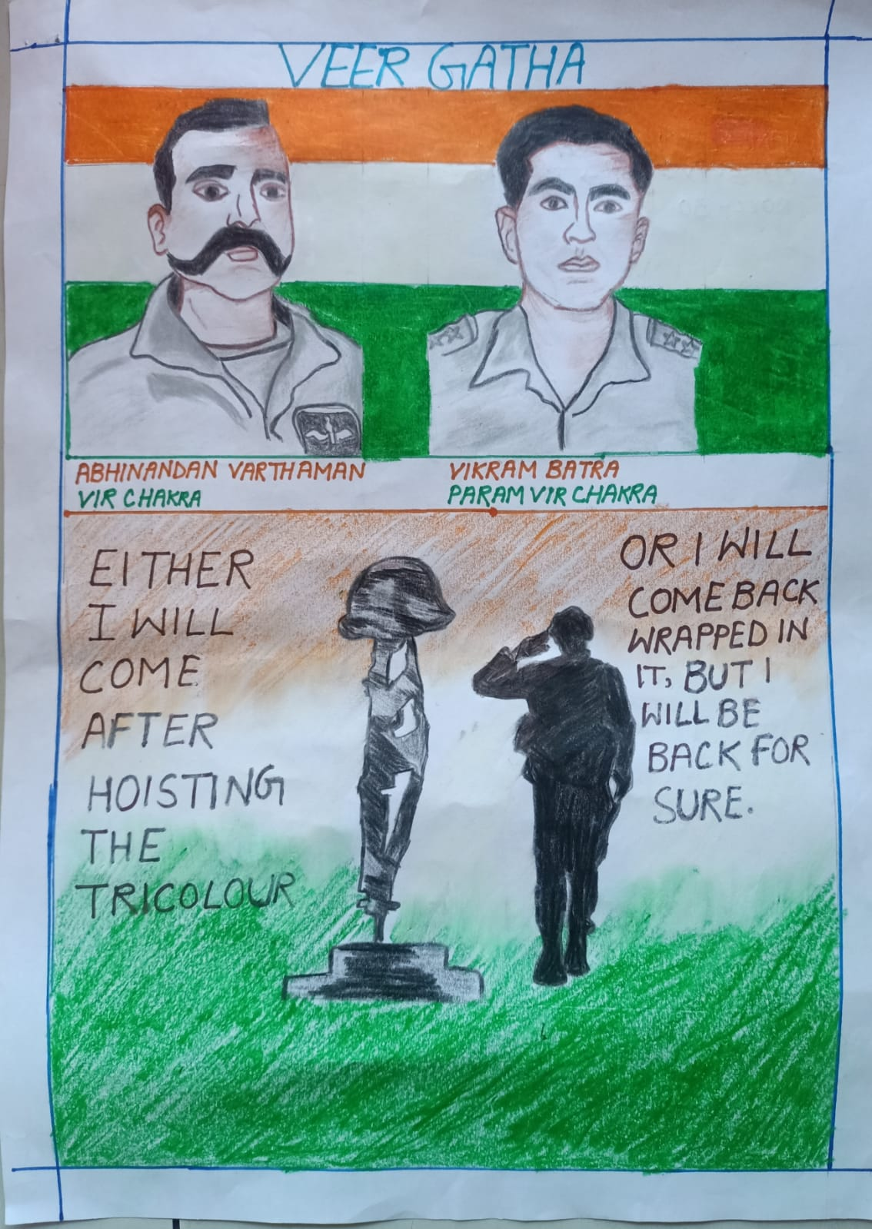
About Veer Gatha:
Project Veer Gatha was launched in 2021 under the Gallantry Awards Portal.
Objective: To spread stories of valor and sacrifice of India’s Gallantry Awardees among students and promote patriotism and civic values.
It provides a national creative platform for school students through essays, poems, paintings, drawings, and multimedia.
Project Veer Gatha 5.0 was launched by the Ministry of Defence in collaboration with the Ministry of Education.

Slide 27
New inclusion: Stories of pre-independence warriors like Prithviraj Chauhan, Kharavela, and dynasties such as Magadha and Chola.
It introduces technology-based formats like videography, reporting, and anchoring.
Focus theme: “Samarik Parampara” — India’s military traditions, strategies, wars, and warriors.
Schools are encouraged to set up “Veer Gatha Corner” to showcase student work.
Top student entries are felicitated at the national level during Republic Day celebrations.

Slide 28
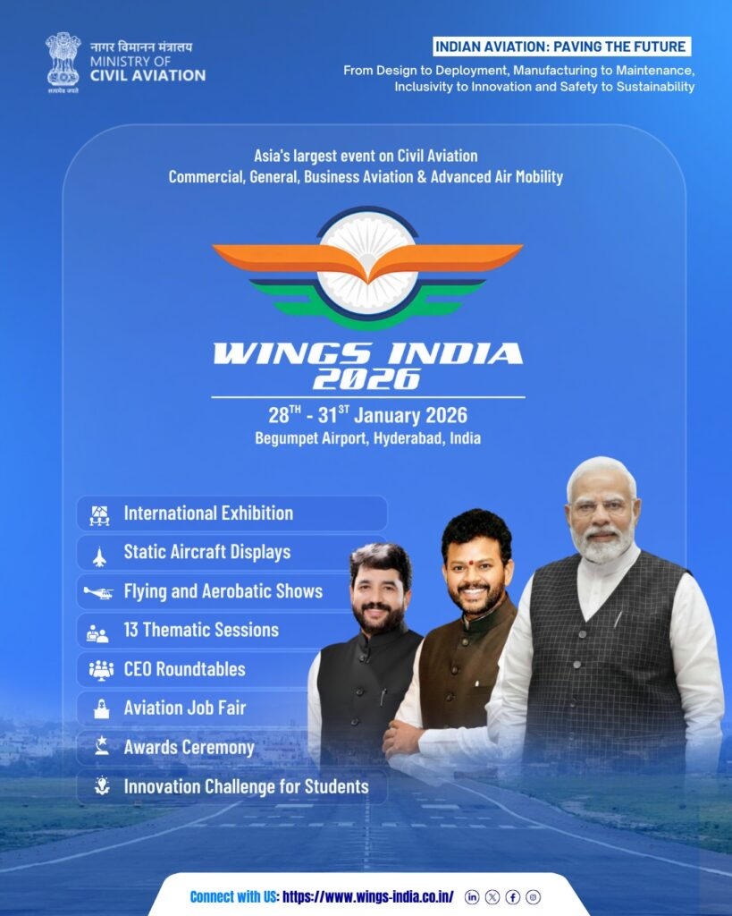
Wings India 2026:
Context: Wings India 2026 to Showcase India’s Aviation Ascent as the World’s Fastest-Growing Civil Aviation Market.

Slide 29
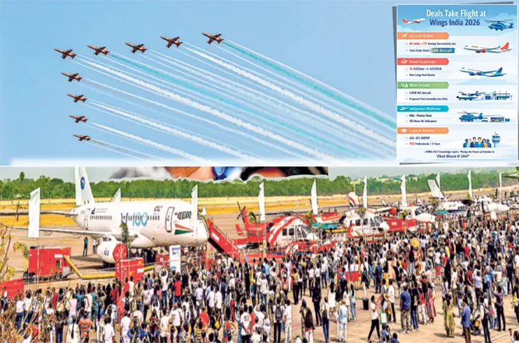
About Wings India 2026:
Wings India 2026 is Asia’s largest civil aviation event, highlighting India’s rapidly growing aviation sector.
The four-day event will be held from 28–31 January 2026 at Begumpet Airport, Hyderabad.
The theme is “Indian Aviation: Paving the Future – From Design to Deployment, Manufacturing to Maintenance, Inclusivity to Innovation and Safety to Sustainability.”

Slide 30
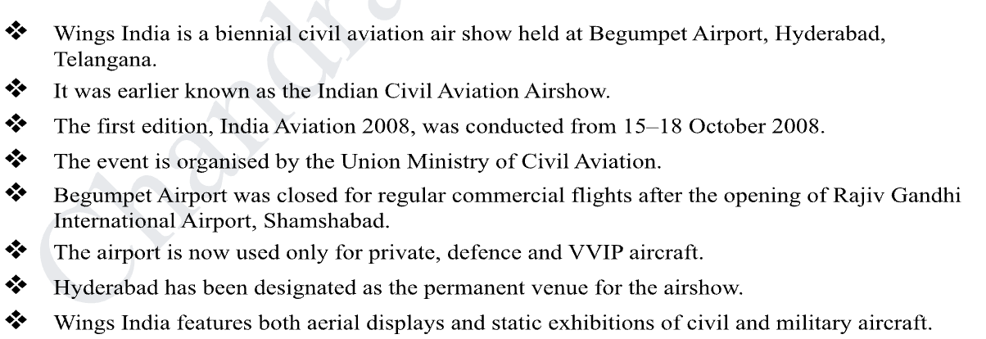

Slide 31
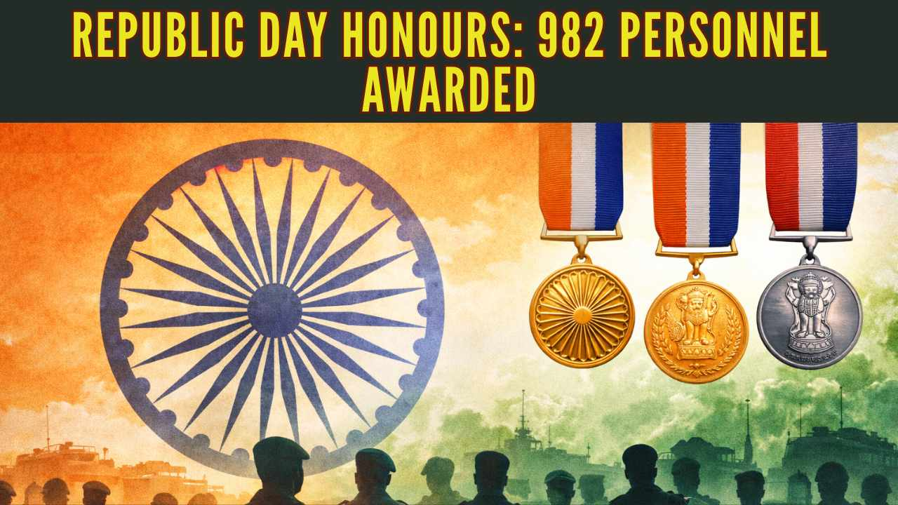
Gallantry awards:
Context: Ministry of defence published list of Army personnel awarded for their gallantry and distinguished service on the occasion of Republic Day 2026.

Slide 32
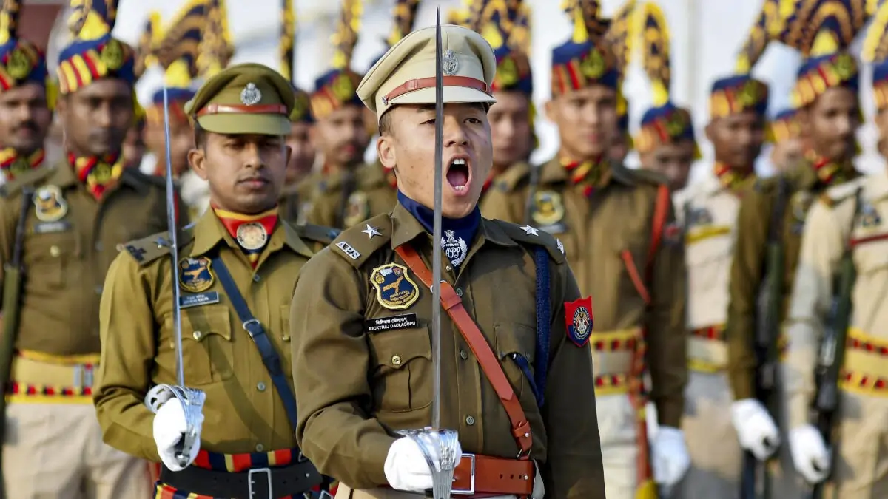
What are Gallantry awards?
Gallantry Awards have been instituted to honour the acts of bravery and sacrifice of the officers/personnel of the Armed Forces, other lawfully constituted Forces and civilians.
These gallantry awards are announced twice a year - first on the occasion of Republic Day and then on the occasion of Independence Day.

Slide 33
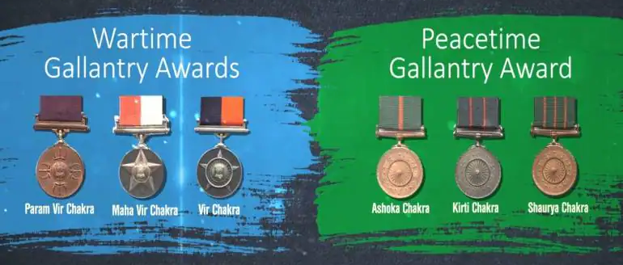
Categorisation of awards:
Gallantry Awards are classified into two categories
Gallantry in the Face of Enemy.
Gallantry Other than in the Face of Enemy.

Slide 34
Gallantry in the Face of Enemy:
  Param Vir Chakra (PVC)
  Mahavir Chakra (MVC)
  Vir Chakra
Gallantry Other than in the Face of Enemy:
Ashok Chakra
Kirti Chakra
Shaurya Chakra

Slide 35
History of the awards:
The first three gallantry awards namely the Param Vir Chakra, the Maha Vir Chakra and the Vir Chakra were instituted by the Government of India on 26th January 1950.
Other three gallantry awards i.e., the Ashoka Chakra Class-I, the Ashoka Chakra Class-II and the Ashoka Chakra Class-III were instituted by the Government of India on 4th January 1952.
These awards were renamed the Ashoka Chakra, the Kirti Chakra and the Shaurya Chakra respectively in January 1967.

Slide 36

Operation Sahyadri Checkmate:
Context: DRI busts mobile mephedrone lab in Sahyadri Ranges under “Operation Sahyadri Checkmate”; seizes nearly 22 kg mephedrone.

Slide 37
About Operation Sahyadri Checkmate:
The Directorate of Revenue Intelligence (DRI) launched Operation Sahyadri Checkmate based on developed intelligence inputs.
The operation targeted a clandestine mephedrone manufacturing network in the Sahyadri ranges.
A mobile and covert drug laboratory was dismantled in a remote hinterland location.
The lab frequently shifted locations to evade law-enforcement detection.

Slide 38
Surveillance revealed the unit was camouflaged as a poultry farm.
On 24 January 2026, DRI conducted a coordinated raid on the site.
The operation uncovered a fully functional makeshift mobile laboratory.
The lab was equipped with apparatus capable of manufacturing mephedrone, a banned NDPS substance.

Slide 39
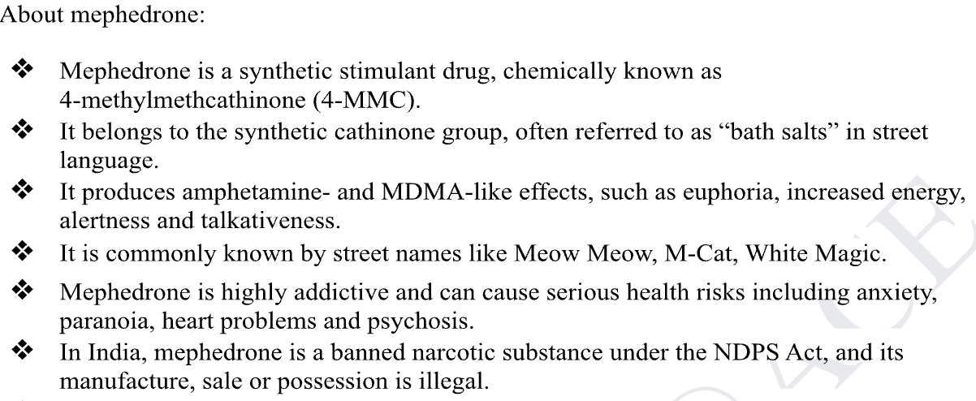

Slide 40
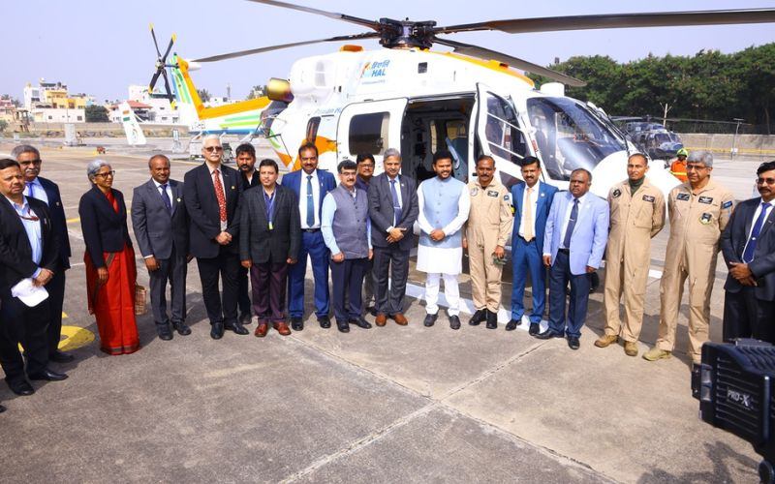
Dhruv-NG:
Context: Dhruv-NG (New Generation) recently completed its inaugural flight in Bengaluru.

Slide 41
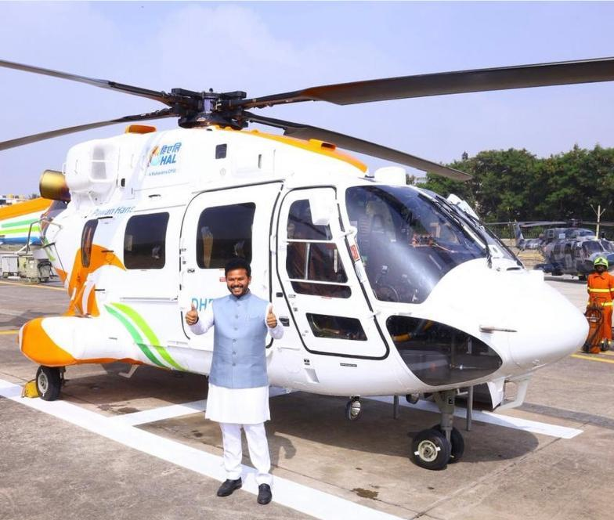
About Dhruv-NG:
Platform: Hindustan Aeronautics Limited’s ALH Dhruv is an indigenously developed twin-engine multi-role helicopter.
Variant: Dhruv-NG is the new-generation civilian version equipped with modern avionics and upgraded systems.
Roles: It is designed for transport, air ambulance, disaster relief, tourism, and utility missions.

Slide 42
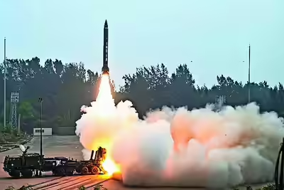
Pralay Missile:
Context: DRDO conducts launch of two Pralay missiles from the Odisha coast.

Slide 43
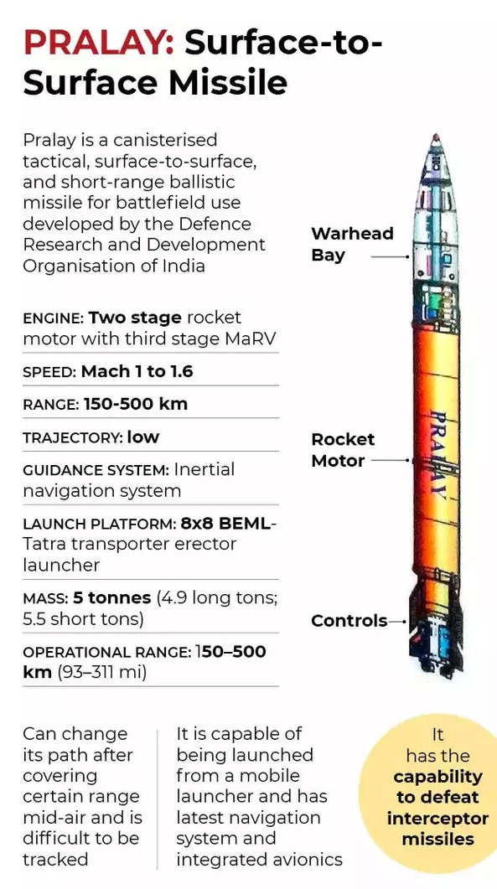
About Pralay missile:
A surface-to-surface short range solid propellant quasi-ballistic missile which can fly at hypersonic speed (Above Mach 5).
Quasi ballistic missiles are a class of missiles that have low trajectory and take ballistic trajectory but can change course and make maneuvers during the flight if required.
Developed indigenously by: Hyderabad-based DRDO facility Research Centre Imarat in collaboration with other facilities.
Strike Range: From 150 to 500 km

Slide 44
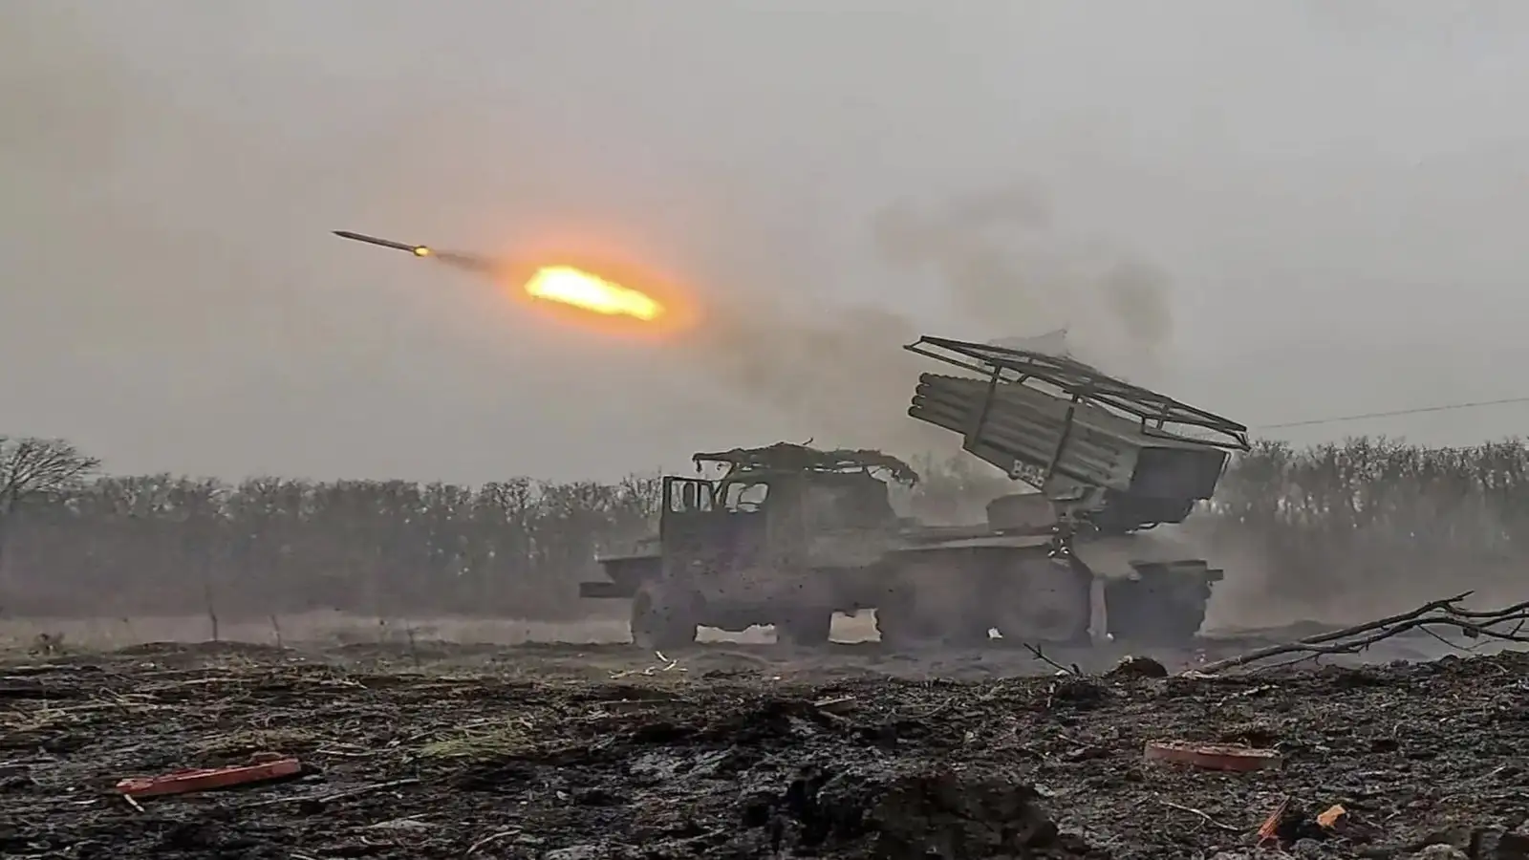
Suryastra:
Context: Indian Army has signed a ₹293 crore contract with private defence manufacturer NIBE Limited, in collaboration with Israel, for the supply of an advanced long-range rocket launcher system Suryastra.

Slide 45
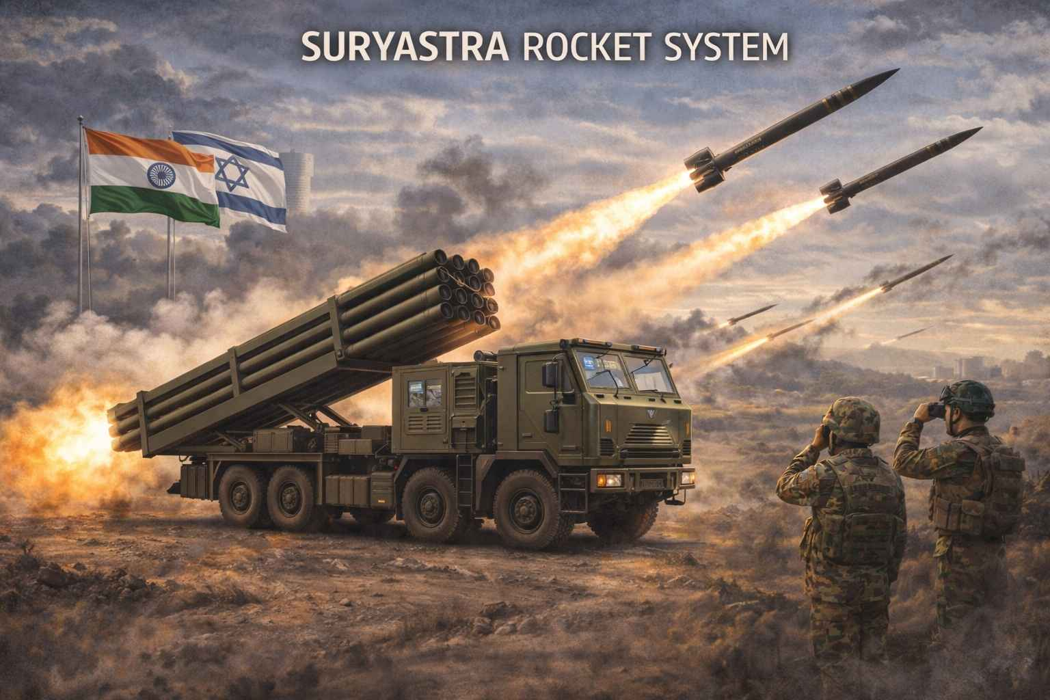
About Suryastra:
Suryastra: India’s first indigenously developed universal multi-calibre rocket launcher
Strike Range: Capable of precision surface-to-surface strikes up to 300 km
Multi-Target Capability: Can engage multiple targets simultaneously at different ranges
Flexibility: Compatible with multiple types of rockets
High Accuracy: Achieves accuracy of less than 5 meters
Loitering Munitions: Can launch loitering munitions up to 100 km

Slide 46
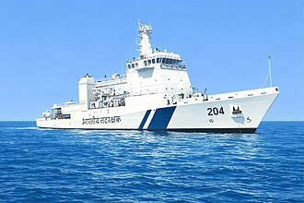
ICGS Samudra Pratap:
Context: ICGS Samudra Pratap, India’s first indigenously designed Pollution Control Vessel (PCV), was commissioned in Goa.

Slide 47
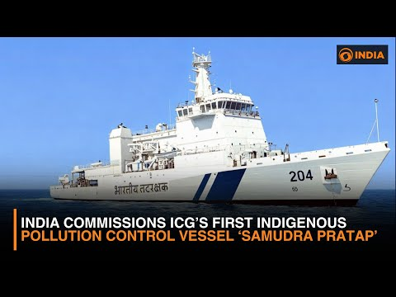
About ICGS Samudra Pratap:
It is first of two PCVs being built by Goa Shipyard Limited (GSL).
Largest ship in the Indian Coast Guard (ICG) fleet.
It is equipped with advanced pollution detection systems, dedicated pollution response boats, pollution control laboratory and modern firefighting capabilities.

Slide 48
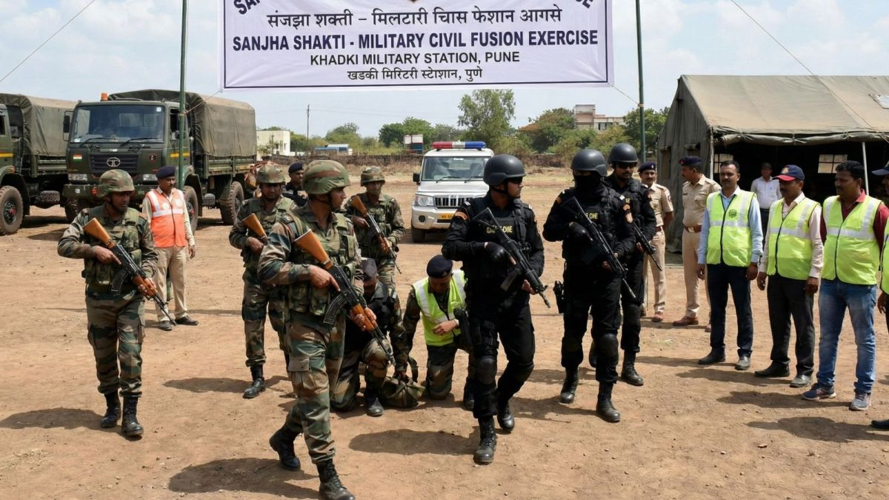
Sanjha Shakti:
Context: Recently, a joint Military Civil Fusion (MCF) exercise, Sanjha Shakti was successfully conducted in Pune.

Slide 49
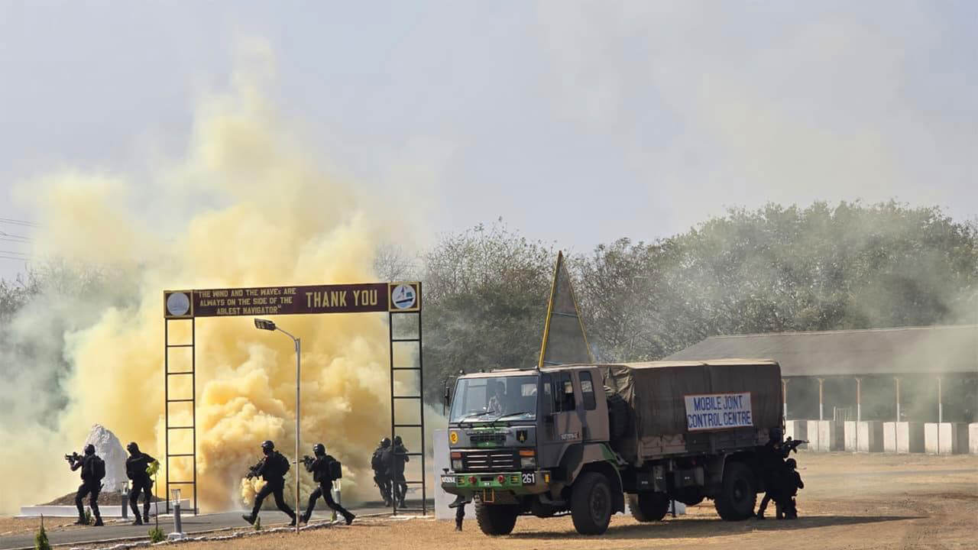
About Sanjha Shakti:
The exercise highlighted seamless coordination and joint preparedness among civil and military agencies to address complex security challenges and emergency situations.
Indian Army and 16 key civilian agencies including Maharashtra Police, Force One and Fire Fighting Departments participated in the exercise.

Slide 51
Environment and Disaster Management:

Slide 52
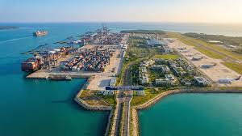
Great Nicobar project:
With some sections of the ₹92,000-crore Great Nicobar Island mega-infrastructure project “nearing approval”, members of the Tribal Council in Little and Great Nicobar on Thursday alleged that they are being pressured by the district administration to “surrender our ancestral lands” to make way for the project.

Slide 53
More about:
Tribal Councils in Andaman & Nicobar Islands are statutory bodies under the 2009 Regulation with only advisory and limited executive powers.
Unlike Sixth Schedule Autonomous Councils, they do not have legislative or judicial powers or significant autonomy.

Slide 54
The A&N administration argues FRA is unnecessary as tribal rights are already protected under the Protection of Aboriginal Tribes Act, 1956.
PAT, 1956 allows unilateral diversion of forest land by the administration, whereas FRA requires Gram Sabha consent after recognition of rights.

Slide 55
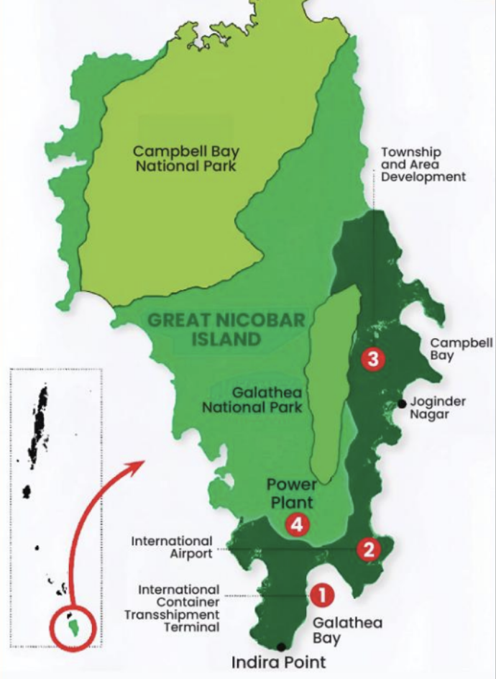
About Great Nicobar Island Project:
The Great Nicobar Island Project is a major Greenfield infrastructure initiative conceptualised by NITI Aayog and approved in 2021.
ANIIDCO is the nodal agency responsible for implementing the project.
Key components include a deep-sea international transshipment port at Galathea Bay (overseen by MoPSW), a Greenfield international airport, a 450 MW power plant, and a modern township.

Slide 56
Graded Response Action Plan (GRAP):
Context: The Sub-Committee on the Graded Response Action Plan (GRAP) of the Commission for Air Quality Management (CAQM) revoked all Stage III actions across Delhi-NCR with immediate effect on 22.01.2026, in view of the improvement in air quality and forecast trends.

Slide 57
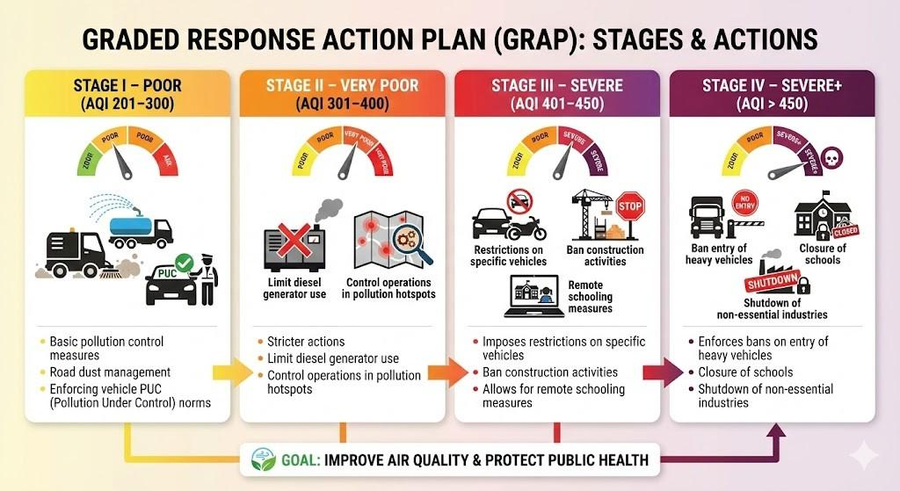

Slide 58
About Graded Response Action Plan (GRAP):
Graded Response Action Plan (GRAP) is a pollution-control mechanism implemented in the Delhi–NCR region.
It was formulated under the directions of the Supreme Court in M.C. Mehta v. Union of India (2016).
GRAP was officially notified in 2017.
It is implemented by the Commission for Air Quality Management (CAQM).

Slide 59
Implementation is carried out in coordination with MoEFCC and concerned state governments.
GRAP classifies pollution-control actions into four stages based on AQI levels.
It provides a graded, coordinated, and time-bound response to air pollution.
Stricter measures are automatically triggered as air quality deteriorates.
The objective is to prevent air quality from reaching hazardous levels.

Slide 60
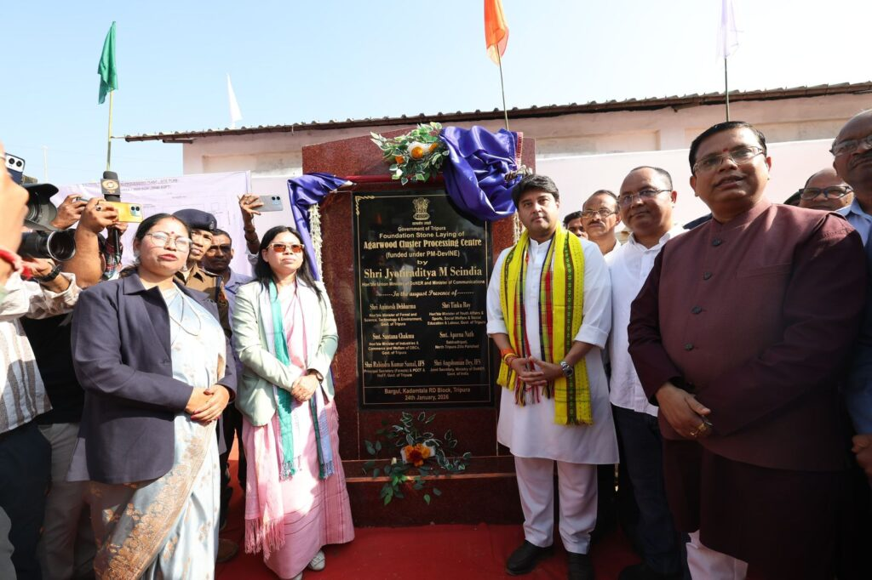
Agarwood:
Context: Union Minister Jyotiraditya Scindia Lays Foundation Stone of ₹80 Crore Agarwood Value Chain Development Scheme.

Slide 61
More in news:
Union Minister Shri Jyotiraditya Scindia laid the foundation stone of the ₹80 crore Agarwood Value Chain Development Scheme.
The foundation stone was laid at North Fulkabari, Tripura.
The announcement was made during the second day of his three-day visit to Tripura and Assam.

Slide 62
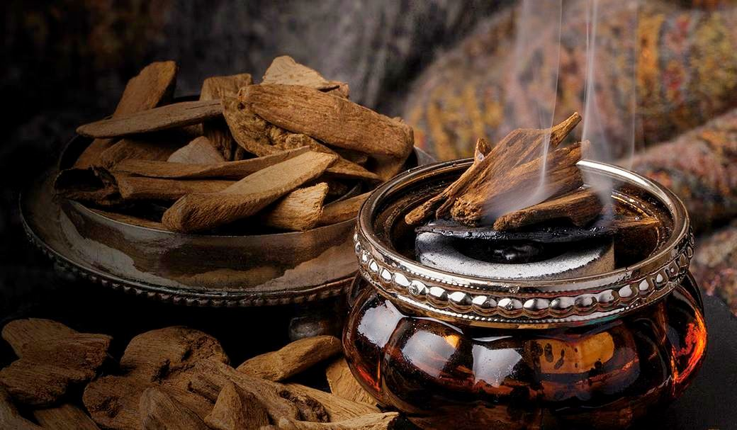
Tripura and Assam are the primary centres of agarwood production in India.
The scheme aims to strengthen and energise the agarwood value chain in both States.
The initiative aligns with the Prime Minister’s vision of “Local to Global”, “Vocal for Local”, and “One District One Product (ODOP)”.
Fulkabari’s agarwood sector was highlighted as a model example of these national development initiatives

Slide 63
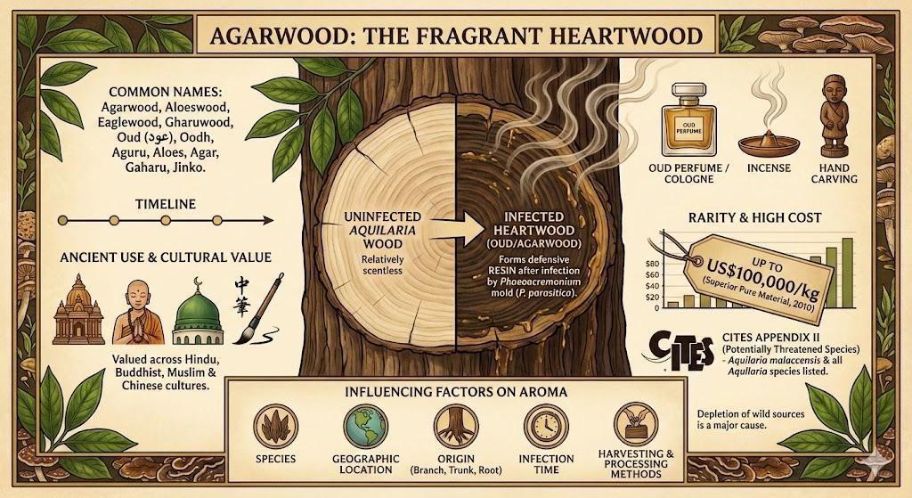

Slide 64
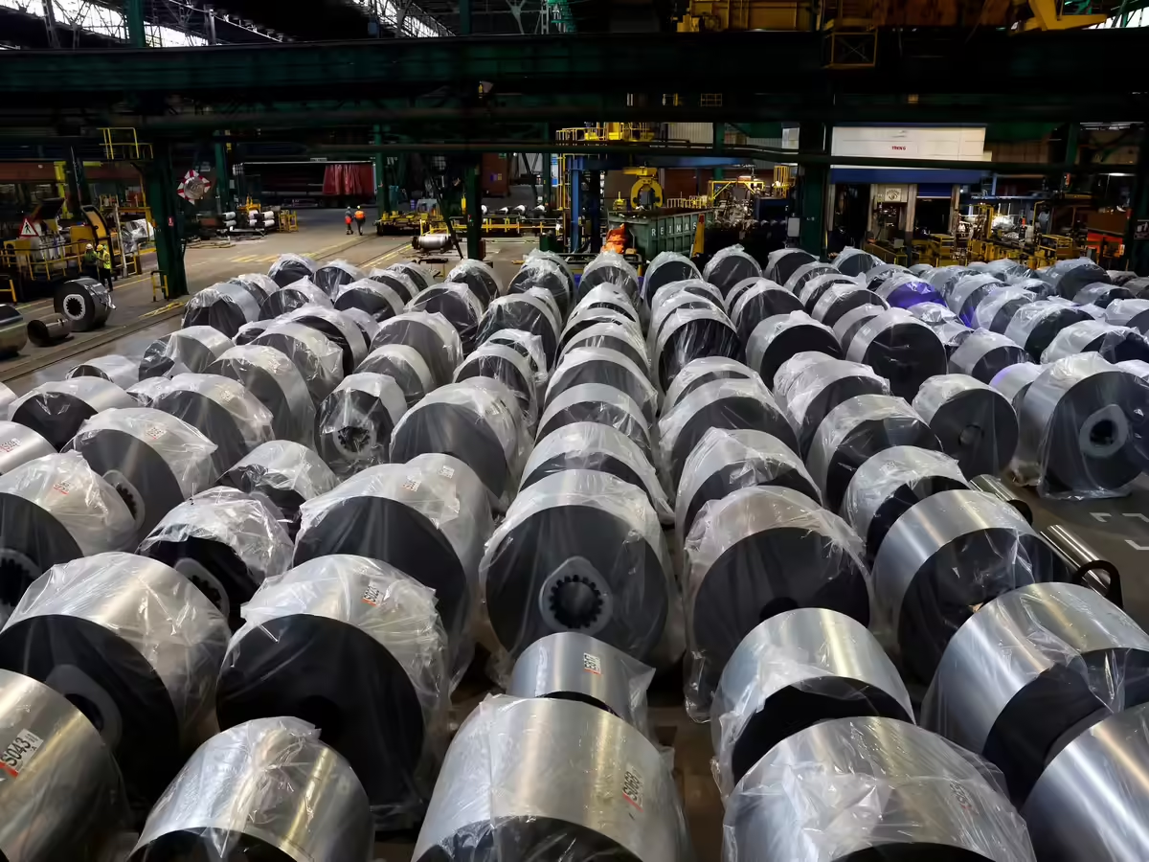
Carbon border adjustment mechanism (CBAM):
Context: The EU implemented the world’s first carbon tax (CBAM) from January 1, 2026, imposing a carbon-related levy on imports of carbon-intensive goods.

Slide 65
About Carbon border adjustment mechanism (CBAM):
Carbon Border Adjustment Mechanism (CBAM) is part of the EU’s “Fit for 55” package targeting a 55% emission reduction by 2030 from 1990 levels.
They are required to purchase CBAM certificates based on emissions.
It ensures imported goods face the same carbon costs as those produced within the EU.
Importers must annually declare the quantity of goods and their embedded GHG emissions.

Slide 66
Certificate prices are linked to the EU’s EU Emissions Trading System (ETS) rates per tonne of CO₂.
Objective: Prevent carbon leakage and protect EU climate goals from high-emission imports.
It promotes cleaner production practices globally by influencing non-EU countries.
It discourages industries from relocating to countries with lax environmental norms.
Revenue generated supports EU climate and green energy initiatives.

Slide 67
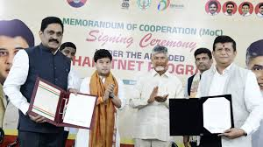
Red Sanders:
Context: National Biodiversity Authority disbursed ₹45 lakh to red sanders farmers from Andhra Pradesh under Access and Benefit Sharing.

Slide 68
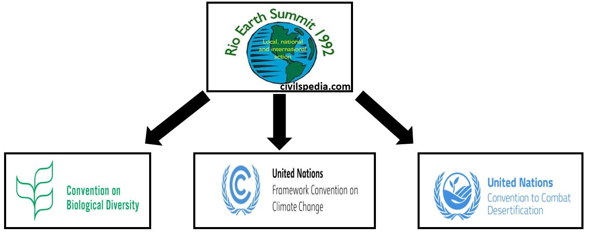
About Access and Benefit Sharing (ABS):
A framework under the Convention on Biological Diversity (1992) and Nagoya Protocol (2010) for fair benefit sharing from genetic resources and traditional knowledge.
In India: governed by the Biological Diversity Act, 2002 and 2025 Access and Benefit Sharing (ABS) Regulations.

Slide 69

United Nations Convention on Biodiversity:
It is an international legally binding convention which entered into force in 1993.
It recognized for the first time, the need for conservation of biological diversity for the welfare of humankind.
The agreement covers all ecosystems, species as well as genetic resources.
The CBD was opened for signature at the Earth Summit(Rio conference/ UNCED), 1992.

Slide 70
Its secretariat is based in Montreal, Canada.
It operates under the UNEP.
All UN member states—with the exception of the United States—have ratified the treaty.
Conference of the Parties (CoP) is the governing body of the Convention, and advances implementation of the Convention. It happens once in every two years.

Slide 71
It has 3 main objectives:
The conservation of biological diversity.
The sustainable use of the components of biological diversity.
The fair and equitable sharing of the benefits arising out of the utilization of genetic resources.

Slide 72
Supplementary agreement to the Convention:
The Cartagena Protocol on Biosafety is an international agreement which aims to ensure the safe handling, transport and use of living modified organisms (LMOs) resulting from modern biotechnology that may have adverse effects on biological diversity, taking also into account risks to human health.
  It was adopted in 2000 and entered into force in 2003.
The Nagoya Protocol- On Access to Genetic Resources and the Fair and Equitable Sharing of Benefits Arising from their Utilization.
  It was adopted in 2010 in Nagoya, Japan, and entered into force in 2014.

Slide 73
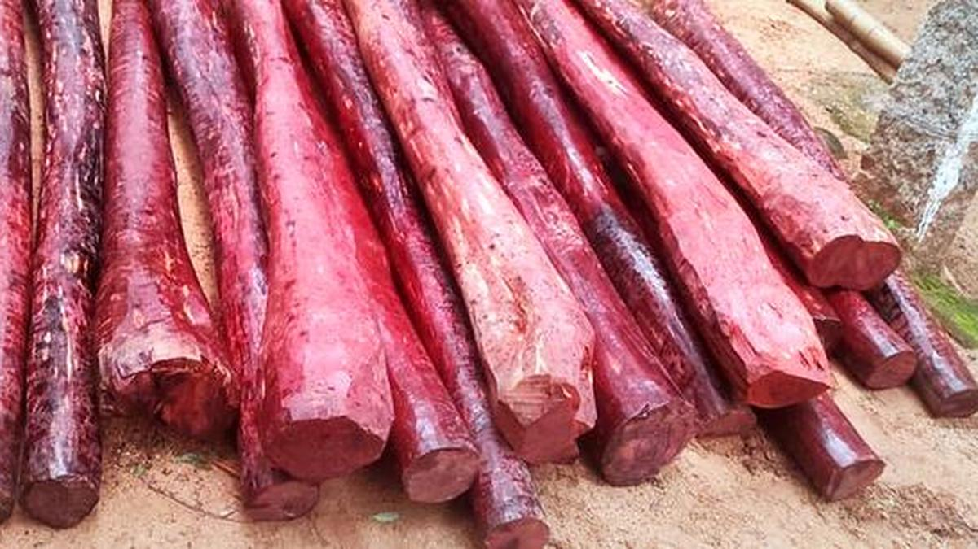
About Red sanders:
Why in News: International Union for Conservation of Nature has reclassified Red Sanders as ‘Endangered’ in its Red List, after it was listed as ‘Near Threatened’ in 2018.
About: Red Sanders (Pterocarpus santalinus) is an endemic tree species of India, mainly found in the Eastern Ghats of Andhra Pradesh.
Habitat: It grows in rocky, degraded, and fallow lands with red soil under hot and dry climatic conditions.

Slide 74
Threats: Major threats include illicit felling for smuggling, forest fires, cattle grazing, and other human-induced pressures.
Uses: It is highly valued for its rich color and medicinal properties, with demand in Asia (especially China and Japan) for cosmetics, medicines, furniture, woodcraft, and musical instruments.
Protection Status: It is listed as ‘Endangered’ in the IUCN Red List, included in CITES Appendix II, and protected under Schedule II of the Wildlife (Protection) Act, 1972.

Slide 75
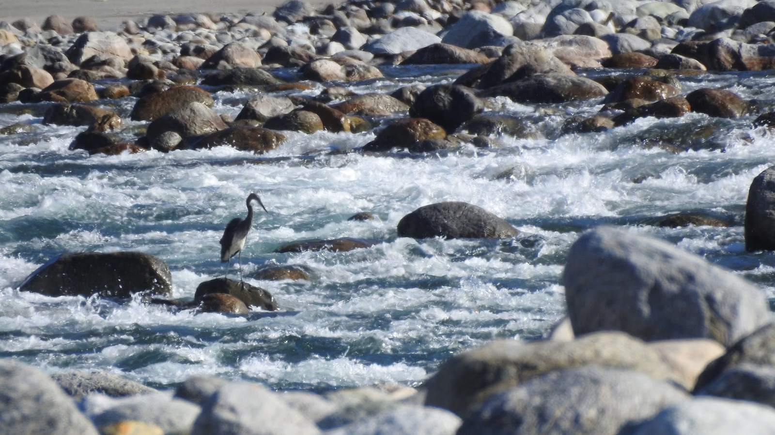
White-bellied heron:
Context: Union Environment Ministry panel has recommended environmental clearance for Kalai-II hydroelectric project on Lohit River in Arunachal Pradesh despite protest to conserve white-bellied heron bird.

Slide 76
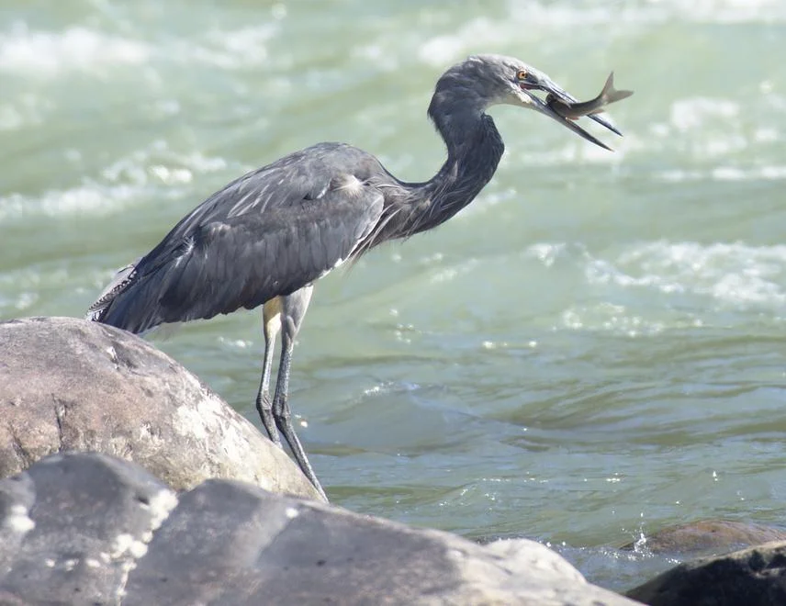
About White-bellied heron:
White-bellied Heron is also known as Imperial Heron or Great White-bellied Heron
It is the second-largest living heron species, distinguished by its prominent white belly
It is largely non-migratory but exhibits local or post-breeding dispersal

Slide 77
It inhabits undisturbed rivers and wetlands in the foothills of the Eastern Himalayas
It is distributed across the Indian subcontinent and Southeast Asia, including India (Arunachal Pradesh, Assam), Bhutan and Bangladesh
It is listed as Critically Endangered on the IUCN Red List
It is placed under Schedule I of the Wildlife Protection Act, 1972 in India

Slide 78
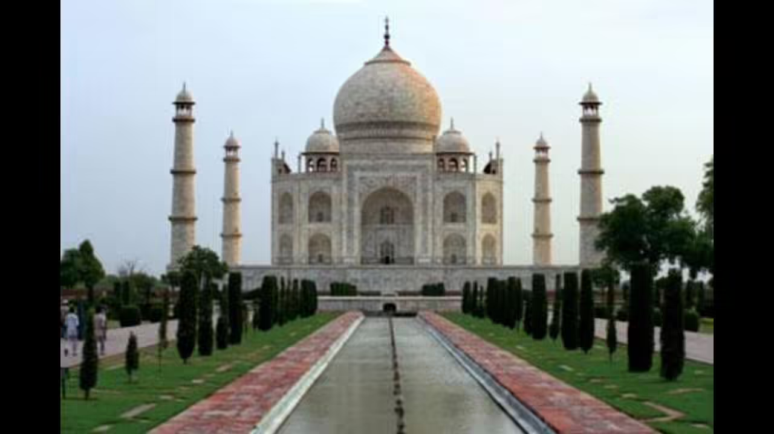
Taj Trapezium Zone (TTZ):
Context: The National Green Tribunal (NGT) notice to centre and UP government highlighted concerns over non-compliance with environmental norms in the protected Taj Trapezium Zone.

Slide 79
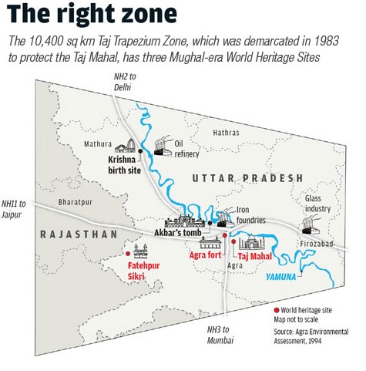
About Taj Trapezium Zone:
Taj Trapezium Zone is a protected eco-sensitive area of about 10,400 sq. km around the Taj Mahal
It was established following the MC Mehta vs Union of India and also covers Agra Fort and Fatehpur Sikri

Slide 80
The Taj Trapezium Zone Pollution (Prevention and Control) Authority was created under the 1996 judgment under the Environment Protection Act to regulate industries, construction, and emissions
Under the MC Mehta vs Union of India, the Supreme Court banned felling of trees within a 5 km aerial distance from the Taj Mahal without prior permission of the Court.

Slide 81
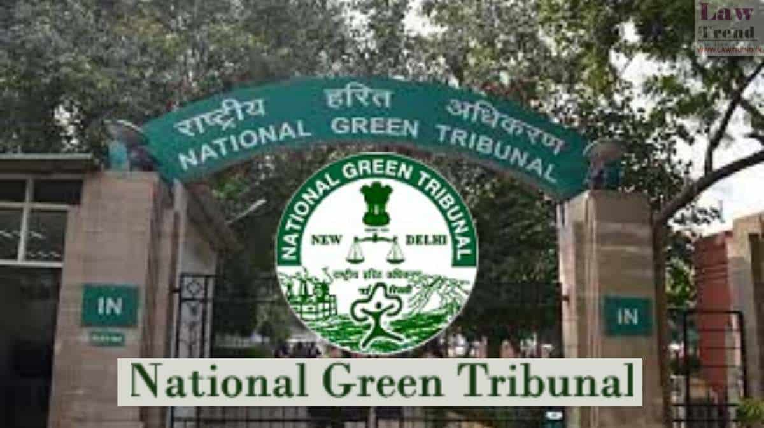
About NGT:
National Green Tribunal is a statutory body established under the National Green Tribunal Act for speedy disposal of environmental cases
It strengthens enforcement and compliance of environmental laws through effective judicial oversight
It covers key laws such as the Environment Protection Act, Water Act, and Air Act
It does not have jurisdiction over the Wildlife Protection Act, Indian Forest Act, and Forest Rights Act

Slide 82

Rangelands and Pastoralists:
Context: United Nations has declared 2026 as ‘International Year for Rangelands and Pastoralists’.

Slide 83
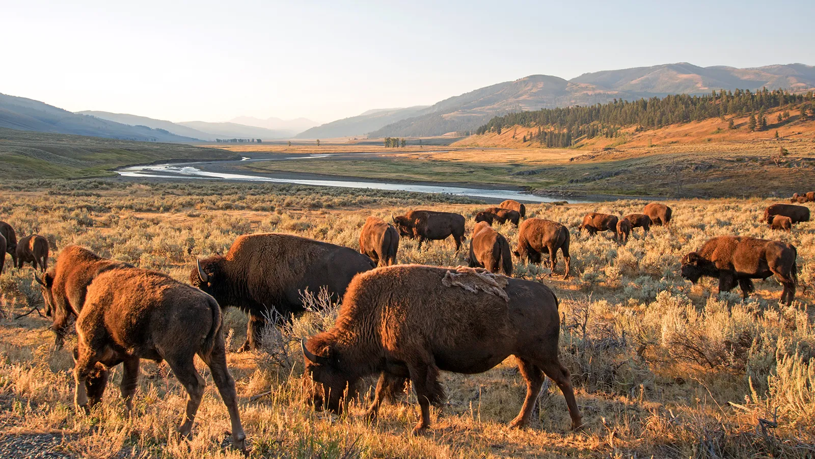
What are rangelands?
The UNCCD report defines rangelands as natural or semi-natural ecosystems that are grazed by livestock or wild animals.
Rangelands contain vegetation such as grasses, shrubs, bushes, open forests, and agroforestry systems.
The exact nature of rangelands’ vegetation is influenced by rainfall, temperature, and other climate phenomena.

Slide 84
Currently, rangelands cover 80 million sq km of Earth’s terrestrial surface area, and are thus the largest land cover or land use type in the world.
In India, rangelands occupy about 1.21 million sq km, from the Thar Desert to Himalayan meadows.

Slide 85
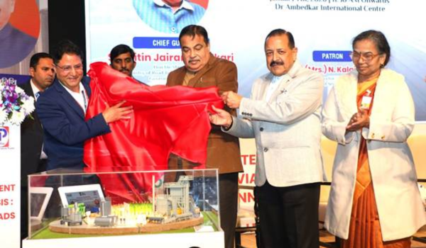
Bio-bitumen:
Context: India has become the first country in the world to commercially produce bio-bitumen in road construction.

Slide 86
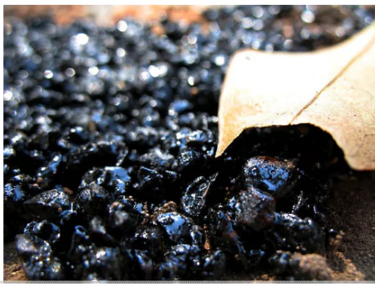
About Bio-bitumen:
Bio-bitumen: An alternative to conventional bitumen produced from organic materials such as agricultural waste, lignin, bio-char and bio-oil.
Bitumen: A black, adhesive substance obtained from the distillation of crude oil

Slide 87
Benefits: Reduces crude oil imports, helps tackle stubble burning, and promotes the bio-economy
Usage: Can be blended with conventional bitumen or used to reduce its proportion in binder mixtures
Applications: Used in road paving and waterproofing works

Slide 88
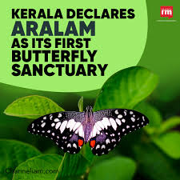
Aralam Butterfly Sanctuary:
Context: The Kerala government has officially renamed the Aralam Wildlife Sanctuary as the Aralam Butterfly Sanctuary.

Slide 89
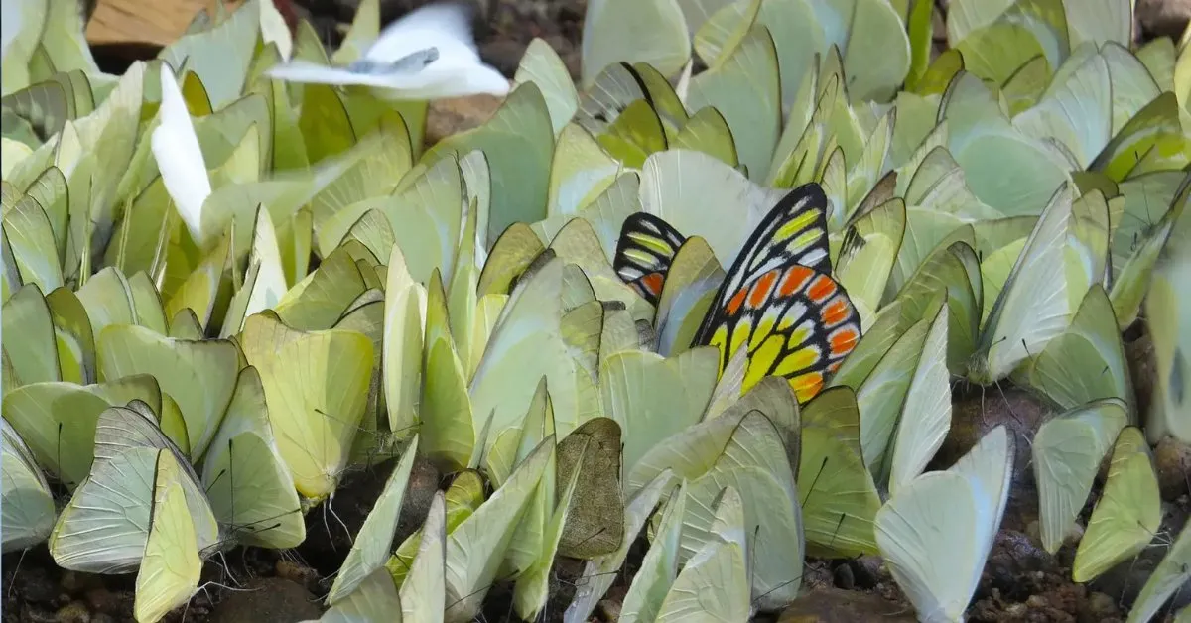
About Aralam Butterfly Sanctuary:
Located on the western slopes of the Western Ghats
It is contiguous with Brahmagiri Wildlife Sanctuary to the north and the forests of Wayanad to the south
It is drained by the Cheenkannipuzha, a tributary of the Valapattanam River
It is a biodiversity hotspot with over 250 butterfly species including Malabar Rose and Southern Birdwing
It supports rich fauna such as elephants, gaur, panther, tiger, sambar and wild boar.’

Slide 90
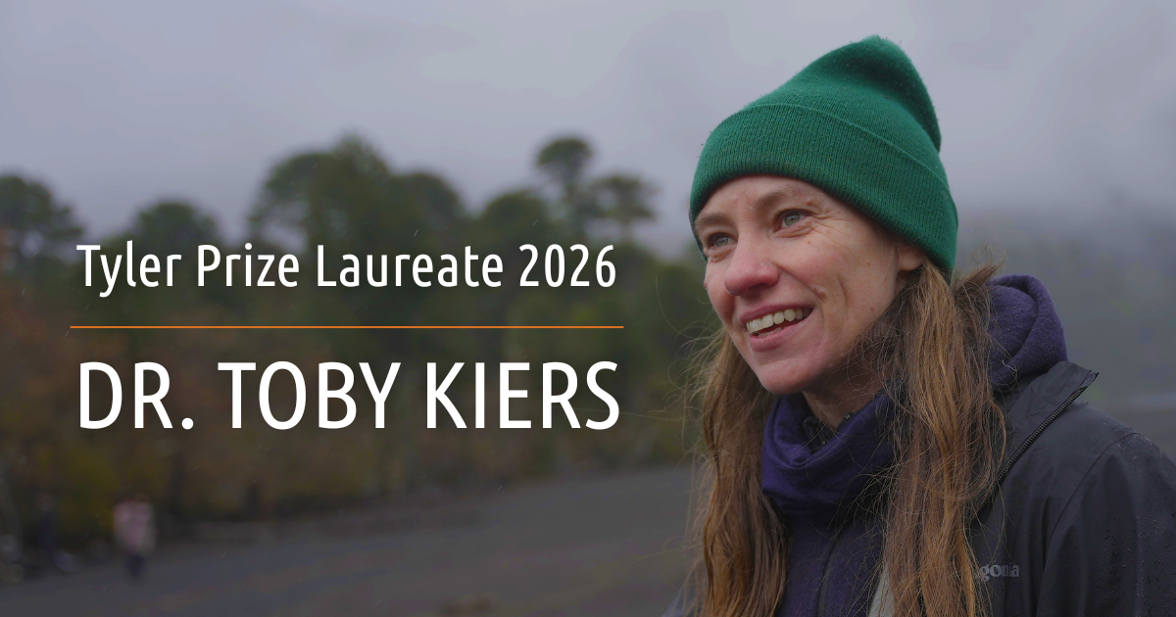
Tyler Prize ("Nobel for the environment"):
Context: American evolutionary biologist Dr. Toby Kiers has been awarded the prestigious 2026 Tyler Prize for Environmental Achievement (often called the "Nobel for the environment") for her pioneering work mapping mycorrhizal fungal networks.

Slide 91
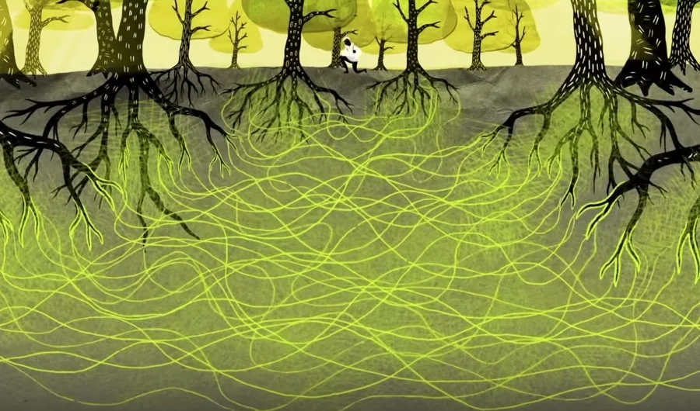
About Mycorrhizal networks:
Mycorrhizal networks: Underground fungal networks where mycorrhizal fungi connect roots of multiple plants through hyphae (thread-like structures)
These fungi form a symbiotic relationship in which plants supply carbohydrates while fungi enhance water and nutrient uptake (especially phosphorus and nitrogen)
The interconnected underground fungal system in forests is popularly called the “Wood Wide Web”

Slide 92
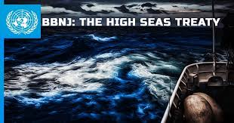
Biological Diversity of Areas Beyond National Jurisdiction (BBNJ):
Context: UN High Seas Treaty comes into force. 83 nations have ratified the treaty. India signed the agreement but is yet to ratify.

Slide 93
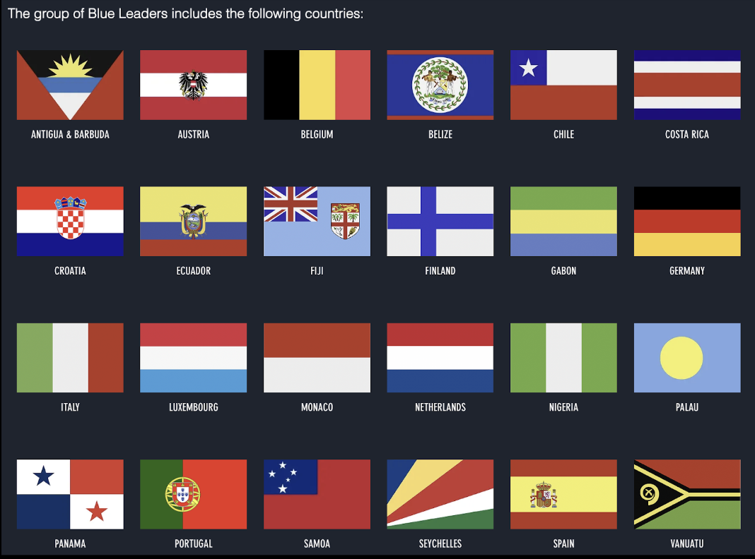
Who are blue leaders?
The Blue Leaders are an ambitious group of countries calling for urgent action to save the global ocean in the face of the climate crisis, overfishing, pollution, and other threats.

Slide 94
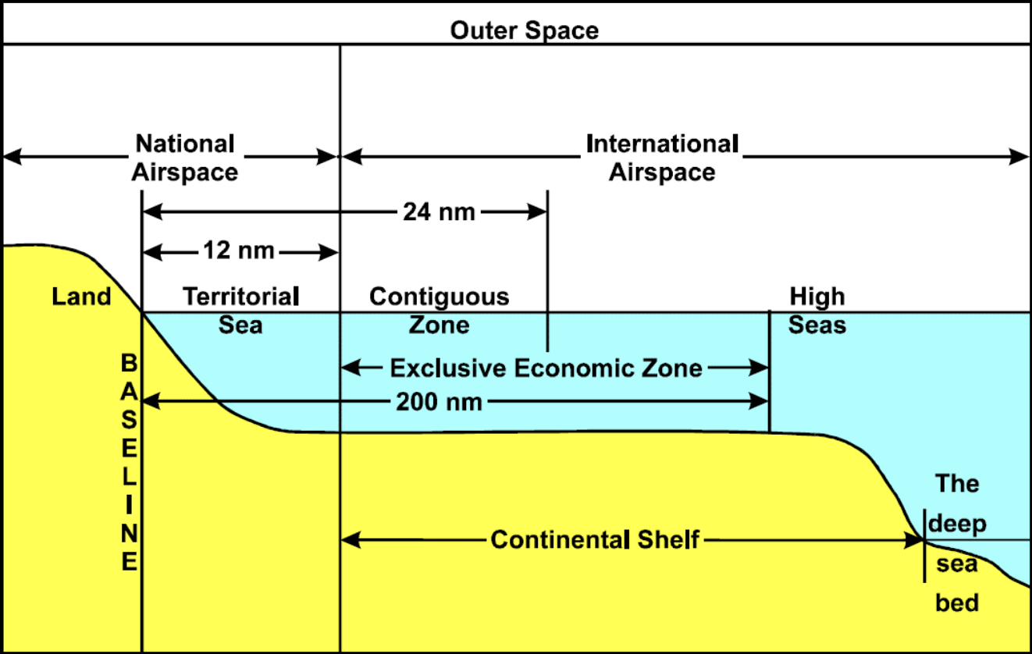
Division of seas:

Slide 95
Territorial Sea | The coastal states have sovereignty and jurisdiction over the territorial sea. These rights extend not only on the surface but also to the seabed, subsoil, and even airspace. But the coastal states’ rights are limited by the innocent passage through the territorial sea.
Contiguous Zone | The coastal state has the right to both prevent and punish infringement of fiscal, immigration, sanitary, and customs laws within its territory and territorial sea. Unlike the territorial sea, the contiguous zone only gives jurisdiction to a state on the ocean’s surface and floor. It does not provide air and space rights.

Slide 96
Exclusive Economic Zone (EEZ): | Within its EEZ, a coastal state has: Sovereign rights for the purpose of exploring, exploiting, conserving and managing natural resources, whether living or nonliving, of the seabed and subsoil. Rights to carry out activities like the production of energy from the water, currents and wind.
High Seas: | It is considered as “the common heritage of all mankind” and is beyond any national jurisdiction. States can conduct activities in these areas as long as they are for peaceful purposes, such as transit, marine science, and undersea exploration.

Slide 97
The Blue Leaders are committed to two major goals:
Securing a new international target to protect at least 30% of the global ocean through a network of highly and fully protected marine areas by 2030.​​
The rapid and successful conclusion of a new High Seas Treaty that provides for establishment of fully and highly protected marine areas in the high seas and strengthens management of human activities outside protected areas.

Slide 98
What is the Biodiversity Beyond National Jurisdiction treaty(BBNJ)Treaty?
BBNJ treaty commonly referred to as the Treaty of the High Seas was agreed upon in March 2023 for the conservation and sustainable use of marine biological diversity in areas beyond national jurisdiction.
The treaty aims to address the challenges faced by the high seas, which constitute areas beyond 200 nautical miles from the exclusive economic zones of coastal countries.

Slide 99
The treaty seeks to increase the percentage of protected areas on the high seas, which currently stands at a mere 1.44%, despite covering more than two-thirds of the global ocean.
Additionally, it aims to ensure fair and equitable sharing of profits from marine genetic resources (MGR)
India has signed but not ratified the treaty.

Slide 101
Science and Technology:

Slide 102
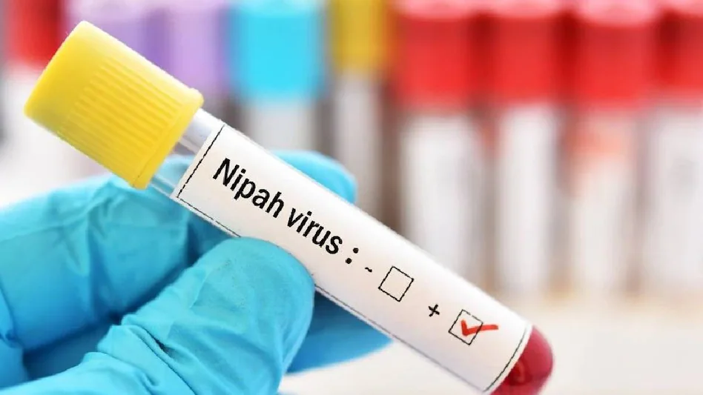
Nipah Virus:
Context: Two Nipah Virus Disease Cases Reported in West Bengal Since Last December: NCDC.

Slide 103


Slide 104
About Nipah virus:
Nipah virus infection is a zoonotic illness that is transmitted via animals to humans.
The organism which causes Nipah Virus encephalitis is an RNA or Ribonucleic acid virus of the family Paramyxoviridae.
It was first broke out in Malaysia and Singapore in 1998 and 1999.

Slide 105
It first appeared in domestic pigs and has been found among several species of domestic animals including dogs, cats, goats, horses and sheep.
The disease spreads through fruit bats or ‘flying foxes,’ who are natural reservoir hosts of the Nipah.
There is no definitive treatment available for the virus.

Slide 106

Stem Cell therapy:
Context: Stem cell therapy cannot be offered as a clinical service for autism: Supreme Court.

Slide 107
What the Supreme Court said?
The Supreme Court ruled that stem cell therapy for Autism Spectrum Disorder (ASD) cannot be offered as a clinical treatment, except within approved and monitored clinical trials.
Citing lack of scientific evidence, safety concerns, and ethical violations, the Court held that such therapies fail the reasonable standard of medical care and that even patient consent is invalid due to inadequate information.
It directed the Union government to set up a dedicated regulatory authority to oversee stem cell research and curb unproven, exploitative practices.

Slide 108

What is Autism?
Autism spectrum disorder is a neurological and developmental disorder that affects how people interact with others, communicate, learn, and behave.

Slide 109


Slide 110


Slide 111


Slide 112

‘Param Shakti’:
Context: Ministry of Electronics and Information Technology (MeitY) launched ‘Param Shakti’ at Indian Institute of Technology Madras.

Slide 113
About ‘Param Shakti’:
Param Shakti: An indigenously developed 3.1 Petaflop supercomputing system in India
It is among the most powerful computational systems available in Indian academic institutions
It is built using Centre for Development of Advanced Computing RUDRA series of servers
It operates on an open-source software stack including AlmaLinux
Significance: Supports advanced research in aerospace engineering, materials science, climate modelling, drug discovery and advanced manufacturing.

Slide 114

Aditya L-1:
Context: ISRO's Aditya-L1 decoded the Impact of Powerful Solar Storm on Earth’s Invisible Magnetic Shield.

Slide 115

About Aditya-L1:
It is India’s first space-based solar mission to study the Sun. It was launched on September 2, 2023.
It was launched into a halo orbit around the Sun-Earth Lagrange point 1 (L1).

Slide 116
Aditya-L1 would provide an uninterrupted view of the Sun for prolonged periods.
Aditya-L1 launched using a PSLV XL launch vehicle.
It aims to establish a solar observatory at a halo orbit around the L1 lagrangian point of the Sun-Earth system.

Slide 117
It carries seven payloads to examine the Sun's properties using visible and X-ray spectrometers.
This multi-wavelength observation capacity will probe the Sun's corona, the chromosphere, the photosphere, flares and coronal mass ejections.

Slide 118

About Lagrangian Point 1 or L1:
It is one of the gravitationally stable points in space where the gravitational forces of two large bodies, like the Sun and Earth, balance out.
It is located about 1.5 million km from Earth towards the Sun.
It provides an uninterrupted view of the Sun without any eclipses or occultations.

Slide 119

Voyager 1:
Context: Voyager 1 is expected to become the first human-made object to reach a distance of one light-day from Earth. One light-day is the distance that light travels in 24 hours, which is about 16 billion miles away.

Slide 120

About Voyager 1:
Voyager 1 was launched in 1977 by NASA to conduct flybys of Jupiter and Saturn
It carried instruments such as the Imaging Science System (ISS) and Ultraviolet Spectrometer (UVS)
It became the first spacecraft to cross the heliosphere, the boundary where interstellar influences dominate over the Sun
It is the first human-made object to enter interstellar space

Slide 121

‘TeraWave’ communications network:
Context: Blue Origin to deploy thousands of satellites for the new ‘TeraWave’ communications network.

Slide 122

About ‘TeraWave’ communications network:
TeraWave Communications Network: A hybrid satellite constellation comprising 5,408 satellites across low Earth orbit (LEO) and medium Earth orbit (MEO)
It delivers symmetrical bandwidth using a combination of radio frequency and optical connectivity

Slide 123
Optical connectivity transmits data using light pulses through fiber optics or free space instead of electrical signals
It uses modulation of light waves to enable high-speed, high-bandwidth and low-latency communication
Target Users: Focused on enterprise, government and data centre clients for reliable critical connectivity

Slide 125
Other News:

Slide 126

Vande Mataram:
Context: Ministry of Culture to Present Republic Day Tableau 2026 on ‘150 Years of Vande Mataram’

Slide 127

About Vande Mataram:
The 150-year celebrations of Vande Mataram were inaugurated by Narendra Modi on 7 November 2025.
The song was composed by Bankim Chandra Chatterjee on Akshaya Navami, 7 November 1875.
It was first published in Bangadarshan and later included in the novel Anandamath (1882).

Slide 128
The music for Vande Mataram was composed by Rabindranath Tagore.
The song symbolizes unity, sacrifice, and devotion to the motherland.
The first two verses were adopted as the National Song in 1937 by the Indian National Congress.

Slide 129
On 24 January 1950, Rajendra Prasad declared it would be honoured equally with the National Anthem Jana Gana Mana.
Though not mentioned in the Constitution, Article 51A(a) emphasizes respect for national symbols.
Vande Mataram became a powerful slogan of resistance against British colonial rule.

Slide 130
In 1896, Rabindranath Tagore first sang it at the Kolkata session of the Congress.
The English daily Bande Mataram was started in 1906 by Bipin Chandra Pal, later joined by Sri Aurobindo.
The song became a rallying cry during the Partition of Bengal and the Swadeshi Movement.
It was first used as a political slogan on 7 August 1905 in Calcutta protests.

Slide 131

GI-tagged "Kaladi":
Context: Udhamapur’s GI-tagged "Kaladi" to be upscaled for diverse food recipes using advanced food technologies: Dr. Jitendra Singh.

Slide 132
What are GI tags?
A GI is a sign used on products that have a specific geographical origin and possess qualities or a reputation that are due to that origin.
The GI tag ensures that only the authorised users or those residing in the geographical territory are allowed to use the popular product name.
GI registration is overseen by the Department for Promotion of Industry and Internal Trade under the Ministry of Commerce and Industry.

Slide 133
India, as a member of the World Trade Organization (WTO), enacted the Geographical Indications of Goods (Registration and Protection) Act, 1999 w.e.f. September 2003.
GIs have been defined under Article 22 (1) of the WTO Agreement on Trade-Related Aspects of Intellectual Property Rights (TRIPS) Agreement.

Slide 134
The tag stands valid for 10 years.
Uttar Pradesh is the leading state in India with the highest number of GI-tagged products, having surpassed 75 registrations.
The Geographical Indications Registry is located at Chennai.

Slide 135


GI Tags in A.P:

Slide 136


GI Tags in Telangana:

Slide 137

‘Parakram Diwas–2026’:
Context: Ministry of Culture to Organize ‘Parakram Diwas–2026’ to Commemorate 129th Birth Anniversary of Netaji Subhas Chandra Bose.

Slide 138

About Parakram Diwas:

Slide 139
Parakram Diwas is observed annually from 2021 to commemorate the birth anniversary of Netaji Subhas Chandra Bose.
The word “Parakram” means courage or valour, symbolising Netaji’s fearless leadership and sacrifice.
The day honours Netaji’s role in India’s freedom struggle and the legacy of the Azad Hind Fauj (INA).
Parakram Diwas 2026, the theme "Netaji: Courage, Determination and Patriotism".
It is organised by the Ministry of Culture in coordination with its allied institutions.

Slide 140

Granth Kutir:
Context: President of India inaugurates Granth Kutir at Rashtrapati Bhavan.

Slide 141

About Granth Kutir:
Granth Kutir is a cultural repository showcasing India’s literary, philosophical, and civilisational heritage.
It houses around 2,300 books in 11 classical Indian languages, reflecting rich linguistic diversity.
On 3 October 2024, the Government of India granted Classical Language status to Marathi, Pali, Prakrit, Assamese, and Bengali.
The collection covers subjects like epics, philosophy, history, science, governance, linguistics, and devotional literature.

Slide 142

The Ministry of Education and Ministry of Culture support the initiative.
The Indira Gandhi National Centre for the Arts provides expertise in conservation and documentation.

