Slide 1
January 2026
Current Affairs

Slide 2
Economy:

Slide 3
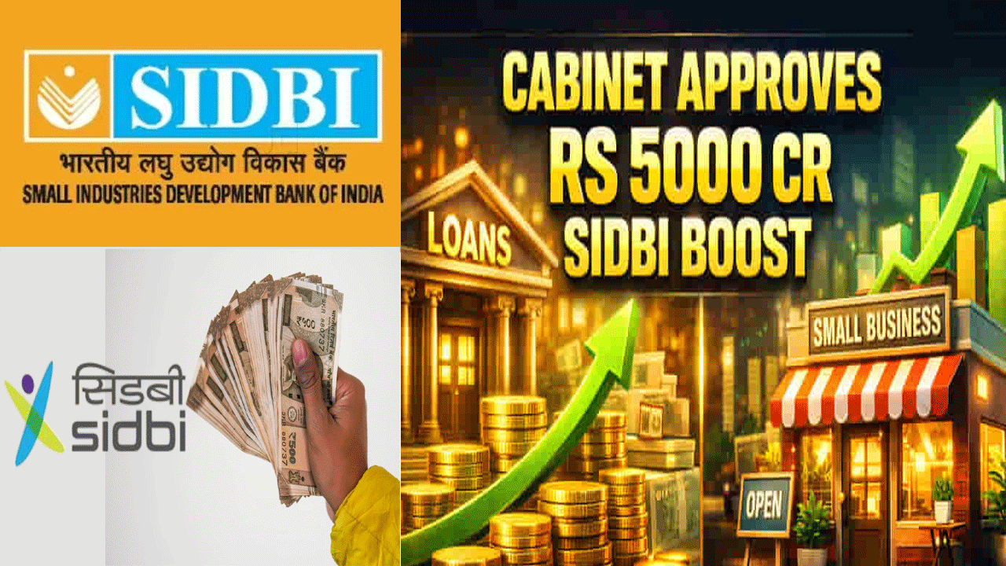
Small Industries Development Bank of India (SIDBI):
Context: Cabinet approves equity support to Small Industries Development Bank of India.

Slide 4
Developments:
The Union Cabinet approved ₹5,000 crore equity support to Small Industries Development Bank of India.
₹3,000 crore will be infused in FY 2025–26 at a book value of ₹568.65 per share (as on 31.03.2025).
₹1,000 crore will be infused in FY 2026–27 at the book value as on 31.03.2026.
₹1,000 crore will be infused in FY 2027–28 at the book value as on 31.03.2027.
The equity infusion aims to strengthen SIDBI’s capital base to enhance financing support for MSMEs.

Slide 5
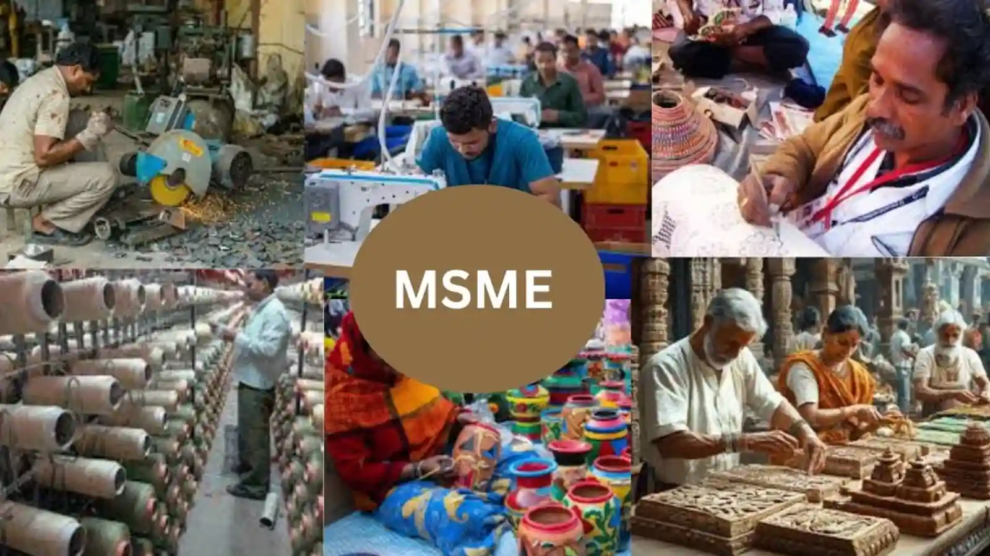
About SIDBI:
Small Industries Development Bank of India is the apex financial institution for promotion, financing, and development of the MSME sector in India.
It operates under the Ministry of Finance and is headquartered in Lucknow with offices across the country.
SIDBI was established on 2 April 1990 under an Act of Parliament as a wholly owned subsidiary of Industrial Development Bank of India (IDBI) Bank.
It was delinked from IDBI Bank on 27 March 2000 to function as an independent institution.

Slide 6
SIDBI provides refinance support to banks and financial institutions to boost MSME lending.
It offers term loans and working capital finance directly to industries.
It promotes rural enterprises and entrepreneurship development.
It provides financial assistance to banks, Small Finance Banks, and NBFCs.
SIDBI also directly lends to MSMEs in addition to its refinance operations.

Slide 7
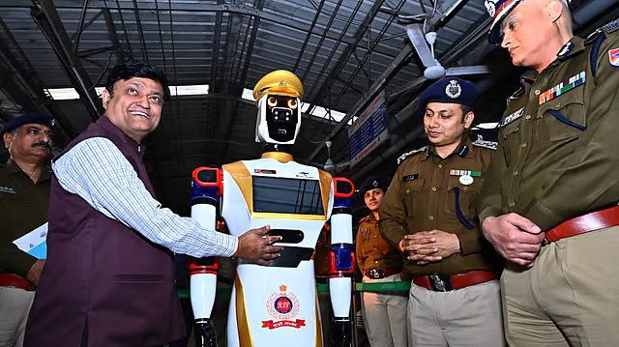
Advanced Security Control - Automatic Retrieval & Joint Unified Node (ASC ARJUN):
Context: Indian Railways Deploys Humanoid Robot ‘ASC ARJUN’ at Visakhapatnam Railway Station.

Slide 8
About ASC ARJUN:
First-ever deployment of a humanoid robot on the Indian Railways network for station security and passenger assistance
Deployed to work alongside Railway Protection Force (RPF) personnel, especially during peak passenger movement
Fully indigenously designed and developed in Visakhapatnam using home-grown technology
Equipped with Face Recognition System (FRS) for intrusion detection and suspect identification

Slide 9

Uses AI-based crowd monitoring with real-time alerts to RPF control rooms
Capable of automated public announcements in English, Hindi and Telugu
Features semi-autonomous navigation, predefined patrol paths and obstacle avoidance
Enables round-the-clock platform patrolling, optimising human manpower deployment
Integrated fire and smoke detection systems for early emergency response

Slide 10
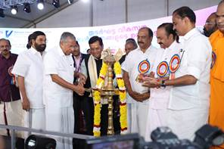
Vizhinjam International Seaport:
Context: Shri Sarbananda Sonowal Inaugurates Capacity Augmentation Works of Vizhinjam International Seaport in Kerala.

Slide 11
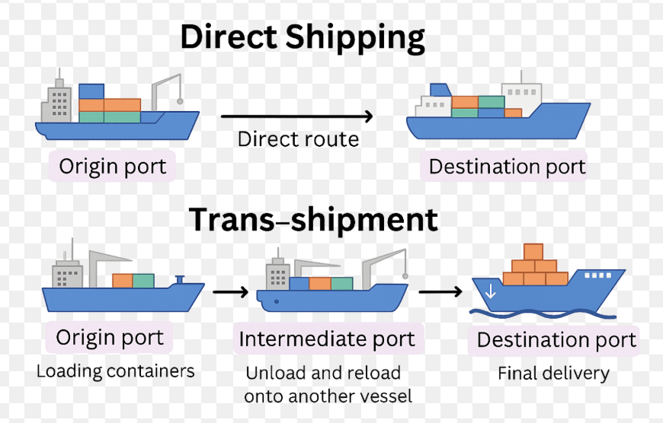
About Vizhinjam seaport:
It is a transshipment deepwater multipurpose seaport project was built by Adani Ports and SEZ Private Limited in Vizhinjam near Thiruvananthapuram, Kerala.
Vizhinjam port is India’s first international deepwater transshipment port.
The port is designed to handle container transshipment, multi-purpose, and break-bulk cargo.

Slide 12
It is strategically located just ten nautical miles from the international shipping route.
The port has minimal littoral drift and requires minimal maintenance dredging, reducing operational costs.
The port boasts a natural depth of more than 18 meters, which can be further scaled up to 20 meters.

Slide 13
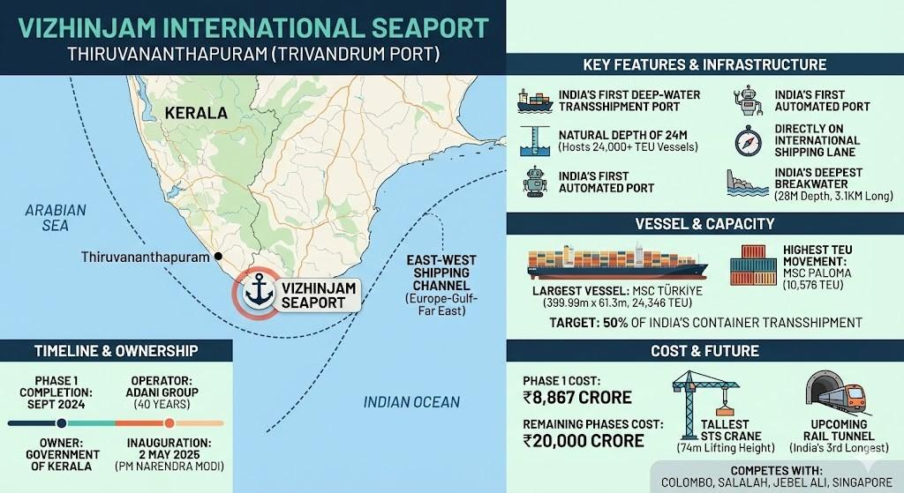

Slide 14
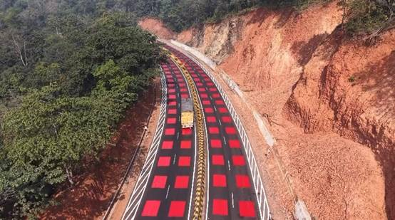
Steel Slag Road Technology:
Context: CSIR-CRRI and JSW Steel, Salem Partner to Build Steel Slag Roads in Tamil Nadu.

Slide 15
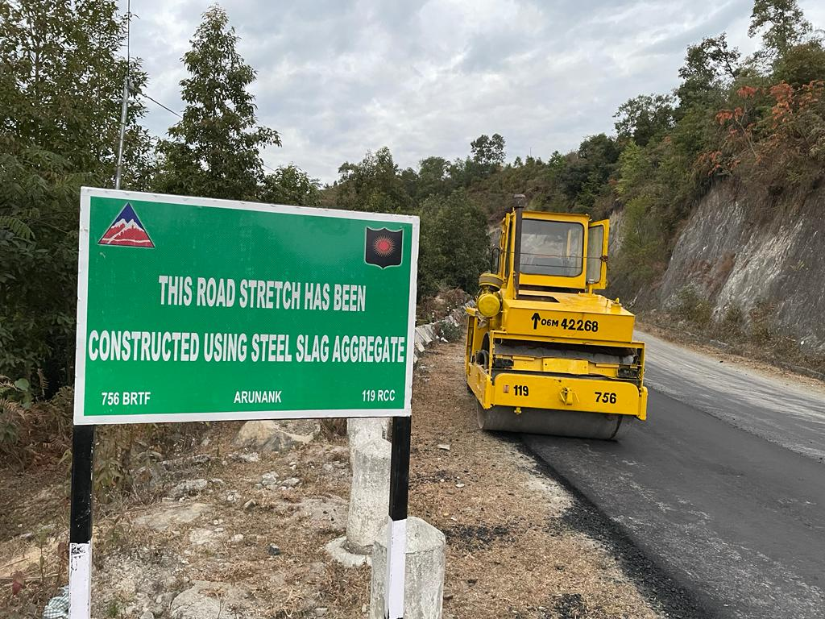
About Steel Slag Road Technology:
Steel slag is an industrial byproduct generated during steel manufacturing.
It is produced in large quantities in electric arc furnaces and basic oxygen furnaces.
It mainly contains silicates and oxides of calcium, magnesium, manganese, and aluminium.
The cooling process determines the type and properties of slag for various uses.

Slide 16

Steel Slag Road Technology uses processed steel slag as aggregate in road base and sub-base layers.
Impurities and residual metal are removed before its use in construction.
It provides high strength, hardness, abrasion resistance, skid resistance, and good drainage.

Slide 17
It enables large-scale utilization of steel waste, reducing environmental concerns.
It helps manage around 19 million tonnes of steel slag generated annually in India.
Roads built with steel slag are more durable and robust than those using conventional materials.

Slide 18
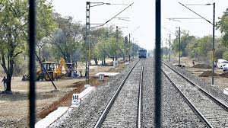
‘Kavach’ system:
Context: The Indian Railways Institute of Signal Engineering and Telecommunications (IRISET) is in the process of signing a pact with the Indian Space Research Organisation (ISRO) to further technological exploration in ‘Kavach’, the indigenously developed Automatic Train Protection (ATP) system.

Slide 19
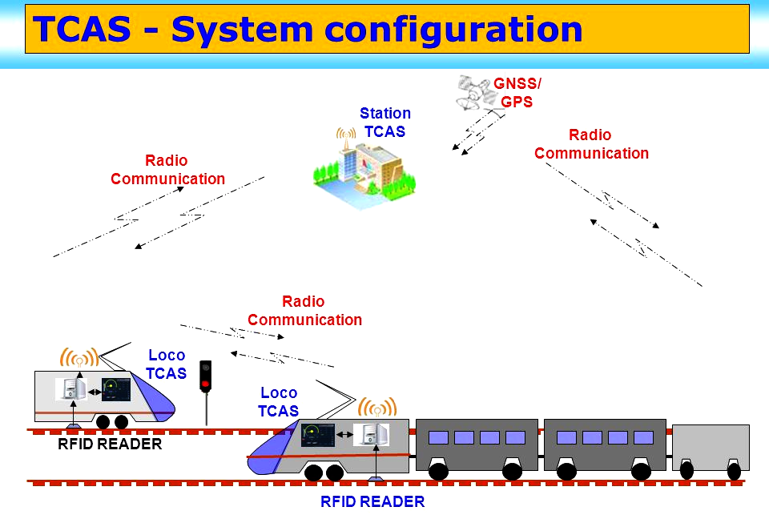
What is Kavach system?
It is an indigenously developed Automatic Train Protection (ATP) system.
Kavach was developed by the Research Design and Standards Organisation (RDSO) under Indian Railway (IR).

Slide 20
It is a set of electronic devices and Radio Frequency Identification devices installed in locomotives, in the signalling system as well the tracks.
It enables to talk to each other using ultra-high radio frequencies to control the brakes of trains and also alert drivers.
Trials are facilitated by SCR.

Slide 21
Application:
Assist locomotive pilots in avoiding Signal Passing At Danger (SPAD).
Can alert the loco pilot, take control of the brakes and bring the train to a halt.
Controls the speed of the train by an automatic application of brakes in case the loco pilot fails to do so.
Helps the loco pilot in running the train during inclement weather conditions

Slide 22
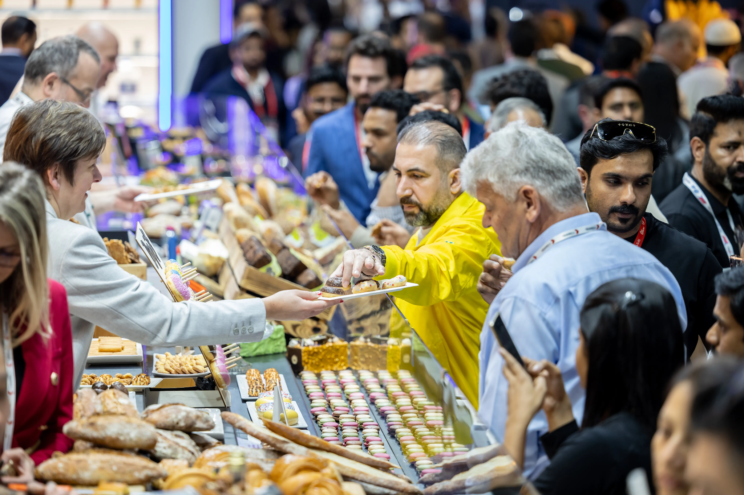
BHARATI initiative, Bharat’s Hub for Agritech, Resilience, Advancement and Incubation for Export Enablement:
Context: India’s participation as Country Partner at Gulfood 2026 reflects the nation’s commitment to delivering high-quality, safe, sustainable, and innovative food products to global markets.
Another significant highlight of India’s participation at Gulfood 2026 is the presence of eight startups under APEDA’s BHARATI initiative, Bharat’s Hub for Agritech, Resilience, Advancement and Incubation for Export Enablement.

Slide 23
About Gulfood 2026:
Gulfood 2026 is the world’s largest annual food and beverage trade exhibition and sourcing event, bringing together key players from the global food industry.
It runs from 26 to 30 January 2026 in Dubai, United Arab Emirates.
For the first time in its history, Gulfood spans two major venues simultaneously—Dubai World Trade Centre and the Dubai Exhibition Centre at Expo City Dubai—doubling floor space and enabling broader global participation and networking.

Slide 24
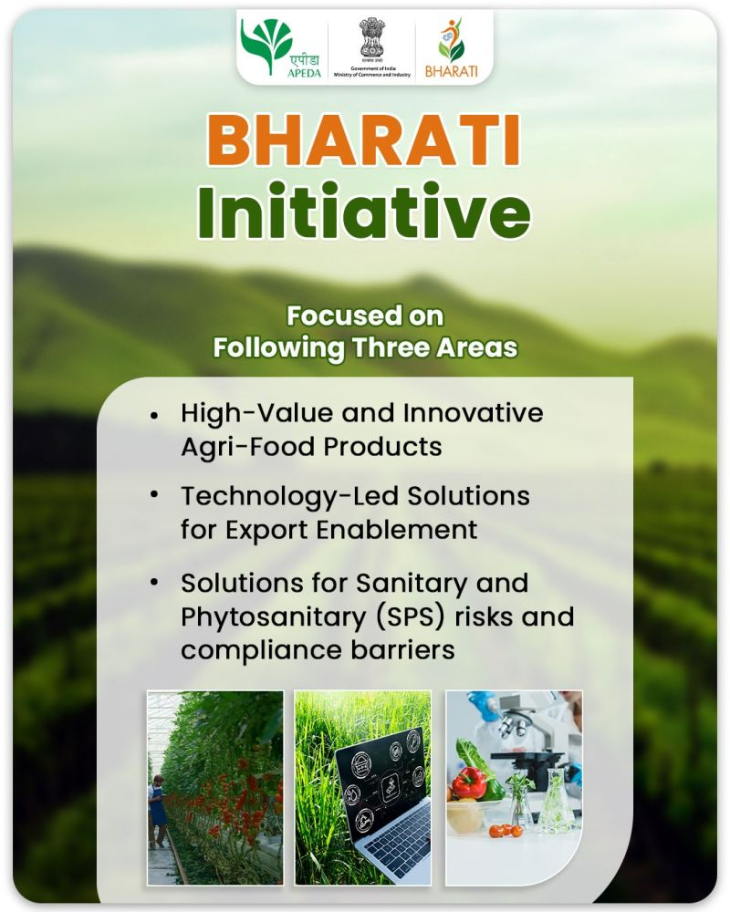
About BHARATHI initiative:
Agricultural and Processed Food Products Export Development Authority has launched BHARATI to support agri-food startups and boost India’s agri-food exports.
Aims to support 100 agri-food startups and achieve $50 billion exports by 2030.
Provides a 3-month acceleration programme for startups on product development, export readiness, and market access.

Slide 25
Attracts startups using AI, blockchain, IoT, and agri-fintech technologies.
Promotes innovation in GI-tagged, organic, superfoods, livestock, and AYUSH products.
Seeks to resolve export challenges like quality, perishability, wastage, and logistics.

Slide 26
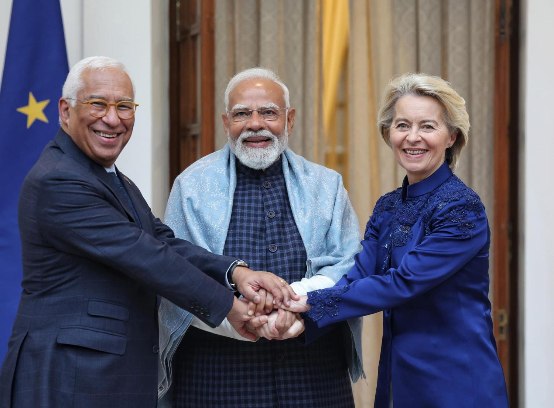
INDIA AND EUROPEAN UNION TRADE AGREEMENT “MOTHER OF ALL DEALS”
Context: India and the European Union (EU) announced the conclusion of negotiations for a Free Trade Agreement (FTA), an important milestone in one of India’s most strategic economic partnerships.

Slide 27
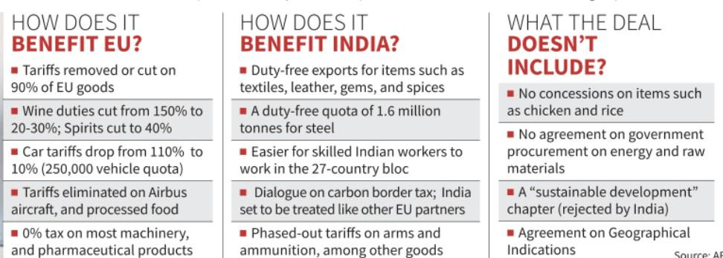

Slide 28
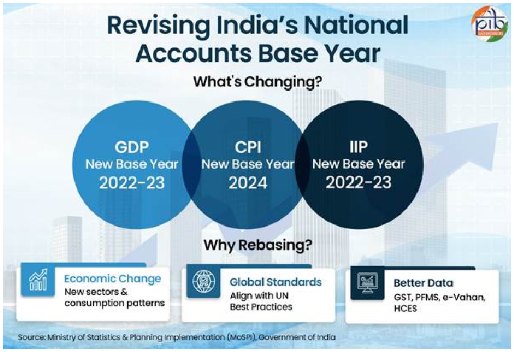
New GDP calculation methodology:
Context: GDP new methodology.

Slide 29
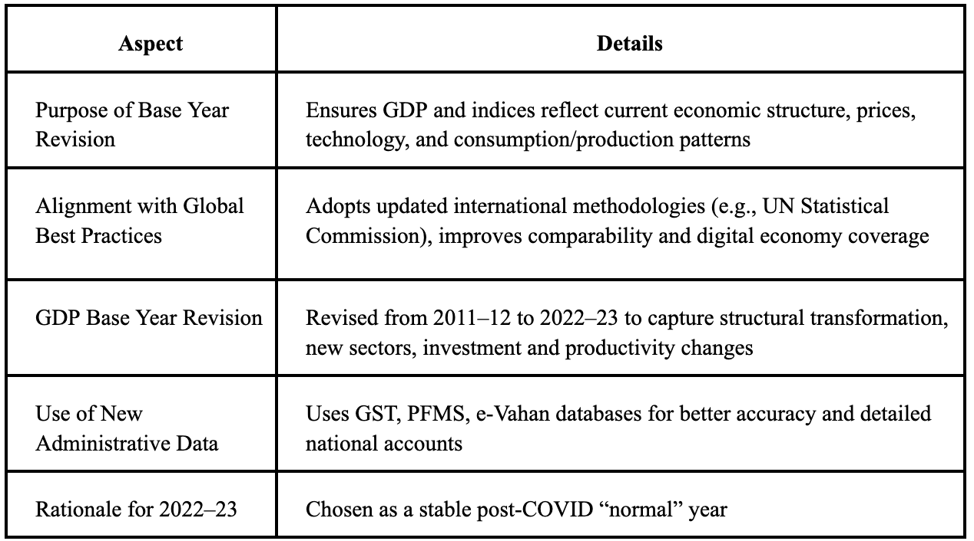

Slide 30
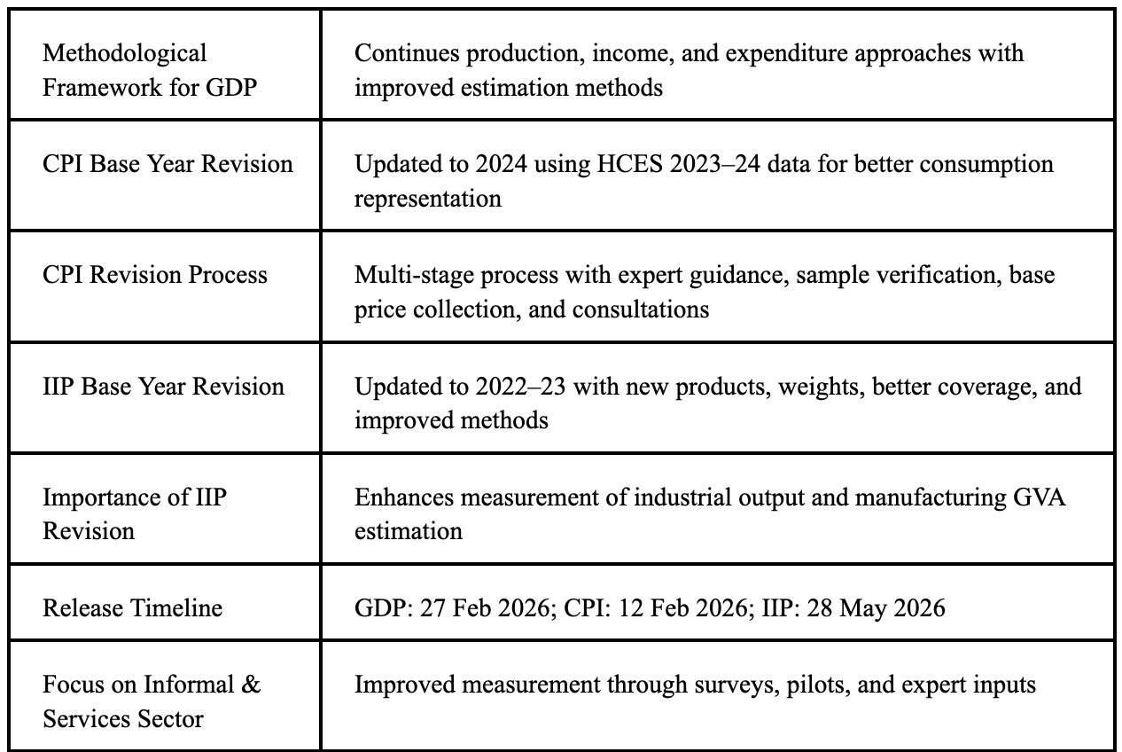

Slide 32
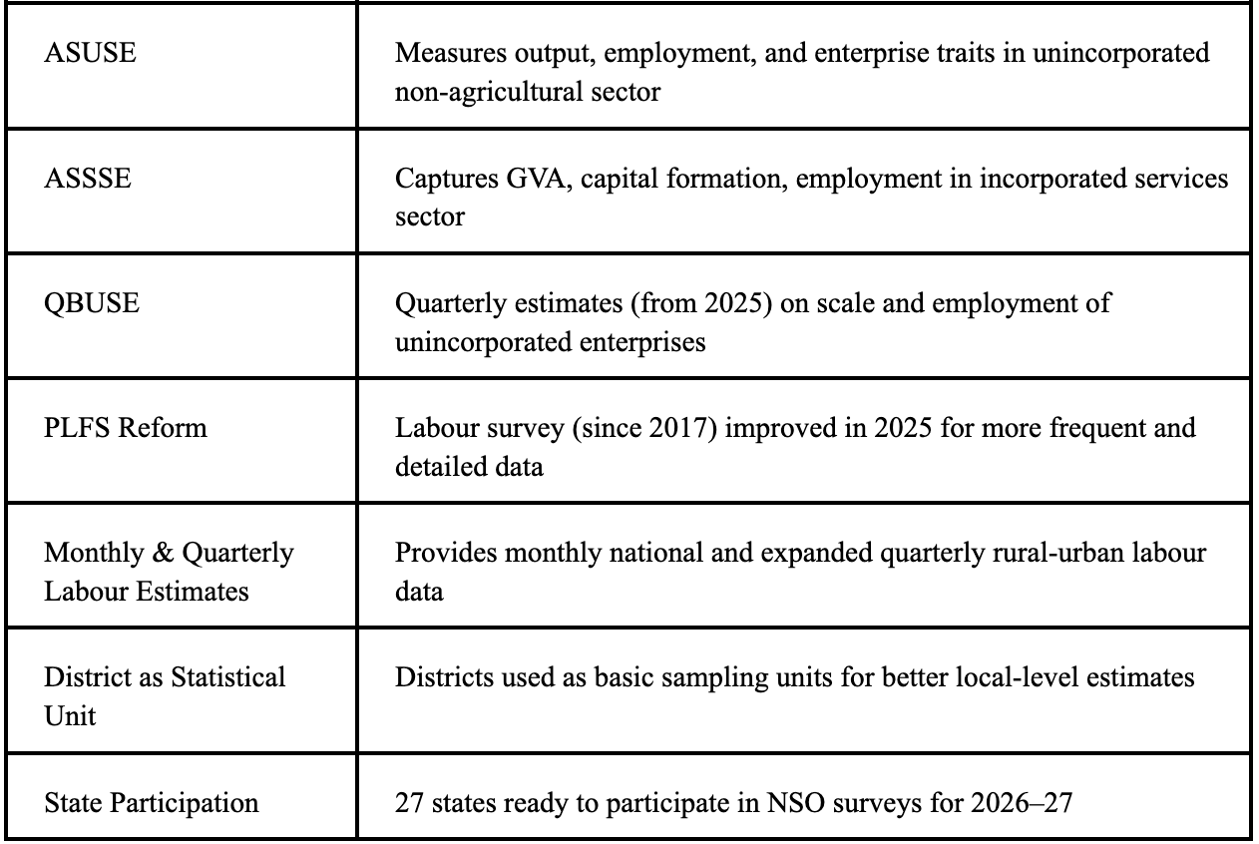

Slide 33

Coking Coal:
Context: Government Notifies Coking Coal as Critical & Strategic Mineral under MMDR Act, 1957.

Slide 34
More about:
Government of India has classified coking coal as a Critical and Strategic Mineral under the MMDR Act, 1957.
India has ~37.37 billion tonnes of coking coal resources, mainly in Jharkhand.
Additional reserves exist in Madhya Pradesh, West Bengal, and Chhattisgarh.

Slide 35
More about:
Coking coal imports increased from 51.20 MT (2020–21) to 57.58 MT (2024–25).
Around 95% of steel sector demand is met through imports.
High import dependence leads to significant foreign exchange outflow.

Slide 36
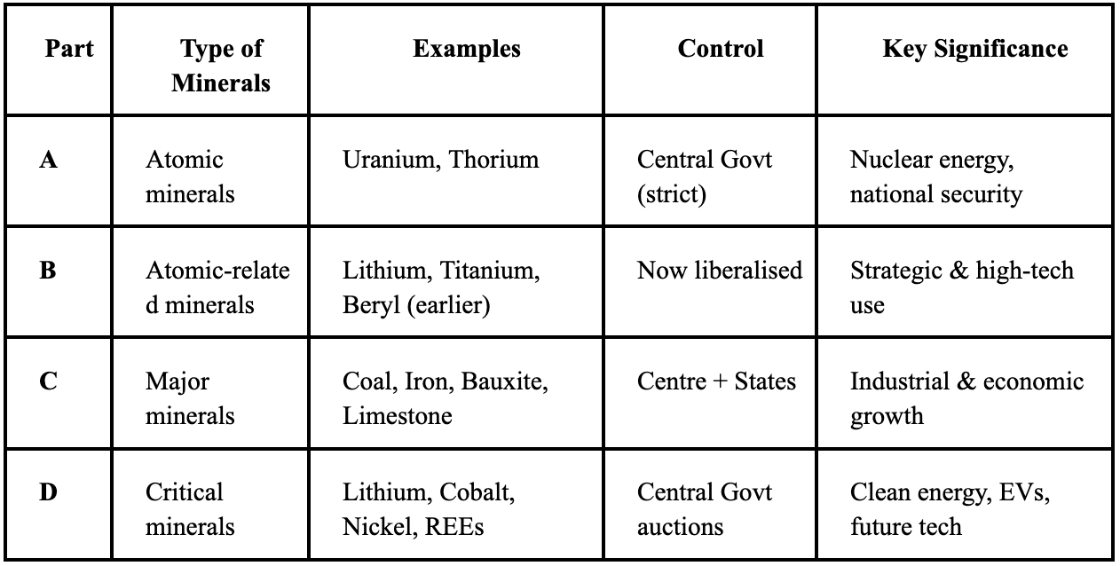
MMDR Act amended under Section 11C to include coking coal as a critical mineral.
“Coal including coking coal” added to Part A; “Coking coal” listed under Part D.
Notification enables faster approvals and ease of doing business in mining.
Promotes accelerated exploration, including deep-seated deposits.

Slide 37
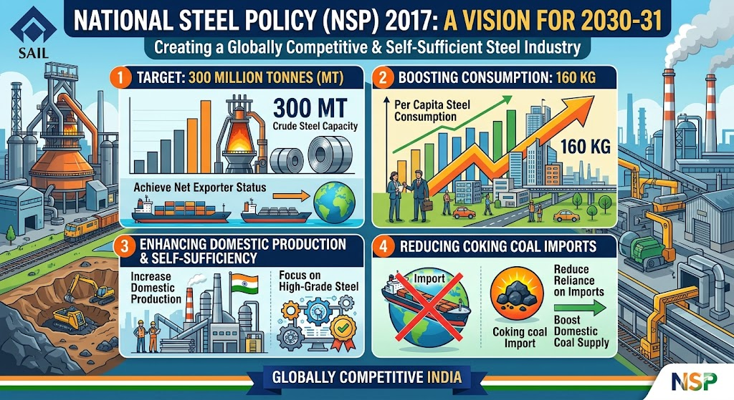
Critical mineral mining exempted from public consultation requirements.
Allows use of degraded forest land for compensatory afforestation.
Encourages greater private sector participation in mining.
Aims to reduce import dependence and strengthen mineral security.
Supports the National Steel Policy and domestic steel industry.

Slide 38
Promotes adoption of advanced mining technologies.
Expected to generate employment in mining, logistics, and steel sectors.
State governments will continue receiving royalties and auction revenues.

Slide 39
About coking coal:
Metallurgical coal (met or coking coal) is a naturally occurring sedimentary rock found in the Earth’s crust.
It has higher carbon content and lower ash and moisture compared to thermal coal used for power generation.
It is a critical raw material for steel production, one of the most widely used construction materials globally.

Slide 40
Metallurgical coal is a type of bituminous coal suitable for producing metallurgical coke.
Coke is obtained through high-temperature carbonisation of coking coal.
Coke is essential in steelmaking, especially in blast furnaces for producing pig iron.

Slide 41
In blast furnaces, coke acts as a reducing agent for iron ore and supports the furnace charge.
About 770 kg of coal is required to produce one tonne of steel.
Nearly 70% of global steel is produced using basic oxygen blast furnace technology.
Major coking coal producers are China (676 Mt, 62%), Australia (169 Mt, 15%), Russia (96 Mt, 9%), USA (55 Mt, 5%), and Canada (34 Mt, 3%).

Slide 42
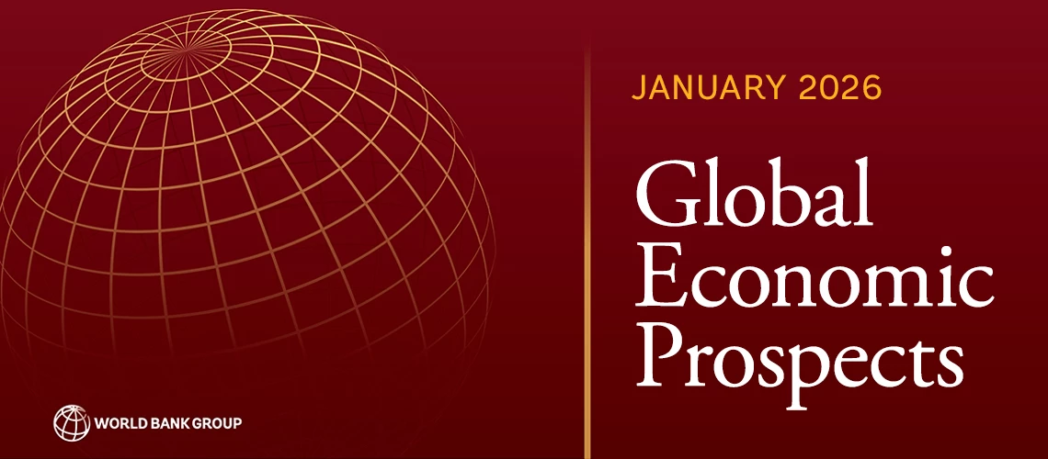
Global Economic Prospects (GEP) report:
Context: The World Bank released the Global Economic Prospects (GEP) report for January 2026. Published twice a year (January and June) assessing global growth prospects.

Slide 43
About Global Economic Prospects (GEP) report 2026:
India’s growth forecast has been revised upward to 7.2% for FY 2025–26 from 6.3% projected earlier
The revision is driven by strong domestic demand, robust private consumption, tax reforms and rising rural incomes
Global trade growth is expected to slow from 3.4% in 2025 to 2.2% in 2026
Government debt in emerging market and developing economies (EMDEs) has reached a 55-year high of nearly 70% of GDP

Slide 44
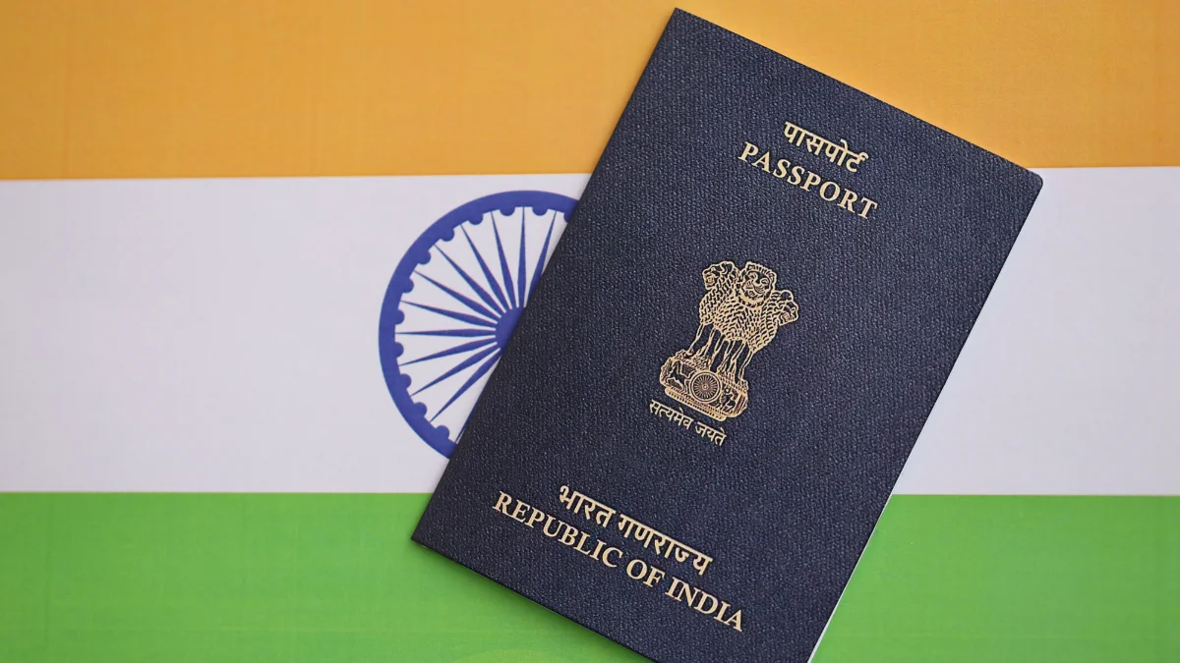
Hanley Passport Index 2026:
Context: India’s ranking improved in the Henley Passport Index 2026 to 80, compared to the 85th rank the country had in 2025.

Slide 45
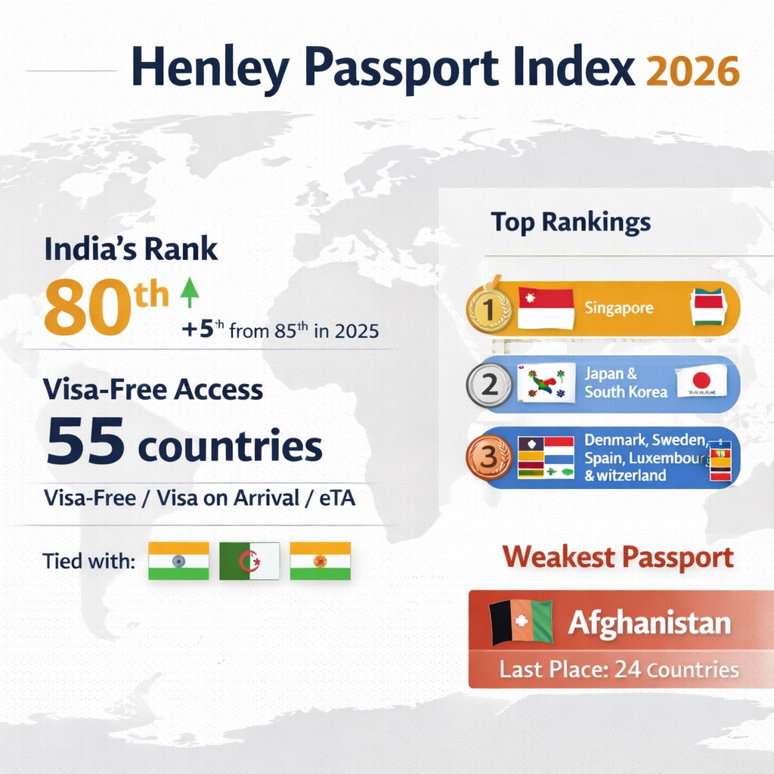
More details:
The Henley Passport Index is released by Henley & Partners, a global residence and citizenship advisory firm based in London.
It is the original, authoritative ranking of all the world’s passports according to the number of destinations their holders can access without a prior visa.
The index is based on exclusive data from the International Air Transport Association (IATA).
In 2026 edition, Singapore has retained its position as the world’s most powerful passport.

Slide 46
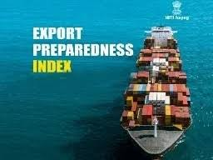
Export Preparedness Index (EPI) 2024:
Context: 4th edition of EPI 2024 has been released by the NITI Aayog.

Slide 47
About EPI:
Export Preparedness Index (EPI): A comprehensive assessment of export readiness across India’s States and Union Territories
It is aligned with India’s target of achieving USD 1 trillion merchandise exports by 2030
It is structured around four pillars, 13 sub-pillars and 70 indicators
Pillars & Weightage: Export Infrastructure (20%), Business Ecosystem (40%), Policy & Governance (20%) and Export Performance (20%)

Slide 48
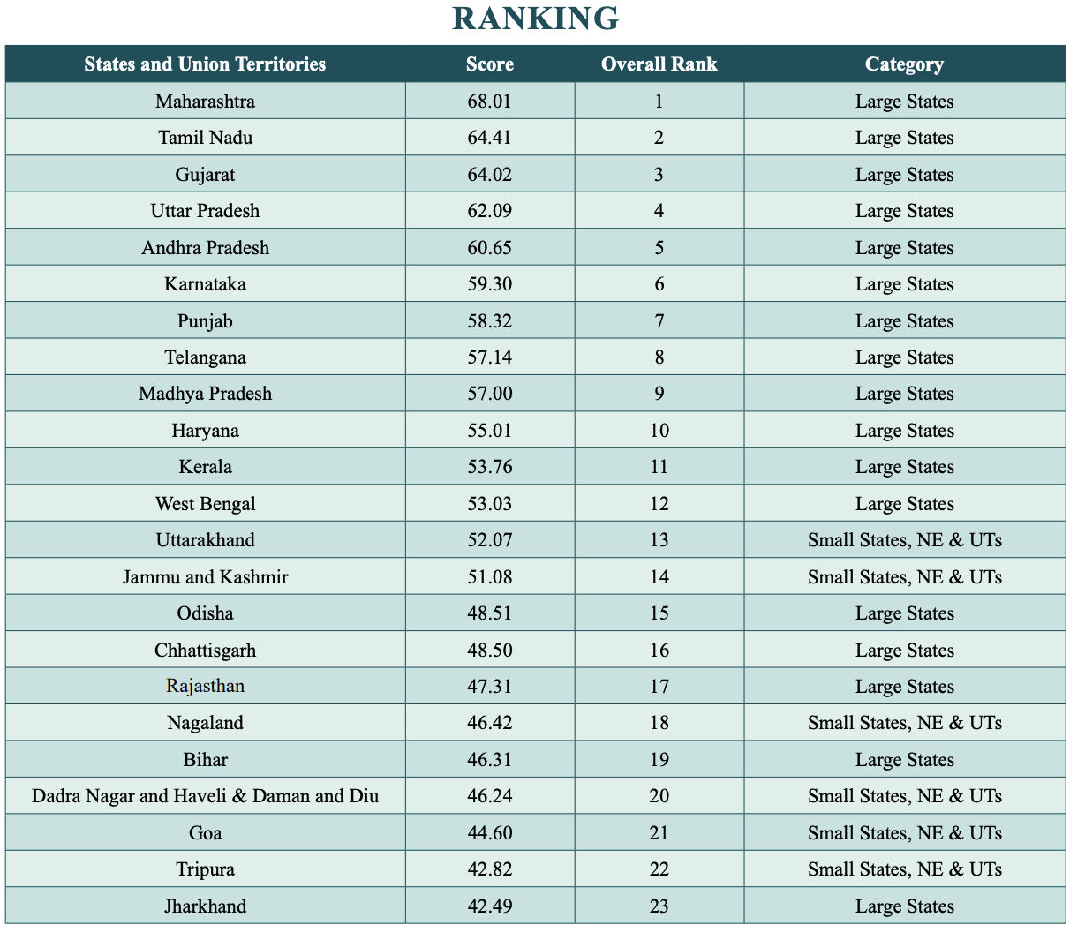

Slide 49
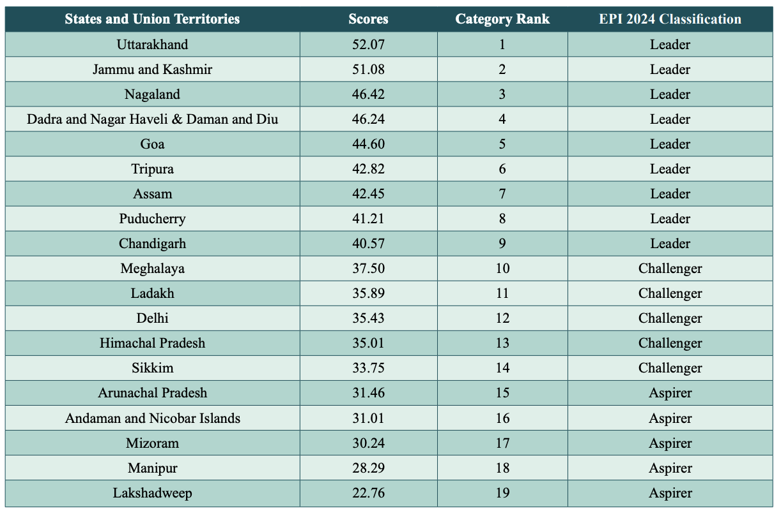

Slide 50
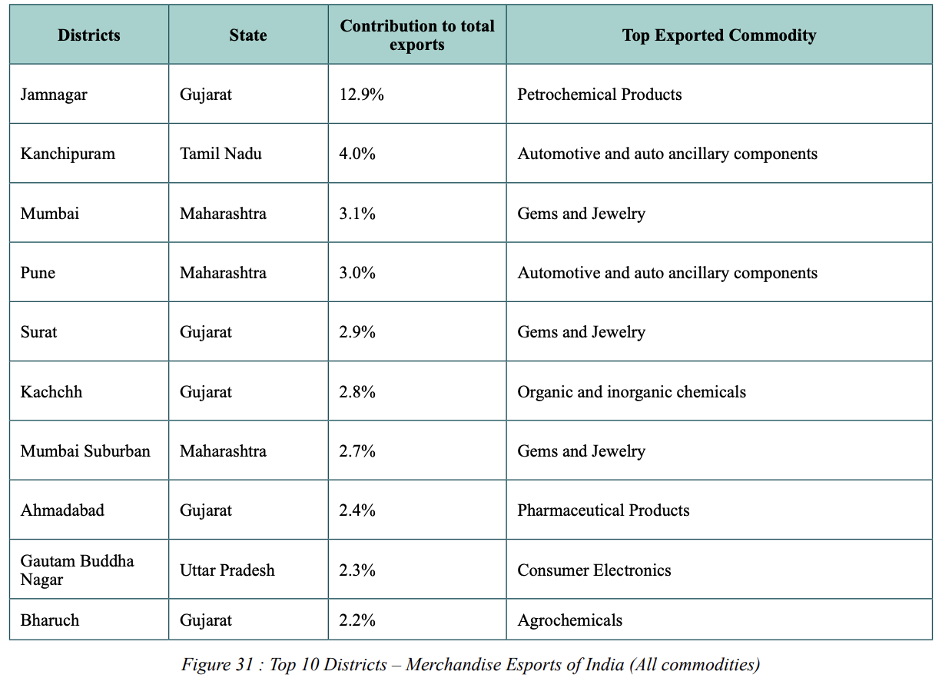

Slide 51
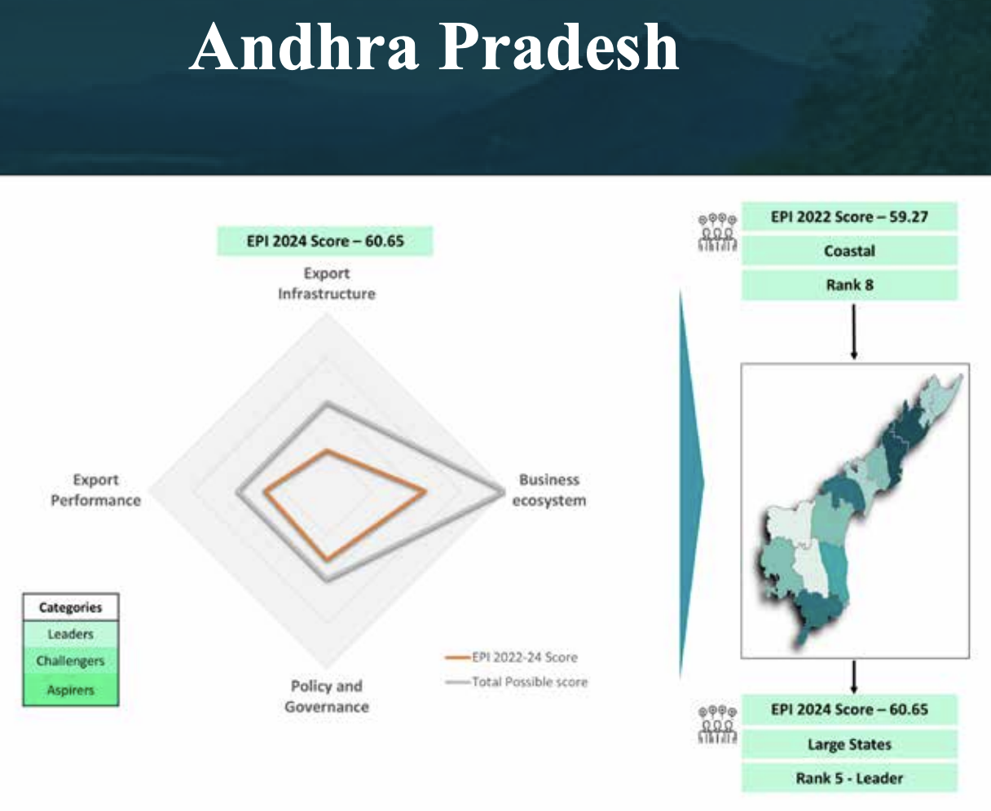

Slide 52
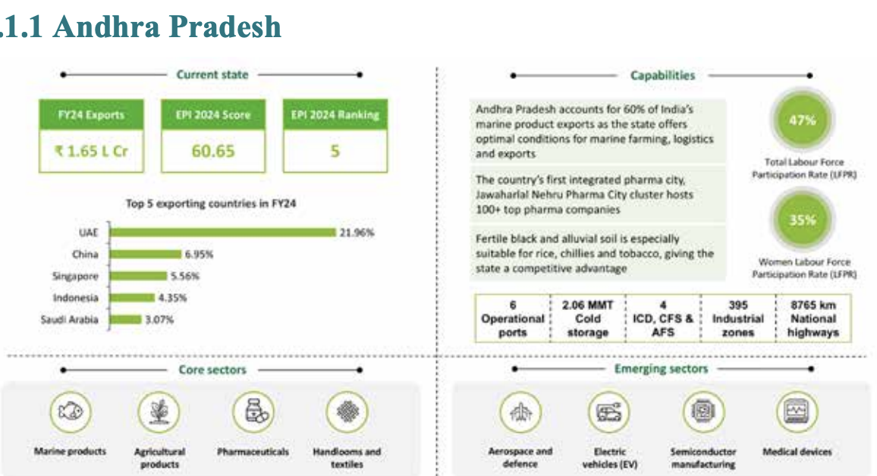

Slide 53
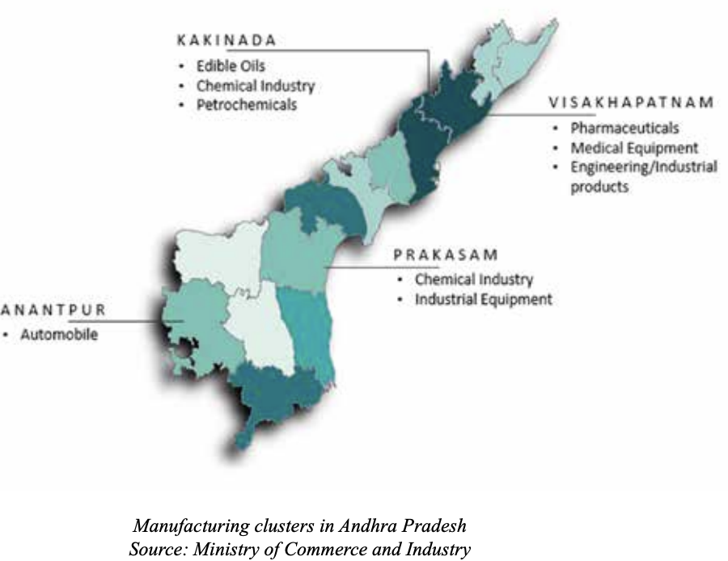

Slide 54
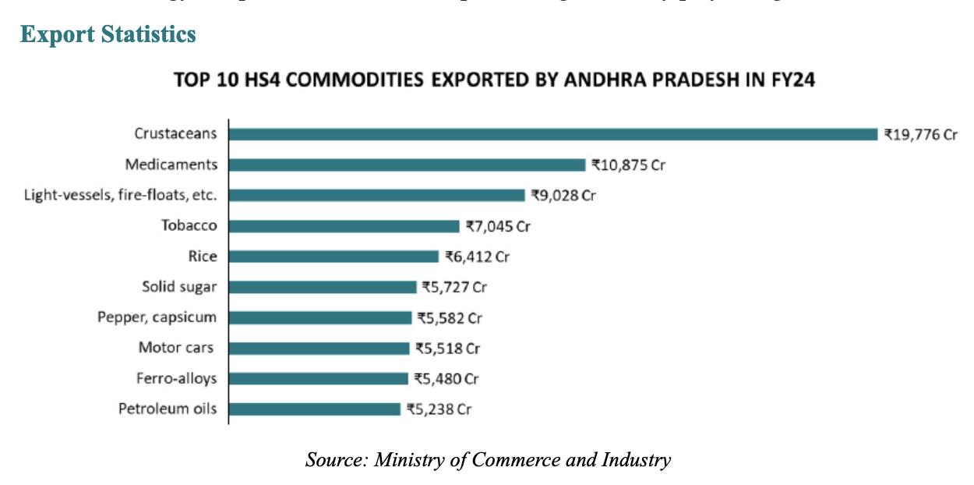

Slide 55
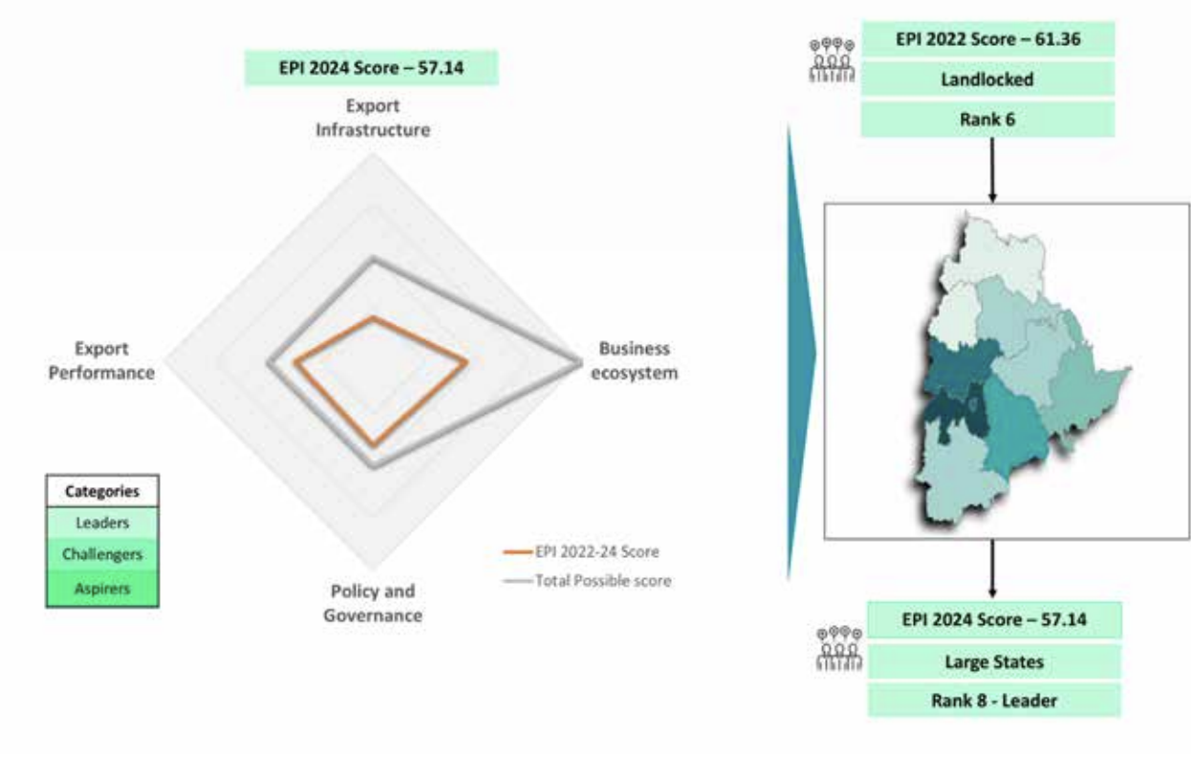
Telangana:

Slide 56
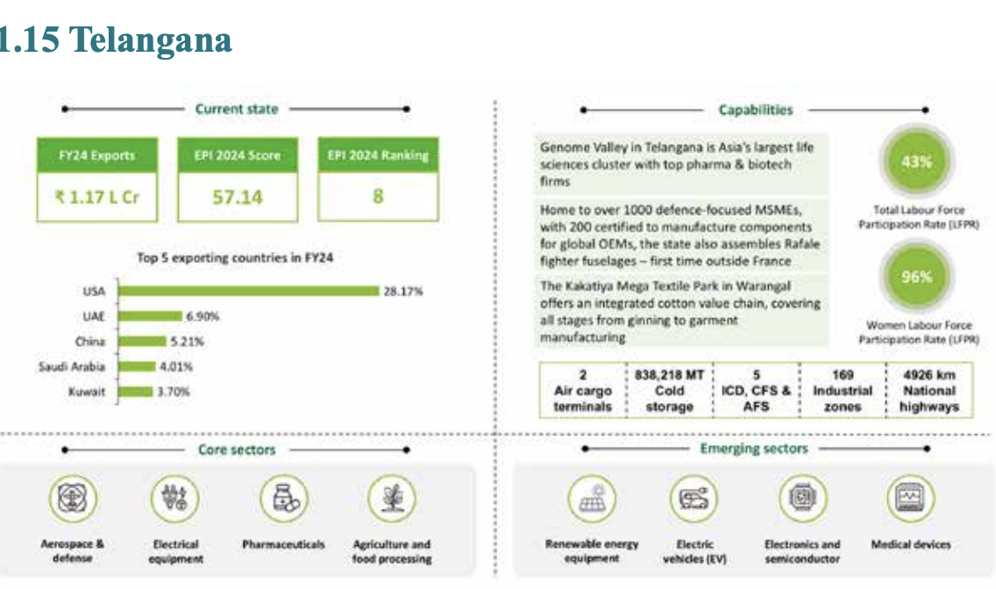

Slide 57
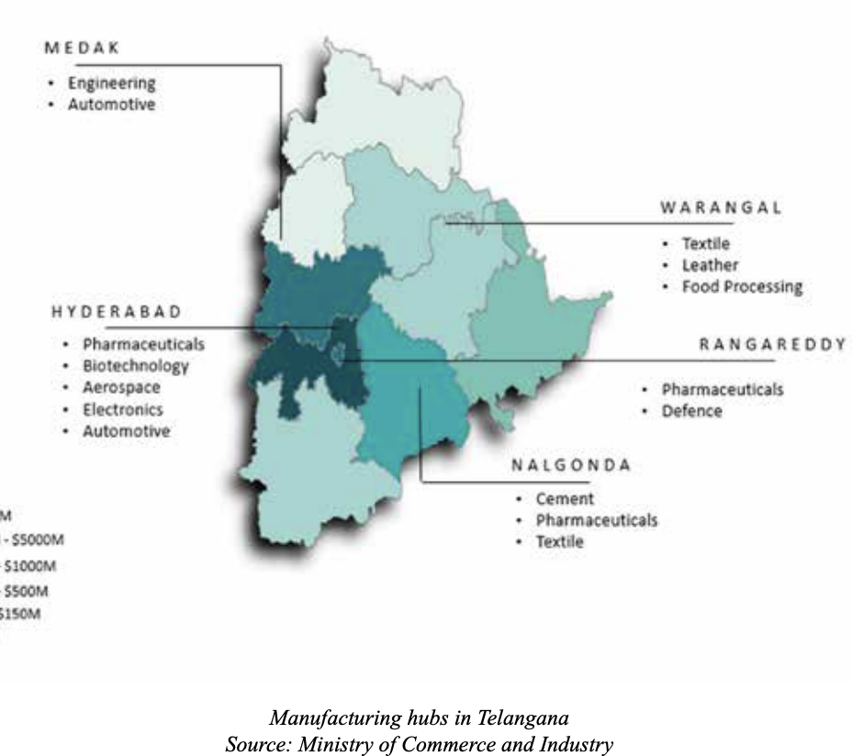

Slide 58
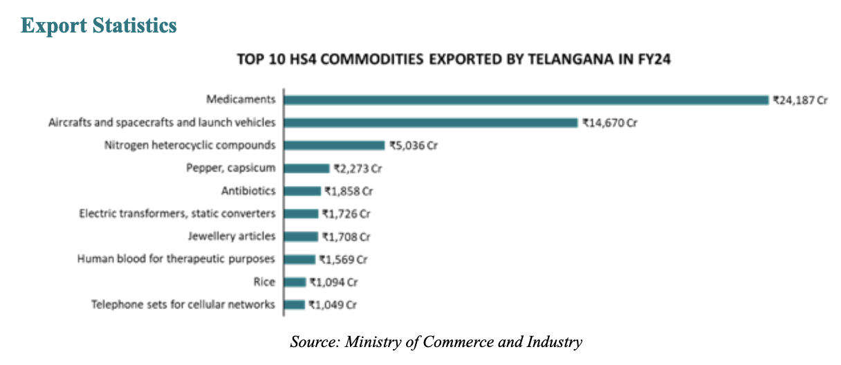

Slide 59
In which of the following does Small Industries Development Bank of India (SIDBI) is generally not involved?
a) Refinance support to banks and financial institutions
b) Offers term loans and working capital finance directly to industries
c) Directly lends to MSMEs
d) Retail banking services

Slide 60
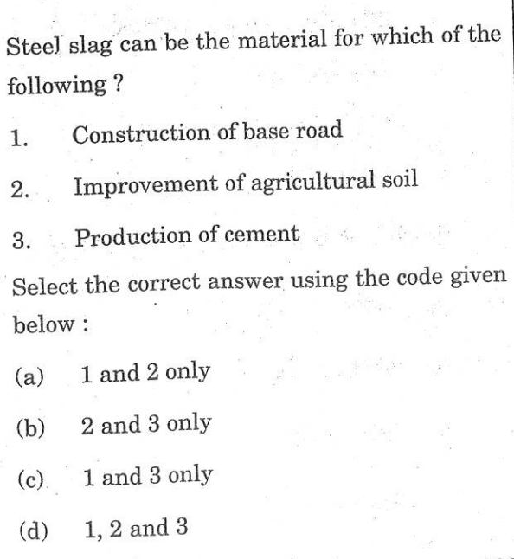

Slide 61
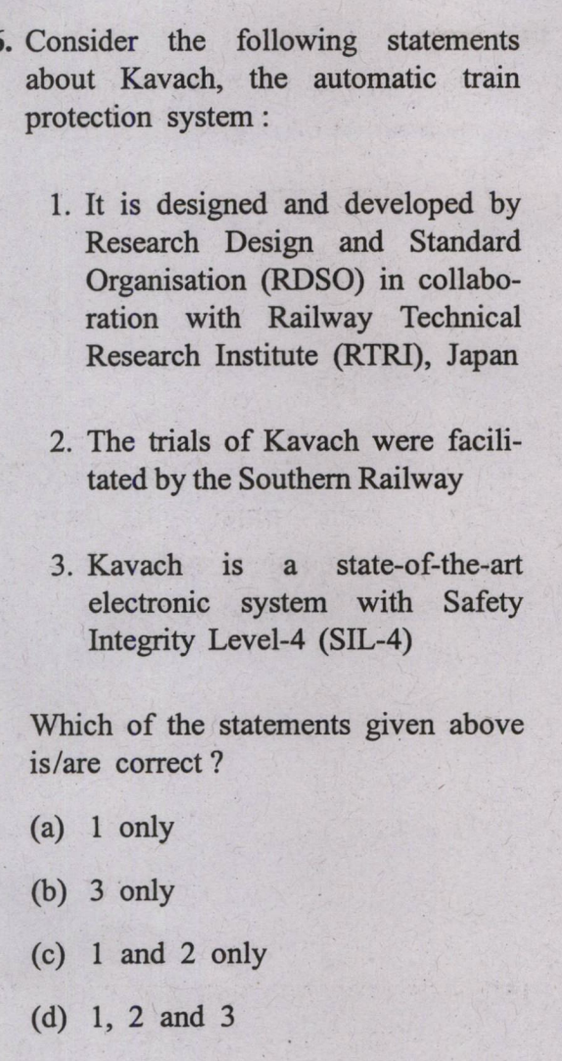

Slide 62
Which of the following is a characteristic of metallurgical coke?
(a) Contains volatile matter
(b) Very fragile
(c) Strong and porous
(d) Highly dense

Slide 63
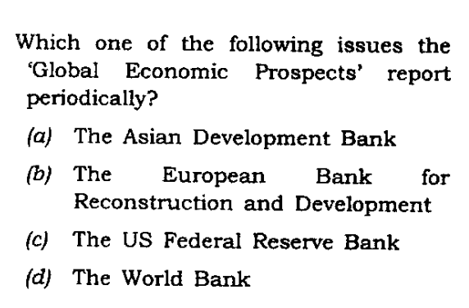

Slide 67
International News:

Slide 68
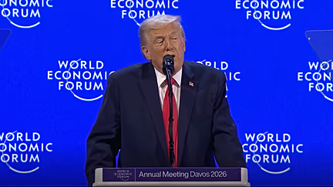
Greenland:
Context: U.S. President Donald Trump demanded immediate talks on acquiring Greenland in a hardline speech at Davos.

Slide 69
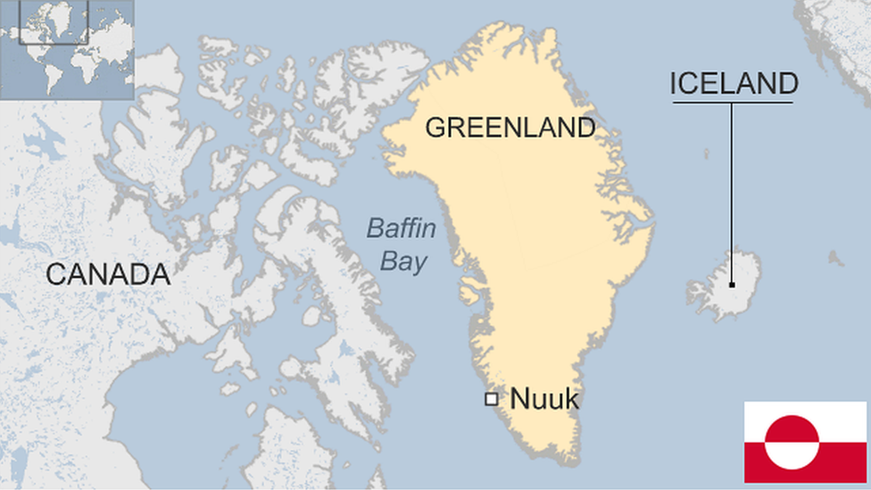
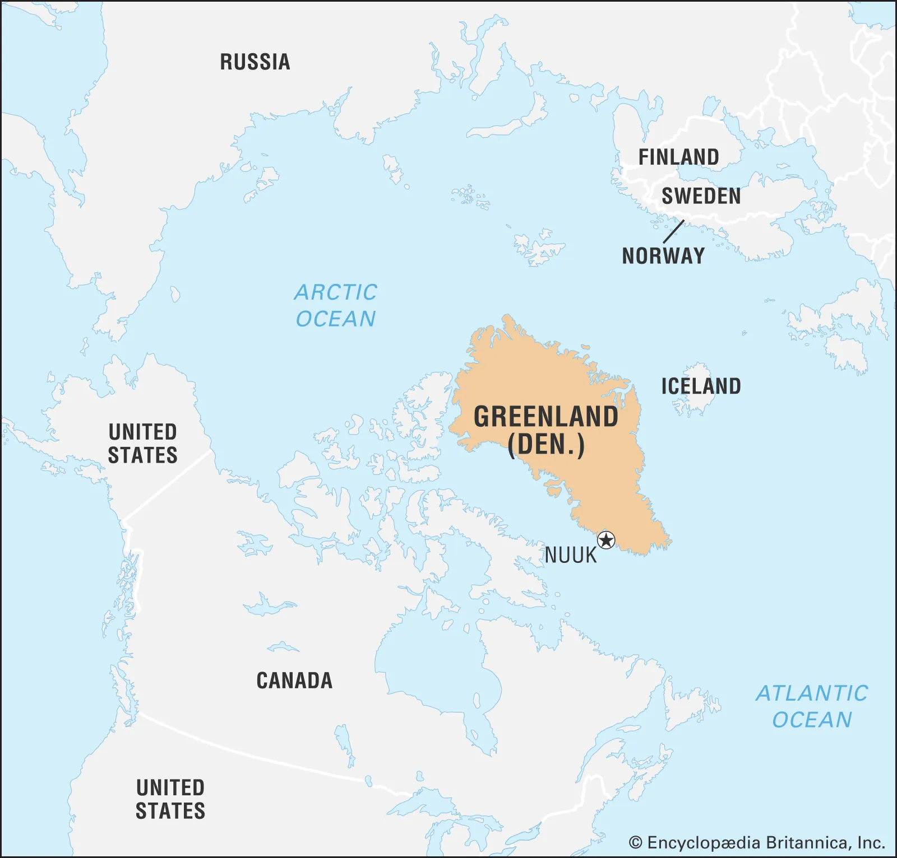
Location and Geography
World’s largest island, located between the Arctic and Atlantic Oceans.
Lies east of the Canadian Arctic Archipelago; part of the North American continent.
Shares a 1.2 km land border with Canada on Hans Island.
Kaffeklubben Island is the world’s northernmost undisputed land point.
Extremely low population density – least densely populated country in the world.

Slide 70
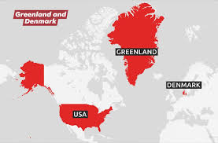
Political Status and Administration:
Greenland is an autonomous territory within the Kingdom of Denmark.
It is the largest constituent part of the Kingdom; others are Denmark proper and the Faroe Islands.
Citizens of Greenland are Danish citizens and thus EU citizens, though Greenland itself is not part of the EU.
Capital and largest city: Nuuk.

Slide 71
Governance Structure
Greenland has its own government (Naalakkersuisut) and parliament.
Controls most domestic affairs and public services.
Denmark retains authority over citizenship, defence, monetary policy and foreign affairs.

Slide 72
Economy and Energy
Economy heavily dependent on Danish financial aid (over 20% of GDP).
Rich in mineral resources, gaining importance due to melting ice from global warming.
About 67% of electricity is generated from renewable sources, mainly hydropower.

Slide 73
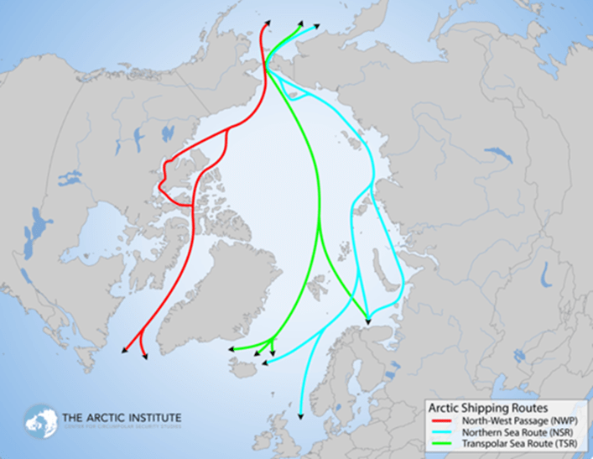
Strategic importance:
Strategic location between Eurasia, North America and the Arctic.
Important for Denmark, NATO and the European Union.
Increasing geopolitical attention due to Arctic routes, minerals and climate change impacts.

Slide 74
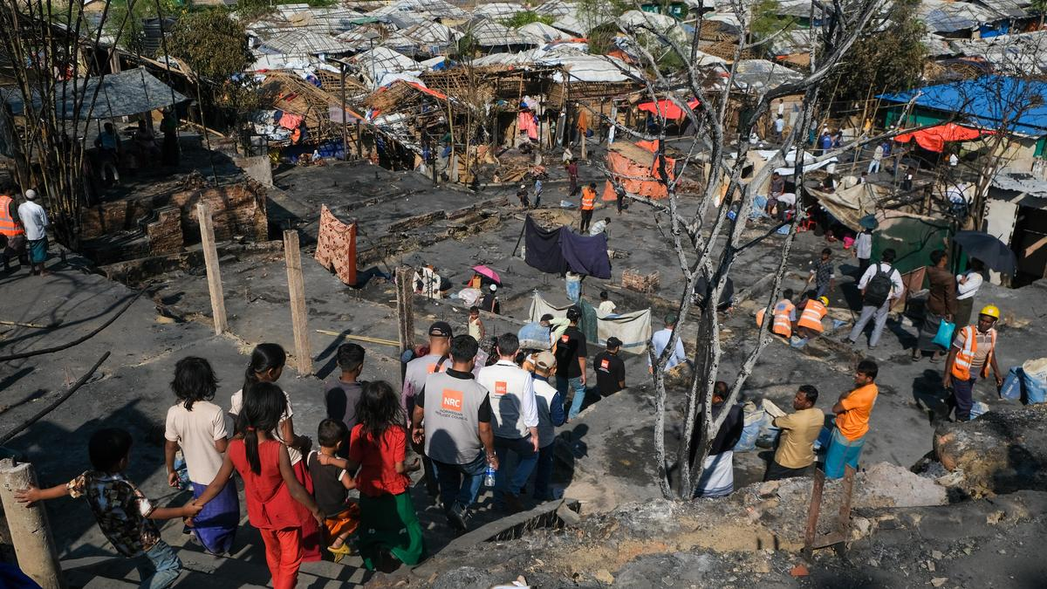
Cox’s Bazar refugee camp:
Context: Fire at Cox’s Bazar refugee camp displaces thousands of Rohingya.

Slide 75
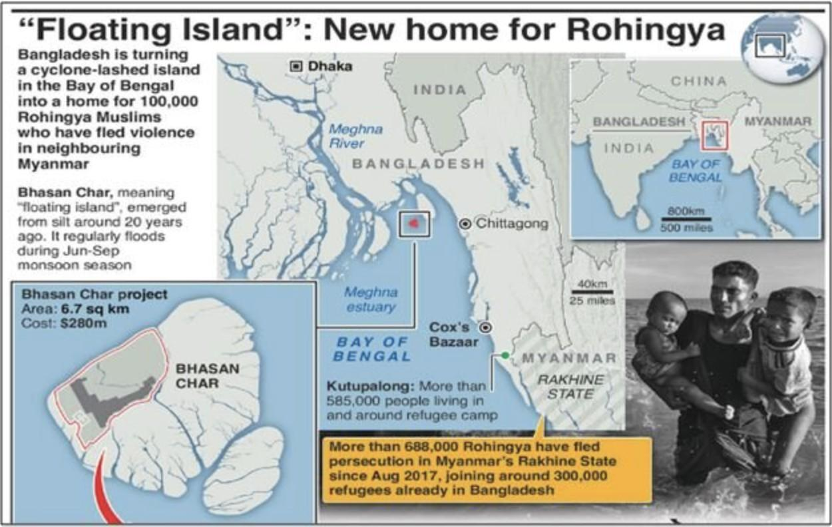

Slide 76
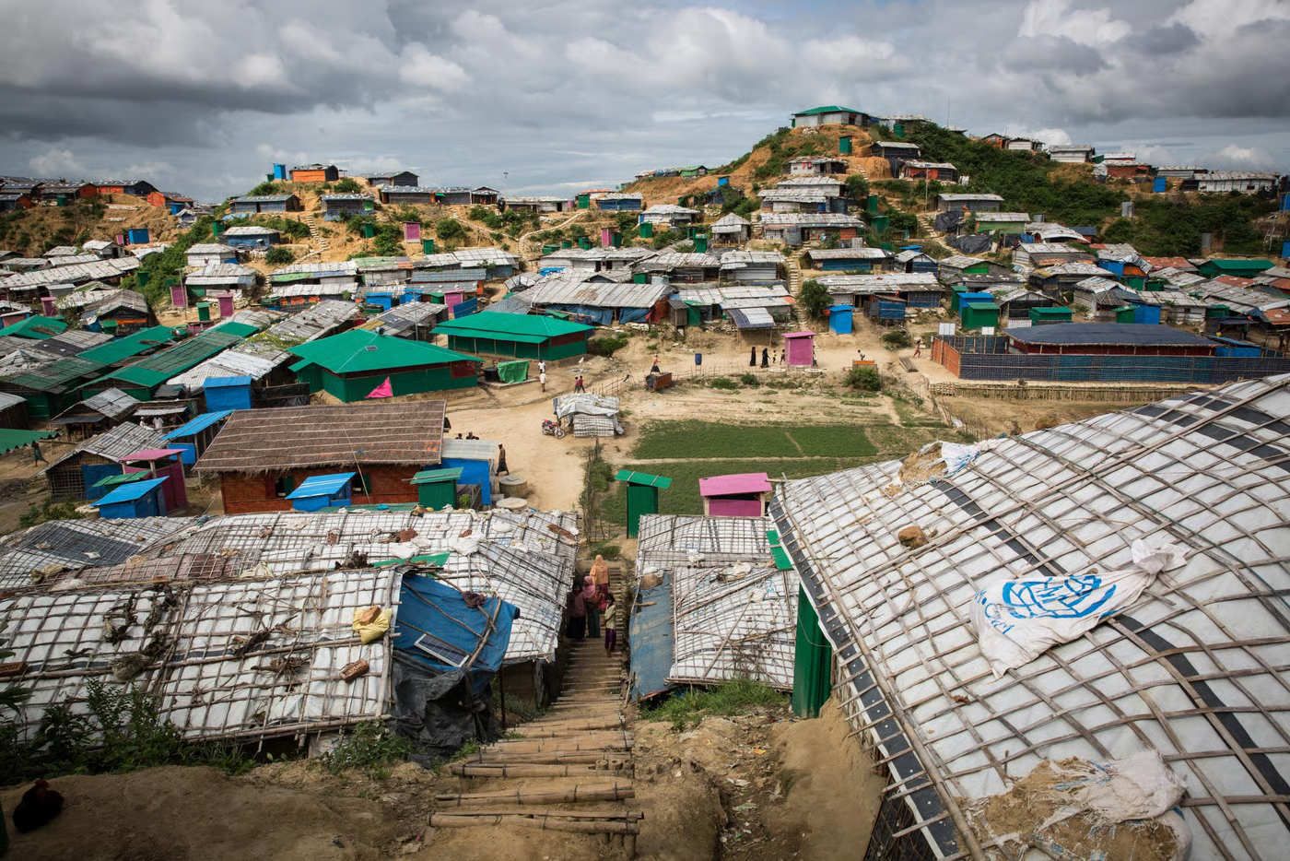
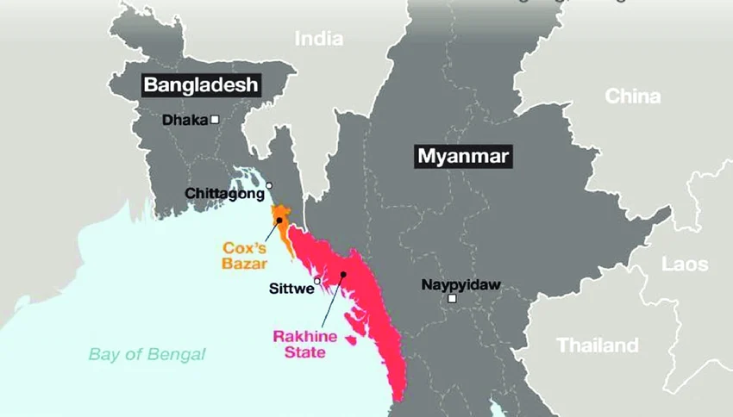
About Cox’s Bazar:
Cox’s Bazar hosts the world’s largest refugee camp, sheltering over one million Rohingya refugees.
The refugees fled persecution and violence in Rakhine State, especially after the 2017 military crackdown.
The crisis originates from long-term denial of citizenship and basic rights to the Rohingya in Myanmar.

Slide 77
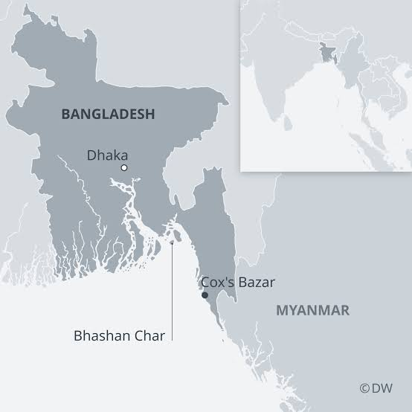
Refugees live in overcrowded shelters with poor sanitation and limited access to essential services.
The camps are highly vulnerable to disasters such as floods, cyclones, landslides, and fires.
Bangladesh continues to host refugees despite limited resources and capacity constraints.
Relocation efforts like Bhashan Char remain controversial and only partially implemented.

Slide 78

About Rohingyas:
The Rohingya are a stateless Indo-Aryan, predominantly Muslim ethnic group from Rakhine State, Myanmar.
They are among the world’s most persecuted minorities and were stripped of citizenship under Myanmar’s 1982 nationality law.
Systematic discrimination includes restrictions on movement, education, employment and political rights.
The Rohingya claim indigenous roots in western Myanmar dating back over a thousand years.

Slide 79
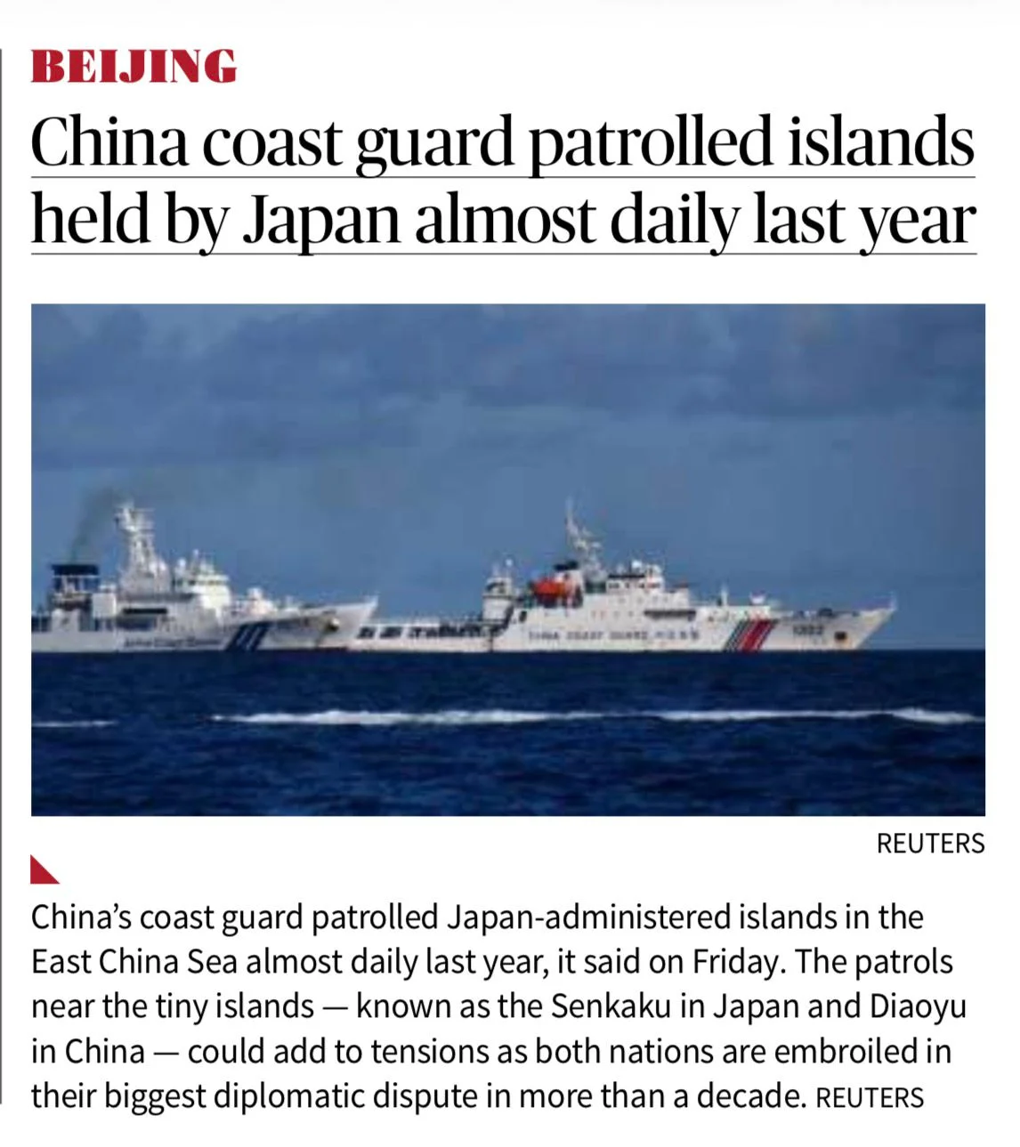
Senkaku Islands:
Context: China’s coast guard patrolled Japan-administered islands in the East China Sea almost daily last year. The patrols near the tiny islands — known as the Senkaku in Japan and Diaoyu in China — could add to tensions as both nations are embroiled in their biggest diplomatic dispute in more than a decade.

Slide 80
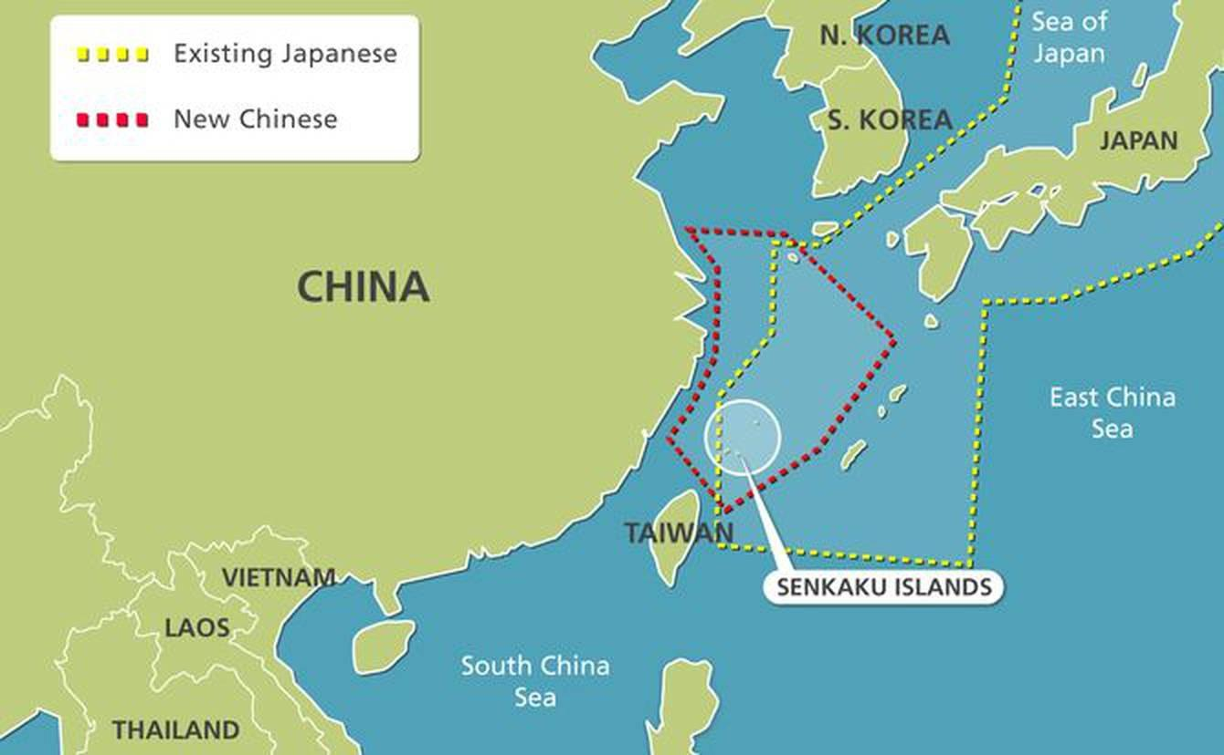
About Senkaku Islands:
Uninhabited group of islands located in the East China Sea
Situated northeast of Taiwan, east of China, west of Okinawa Island, and north of the Ryukyu Islands
Known as Senkaku Islands (Japan), Diaoyu Islands (China), and Diaoyutai Islands (Taiwan)
Historically called the Pinnacle Islands in Western records

Slide 81
Comprise eight small islands including Uotsuri, Kuba, Taisho, Kitakojima, Minamikojima, Tobise, Okinokitaiwa, and Okinominamiiwa
Total land area is approximately 6.3 sq km
Geology includes sandstone, conglomerate, tuff, andesitic lava, coral outcrops, and volcanic rock formations
Located in a volcanically active zone with associated fault lines

Slide 82
Administered and controlled by Japan as part of Ishigaki city, Okinawa Prefecture
Subject of a territorial dispute between Japan, China, and Taiwan
Japan claims incorporation of the islands in 1895
China claims historical discovery and ownership since the 14th century
Administered by the United States (1945–1972) under the San Francisco Treaty before being returned to Japan
Discovery of potential undersea oil and gas reserves (1968) intensified the dispute

Slide 83

Venezuela:
Context: The recent U.S. Operation Absolute Resolve, resulting in the arrest of the Venezuelan President, has revived serious debates over the prohibition on the use of force in international law.

Slide 84

About Venezuelan:
Political Features: Venezuela is located in northern South America, bordered by Guyana (east), Brazil (south), and Colombia (west and southwest), with the tri-junction at Mount Roraima, and is bounded by the Caribbean Sea and Atlantic Ocean to the north.
Physical Features: Major landforms include the Andes Mountains, Maracaibo Lowlands, and Guiana Highlands.

Slide 85

Rivers & Water Bodies: The Orinoco River is the major river flowing into the Atlantic Ocean, along with Rio Negro and Lake Maracaibo.
Waterfall: Angel Falls on the Churún River is the highest waterfall in the world.
Grasslands: The Llanos are vast tropical grassland plains in the Orinoco basin.
Resources: Venezuela possesses the world’s largest proven oil reserves, mainly concentrated in the Faja Petrolífera del Orinoco (Orinoco Oil Belt).

Slide 86


Slide 87

UN Security Council (UNSC):
Context: Five countries Bahrain, Colombia, the Democratic Republic of the Congo, Latvia, and Liberia; elected to serve as non-permanent members of UNSC for 2 year term.

Slide 88


Slide 89

About UNSC:
Genesis: Established in 1945 through the UN Charter as one of the 6 principal organs of the UN.
Purpose: Maintaining international peace and security.
Members: 5 permanent members (P5) and 10 non-permanent members.

Slide 90

BRICS:
Context: India assumes BRICS chairmanship and will host the 18th BRICS Summit in 2026. India’s chairmanship is structured around four pillars - Resilience, Innovation, Cooperation and Environmental Stability / Sustainability.

Slide 91

What BRICS?
BRICS is an acronym for the grouping of the world’s leading emerging economies, namely Brazil, Russia, India, China, and South Africa.
In 2001, the British Economist Jim O’Neill coined the term BRIC to describe the four emerging economies of Brazil, Russia, India, and China.

Slide 92

The grouping was formalized during the first meeting of BRIC Foreign Ministers in 2006.
The first BRIC summit took place in the year 2009 in Yekaterinburg (Russia).
South Africa was invited to join BRIC in December 2010, after which the group adopted the acronym BRICS.

Slide 93
The Johannesburg declaration,2023 issued after the summit, said Argentina, Egypt, Ethiopia, Iran, Saudi Arabia and the United Arab Emirates (UAE) had been invited to become full members from January 1, 2024.
However Argentina did not join.
Indonesia joined as 11th member in 2025

Slide 94
Agenda of the BRICS
International terrorism
Climate change
Food and energy security
International economic and financial situation
Reform of the Bretton Woods Institutions
Trade protectionism and the WTO

Slide 95

Weimar Triangle:
Context: The Minister of External Affairs participated in India’s first-ever engagement in the Weimar Triangle.

Slide 96

About Weimar Triangle:
It is a regional alliance of France, Germany, and Poland set up in 1991 in the German city of Weimar.
Initially formed as a key forum for supporting German-Polish reconciliation.
It aims to promote European integration, political dialogue, security cooperation, etc.

Slide 97

Responsible Nations Index (RNI):
Context: India recently launched the Responsible Nations Index (RNI) to prioritize ethical governance and global responsibility over mere economic strength.

Slide 98

About Responsible Nations Index (RNI):
Responsible Nations Index (RNI): A global index assessing responsibility of 154 countries
It is developed by World Intellectual Foundation in collaboration with Jawaharlal Nehru University and IIM Mumbai
It evaluates countries across parameters like ethical governance, social well-being, environmental stewardship and global responsibility

Slide 99
It is based on 58 indicators drawn from international data sources
Top Rankings: Singapore (1st), Switzerland (2nd), Denmark (3rd)
India’s Rank: India is ranked 16th, ahead of United States (66th) and China (68th)

Slide 100


Slide 101
Greenland falls under which of the following continents?
a) North America
b) Asia
c) Europe
d) Antarctica

Slide 102
Rohingya migrants originate from which of the following countries?
a) Bangladesh
b) Myanmar
c) Pakistan
d) Afghanistan

Slide 104
Schemes and Policies:

Slide 105

Atal Pension Yojana (APY):
Context: Union Cabinet chaired by the Prime Minister, Shri Narendra Modi, today approved the continuation of Atal Pension Yojana (APY) up to FY 2030-31 along with extension of funding support for promotional and developmental activities and gap funding.

Slide 106

About Atal Pension Yojana:
Launch: APY was launched on 9th May, 2015 with the objective of providing old-age income security to workers in the unorganised sector.
Scheme Features: APY offers a guaranteed minimum pension of Rs.1,000 to Rs.5,000 per month starting at age 60, based on contributions.
Progress: As of 19th January, 2026, over 8.66 crore subscribers have been enrolled, making APY a cornerstone of India’s inclusive social security framework.

Slide 107
The Atal Pension Yojana (APY) is open to Indian citizens aged 18 to 40 years.
Subscribers must contribute for at least 20 years, with pension payouts starting at age 60.
The lowest possible monthly contribution is ₹42 for an 18-year-old seeking a ₹1,000 monthly pension.
Individuals who are or have been income tax payers cannot join.

Slide 108

BHASHa INterface for India (BHASHINI):
Context: Digital India BHASHINI Division Showcases Voice-First Multilingual AI at Uttar Pradesh AI Innovation and Capacity Building Conference.

Slide 109

About BHASHa INterface for India (BHASHINI):
BHASHINI is an AI-powered language translation platform under the National Language Translation Mission.
Developed by Ministry of Electronics and Information Technology.
To create a National Public Digital Platform for languages using AI and emerging Technologies.

Slide 110
To enable translation of content across multiple Indian languages.
Promotes access to internet content in regional languages, especially in governance, policy, and science domains.
Uses Artificial Intelligence and Natural Language Processing (NLP) to bridge language barriers.
Implemented by Digital India BHASHINI Division under Digital India Corporation.

Slide 111
Supports 22+ Indian languages to ensure linguistic inclusivity.
Offers text-to-text translation, speech recognition, text-to-speech, OCR, video and document translation, and language detection.
Enables voice-based payments and multilingual digital services.
Available as a mobile application for public use.

Slide 112

‘Sampoornata Abhiyan 2.0’:
Context: NITI Aayog launched ‘Sampoornata Abhiyan 2.0’ today, a 3-month campaign running from 28th January to 14th April, 2026, to undertake a sustained effort to achieve saturation of 5 Key Performance Indicators in Aspirational Districts and 6 Key Performance Indicators in Aspirational Blocks across the country.

Slide 113

About Aspirational Districts Programme:

Slide 114
About ‘Sampoornata Abhiyan 2.0’:
Sampoornata Abhiyan 2.0 is a three-month focused campaign launched by NITI Aayog to saturate critical development indicators in Aspirational Districts and Blocks across India.
It builds on the success of Sampoornata Abhiyan 2024, aiming for last-mile delivery and full coverage of key social sector outcomes.
The initiative targets 112 Aspirational Districts and 513 Aspirational Blocks under the Aspirational Districts and Blocks Programme.

Slide 115
It focuses on improving nutrition, health, sanitation, education infrastructure, and livestock health through outcome-based KPIs.
The campaign emphasises Anganwadi performance, child nutrition, girls’ sanitation facilities, TB reporting, and animal vaccination.
Overall, Sampoornata Abhiyan 2.0 seeks to accelerate inclusive, data-driven, and accountable governance in India’s most underdeveloped regions.

Slide 116

Skilling for AI Readiness (SOAR):
Context: President of India to Grace SOAR Programme and Confer AI Certificates.

Slide 117

About Skilling for AI Readiness (SOAR):
About Skilling for AI Readiness (SOAR): It is a national skilling initiative launched in July 2025 under the Skill India Mission.
Ministry: It is implemented by the Ministry of Skill Development and Entrepreneurship (MSDE).

Slide 118
Objective: It aims to integrate Artificial Intelligence competencies into India’s education and skilling ecosystem.
Target Groups: It targets school students from classes 6 to 12 and educators from both government and private schools.

Slide 119

Standards and Labelling Program:
Context: Recently Government notified to penalise manufacturers of ACs, TVs etc if the actual energy consumption deviates from declaration in the energy star rating label.

Slide 120

About Standards and Labelling Program:
Ministry: Ministry of Power
Implementing Agency: Bureau of Energy Efficiency
Legal Basis: Energy Conservation Act, 2001
Objective: Reduce energy consumption of appliances
Consumer Benefit: Helps consumers make informed, cost-effective and energy-efficient choices

Slide 121
Coverage: 40+ appliances under mandatory and voluntary categories
Mandatory Star-Labeled Appliances: Refrigerators, Deep-freezers, Air conditioners, Fans, Televisions, Washing machines, Chillers, Electric geysers, Distribution transformers, Tubular fluorescent lamps, LED lamps, Induction hobs, Solar inverters, Domestic LPG stoves

Slide 122

PANKHUDI Portal:
Context: The Ministry of Women and Child Development launched PANKHUDI Portal.

Slide 123

About PANKHUDI Portal:
PANKHUDI Portal: An integrated single-window digital platform for CSR and partnership facilitation
It connects individuals, NRIs, NGOs, corporate entities and government agencies on a common platform
It streamlines voluntary and institutional contributions across sectors like nutrition, health, ECCE and child welfare

Slide 124
It promotes convergence of resources and efforts for women and child development initiatives
Aim: To enhance coordination, transparency and structured stakeholder participation.

Slide 125

NPS Vatsalya Scheme:
Context: Pension Fund Regulatory and Development Authority (PFRDA) issued guidelines for the NPS Vatsalya Scheme, 2025.

Slide 126

About NPS Vatsalya Scheme:
Nodal Ministry: Ministry of Finance
Regulator: Pension Fund Regulatory and Development Authority (PFRDA)
Objective: To inculcate early, disciplined long-term savings among children for future financial security and pension readiness

Slide 127
Eligibility: Open to all Indian citizens including NRI/OCI below 18 years of age
Beneficiary: The minor is the sole beneficiary of the account
Account Operation: Opened in the name of the minor and operated by parent or legal guardian
Contribution: Minimum initial and annual contribution of ₹250 with no maximum limit

